Slide 1


Mapping of MS pathways - rehabilitation
Case study 10
Related toolbox element: Method 7 - Modeling of MS patient pathway (CJML)
Responsible: Binyam Bogale, University of Oslo
Date: Dec 1, 2025
Version: v2
Type: Patient pathway
Health condition: Multiple sclerosis
Language: English
© The authors, Pathway, 2025

Slide 2



Content
About
About the case study
Visuals/Diagrams/Content
More information
This document is part of the Pathway Toolbox www.cjml.no/health
Developed within the Pathway research project (2021–2025)
Project partners:
SINTEF Digital, Norway
University of Oslo, Norway
Aalto University, Finland
Funded by:
The Research Council of Norway

Slide 3

About the case study
Context
Researchers involved
Method

Slide 4

About the case study
Context
Mapping of MS patient pathways from the perspective of healthcare workers after initial desk review to gain the oversight of MS care organization in Norway
Phase: rehabilitation services for new and repeat patients
Where: a major rehabilitation center for neurological disorders in Norway
When: 2022-2023
Researchers involved
Binyam Bogale, Oslo University
Elisabeth Gulowsen Celius, Oslo University and Oslo University Hospital
Ingrid Konstanse Ledel Solem , SINTEF Digital
Kristine Gjermestad, SINTEF Digital
Method
Data collections: includes a pre-modeling interview using interview guide (a meeting agenda) and post-modeling interview and feedback to the .v1 CJML model
Participants: 2 healthcare professionals with leadership capacities
Data analysis: identification of actors and touchpoints, reduction of workflows and mapping, Process modeling using CJML

Slide 5
Visuals - diagram
The next slides show the existing organization of MS care across healthcare levels as summarized from the desk review and an overview of MS patient pathways for the Rehabilitation services including an overview of services divided into phases. ​
The diagram spans 2 pages.

Slide 6
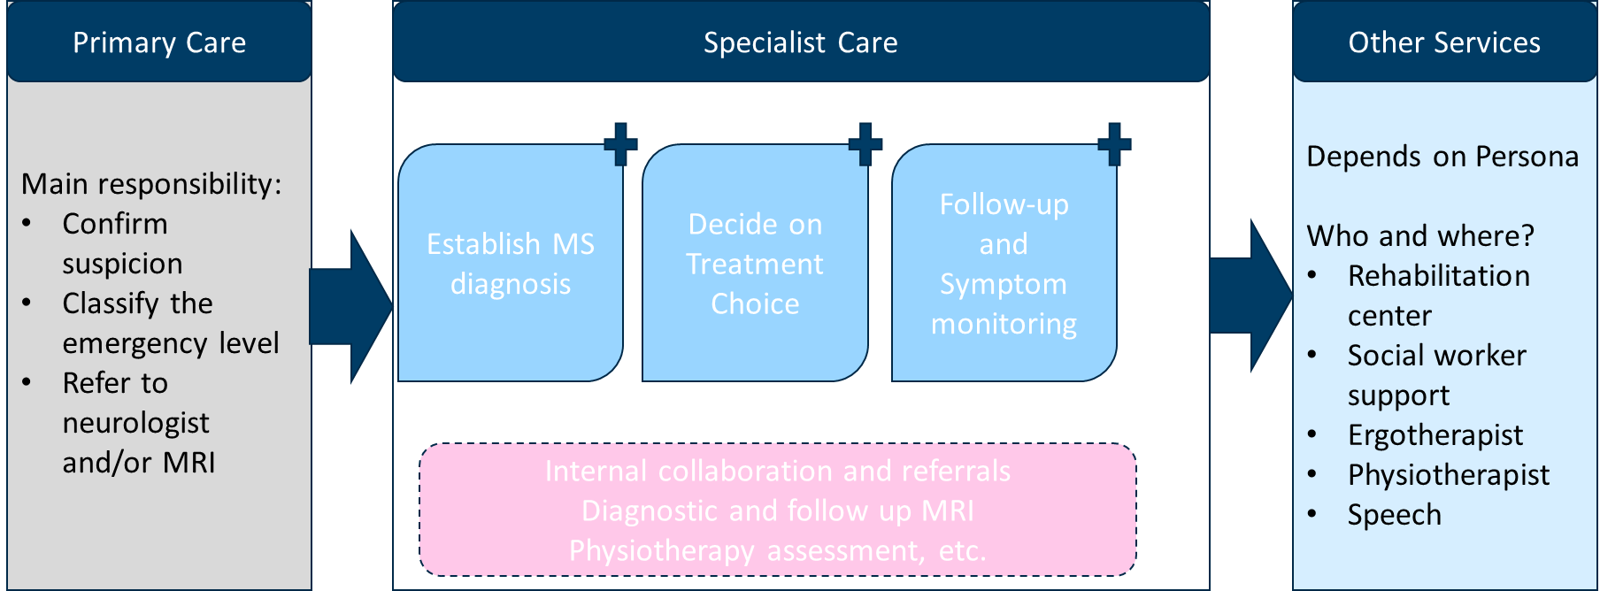
An overview of MS care organization, from desk review

Slide 7




6—8 weeks, average waiting time
(Emergency admitted fast-track)
3 weeks, average stay
Referral processed with in 10 days
Phase 1: REFERRAL PROCESSING
Phase 2: ADMISSION
Phase 3: REHABILITAION SERVICES
Patients identified for admission get notified, including the referring institution
Patient admission to the centre
Goal setting and planning the rehabilitation period
Receives referral from Specialist care or
GP via RKI received
Final assessment and discharge
‘Triage’ team go through the list & sort who and when to admit
A team is established around the patient
Continuous monitoring of the progress throughout
Rehab centre
GP = General Practitioner
RKI = Rehab = Rehabilitation center

Slide 8
Visuals - diagram
The next slides show detailed diagrams of touchpoints. ​
The diagram spans 4 pages.

Slide 9



Assumptions:
Referral is from General Practitioner via RKI ( A regional coordinating unit); none emergency service request
Initiator of the referral request is the patient or the GP while the patient comes with the complaints and finds it necessary
Phase 1: REFERRAL PROCESSING
Visits the GP with specific compliant or ask for rehabilitation service
Patient
Verifies the need for a rehabilitation service, agrees with the patient for referral
Prepares referral letter and any other communications needed, personalized
Sends referral request for approval
Receives admission acceptance notification
General Practitioner
Receives referral request
Accepts a referral request and authorizes a referral letter
Sends referral request to the rehabilitation centre
RKI
If the patient is referred from their neurologist at the specialist care, direct
Receives referral request
List compiled; ‘Triage’ team go through every Tuesdays & Fridays and decides on admission
Notifies the admission decisions to the referring organ
Rehab centre
The referral can also be initiated by the GP during a regular check-ups, requests may arise from other care providers involved
The criteria to accept the referral request and the protocols of referral handling by the RKI is not the focus of this model
Rejections are very seldom and sent back to the referring organization; is not the focus of this model

Slide 10

Assumptions:
Referral is from GP via RKI ( A regional coordinating unit); none emergency service request
Initiator of the referral request is the patient or the GP while the patient comes with the complaints and finds it necessary
Phase 2: ADMISSION –COMMUNICATION WITH THE PATIENT
WAITING TIME
Receives admission information, request to fill out a form via Digipost
Notification of referral acceptance received
Replies to the confirmation request to the rehab centre admission
Fills out the requested form and mails back to the rehab centre, often email not correct way
Appointment notification received
Patient
General Practitioner
RKI
Prepares all the communication points in admission letter, including a form to be filled and sent back
Sends admission letter; 3 letters mailed together
Automated text message sent 7 days after the mail for patient to confirm
Receives confirmation to acceptance of the admission to the centre
Receives the filled-out form about the patient & uses for next steps
The coordinator of admission at the centre prepares the documentations
Automated appointment reminder sent 1 week before, from electronic record system
Rehab centre
The patient fills out a form to individualize the rehab care. The form asks their functional status & other general information
Three letters: describing the admission offer; a form to fill out and send back; and information about the rehab centre, sent via mail, standardized letter
The waiting time may vary depending on the availability of beds and the level of priority of the service

Slide 11


Assumptions:
Routine admission process; none emergency service request
Considering the rehabilitation centre as a unit and not modelled specifically for each service provider, to minimize repetitions in the model
Phase 2: ADMISSION –COMMUNICATION WITH INFORMATION SOURCES and GOAL SETTING
WAITING TIME
Arrives at the rehab centre, contacts the coordinator/staff
Provides info, communicates the goal for rehabilitation, works with the team
Provides info, communicates the goal for rehabilitation, works with the team
Patient
Communicates the needed information, if any, directly or later
General Practitioner
Communicates the needed information, if any, directly or later
Neurologist, patient’s main
A team comprised of various professionals in the centre meets & delegate responsibilities
The nurse welcomes, shows around, provides info on next steps
Day 2: Summons the patient for joint goal setting and rehab planning
‘Mapping process’ Identifies additional information need about the patient and plans how to get it
Contacts for more info about the patient, if any need
Collects blood sample for test if there is any infection
Modifies the Team composition based on the holistic patient assessment results
Rehab centre
The manager, coordinator, and others (physio, occupation, speech therapists, social workers, nurses, health assistants) makes up a team of 4-5 during admission
Monday is the regular admission day. The patient arrives at the centre and given practical information and services on arrival, next instructions …
Depending on the information needed, any professional might be involved in colling and collecting info, including family members and other institutions

Slide 12
Assumptions:
Routine admission process; none emergency service request
Considering the rehabilitation centre as a unit and not modelled specifically for each service provider, to minimize repetitions in the model
Phase 3: REHABILITATION SERVICE and DISCHARGE
Discharged after 3 weeks
Have a session with the neurologist, raises if any concern
Follows the rehabilitation plan, coordinates with the care providers
Meets the physician, if recommended or requested
Periodic assessment, continued communication, last before discharge
All the plans are received via Digipost
Patient
Acts up on the info, checks the patient etc
Meets the patient for tests, medication, etc, if needed
A Physician
Checks the patient, if the patient came for the first time
Neurologist at the rehabilitation centre
A nurse and a physiotherapist are the main contacts to the patient
Based on the goal & patient needs, every profession prepares their own plan
Weekly meeting and adjustment of the rehabilitation plan, if needed
If there is any need to be seen by specialist, or another profession
Morning meetings to plan the day the patient, that is how the care is delivered
Continued assessment of the progress, first and last evaluations
Prepare a plan for continued home rehab care & discharge letter, via digipost
Discharge letter sent to stakeholders
Rehab centre
The manager, coordinator, and others (physio, occupation, speech therapists, social workers, nurses, health assistants) make up a team of 4-5 during admission
Every Wednesday, there is a team meeting where every patient is discussed in the bigger group. A team around the patient can also have team meeting as needed
Information will be sent

Slide 13
Comments to the MS Rehab pathway model
Many actors are involved in the rehabilitation center. For clarity, we grouped them; therefore, the specific services provided by each actor are not individually depicted.
The diagrams are assumption-based.
Whether the patient is new or previously admitted affects documentation needs. New patients require comprehensive personal, medical, social, and functional information to guide care, while existing patients only provide updates.
Level of functionality, including cognitive capacity, influences the degree of independence — more functional patients require less assistance and interact with fewer actors.
Source of referral may not change the service procedures but does affect the information flow. For instance, patients referred by a GP involve coordination with the regional unit at Helse Sør-Øst.
Services are highly individualized. As staff emphasize: “Every patient is different — we work with humans.” Therefore, detailed modeling of every individual encounter is not feasible.

Slide 14
More information

Slide 15
Relevant publications
Further details can be found here:
Bogale B, Solem IKL, Celius EG, Halvorsrud R. Visual Modeling of Multiple Sclerosis Patient Pathways: The Healthcare Workers’ Perspectives. In: Särestöniemi M, Keikhosrokiani P, Singh D,Harjula E, Tiulpin A, Jansson M, et al., editors. Digital Health and Wireless Solutions. Cham:Springer Nature Switzerland; 2024. p. 303–17.
https://link.springer.com/chapter/10.1007/978-3-031-59080-1_22

