Slide 1


A Service-Dominant Logic perspective
Case study 12
Related toolbox element: Method 2: Mapping of patient journeys (CJA), Method 3: Mapping of patient pathways, and Method 8: Qualitative adaptation of CPSET
Responsible: Kristine Gjermestad, SINTEF Digital​
Date: January 8, 2026
Version: v1
Type: A dual study on Patient pathways and Patient journeys
Health condition: Multiple sclerosis (MS) and kidney cancer
Language: English
© The authors, Pathway, 2025

Slide 2



Content
About
About the case study
Content
Result
More information
This document is part of the Pathway Toolbox www.cjml.no/health
Developed within the Pathway research project (2021–2025)
Project partners:
SINTEF Digital, Norway
University of Oslo, Norway
Aalto University, Finland
Funded by:
The Research Council of Norway

Slide 3

About the case study

Slide 4
Purpose
This case study is based on a master’s thesis conducted in collaboration with the Pathway research project.
The study explores patient pathways through the Service-Dominant Logic, and particularly the systemic perspective, combining empirical patient data with insights from healthcare professionals.
The study is positioned at the intersection of healthcare management, communication, and patient experience, addressing limitations in prevailing pathway approaches that prioritize operational efficiency and linearity.
Empirically, the case combines longitudinal patient journeys with healthcare professionals’ accounts of pathway design and coordination.
Analytically, it examines how value is created, constrained, and negotiated through interactions among patients, professionals, and institutions across the continuum of care.
By focusing on both planned and lived pathways, the case demonstrates how patient pathways operate as dynamic service ecosystems rather than fixed process structures.

Slide 5

About the case study
Context
  The context of the study is specialist and primary healthcare services within the South-Eastern Norway health region, focusing on patients diagnosed with multiple sclerosis (MS) and kidney cancer. These conditions were deliberately selected due to their complexity, long-term trajectories, and reliance on coordination across multiple healthcare actors and organizational levels.
  The purpose of this case study is to explore how integrating a marketing-inspired, systemic perspective, grounded in Service-Dominant Logic, can enrich healthcare management and communication practices along patient pathways.
Researchers involved in data collection
  Anna Grøndahl Larsen, SINTEF Digital
  Binyam Bogale, Oslo University​
  Ragnhild Halvorsrud, SINTEF Digital​
  Ingrid K. Ledel Solem, SINTEF Digital
  Kristine Gjermestad, SINTEF Digital
Method
  This exploratory study combines qualitative methods adapted to healthcare professionals and patients.
  Seven in-depth interviews and workshops were conducted with healthcare professionals to map the planned patient pathway.
  A longitudinal study followed two MS and two kidney cancer patients over 2–4 months to capture actual patient journeys.

Slide 6
Content
The case outlines the analytical perspective and literature review grounded in Service-Dominant Logic (SDL), followed by the methodology and analysis. The findings are illustrated through CJML visualisations.

Slide 7
Analytical perspective
The study applies Service-Dominant Logic (SDL) as its primary analytical framework, with a strong emphasis on the systemic perspective.
SDL challenges goods-dominant views of service delivery by conceptualizing value as something that emerges through interaction, rather than something that is produced and delivered by a single provider.
Within this framework, patient pathways are understood as service ecosystems composed of interconnected actors operating at micro (patient), meso (organizational), and macro (systemic) levels.
This perspective allows the analysis to account for how institutional norms, resource configurations, and actor interactions jointly influence pathway design, enactment, and experience.

Slide 8
Literature review
Patient pathways
Previous research on patient pathways is largely influenced by health operations management and lean thinking.
Strong focus on sequences and efficiency has led to mainly linear pathway models.
This makes it difficult to capture the complexity of healthcare systems in practice.
Service-Dominant Logic
Service-Dominant Logic offers a systemic perspective across micro, meso, and macro levels.
Pathway design and outcomes are shaped by broader organizational and institutional conditions.
Patient pathways are understood as part of larger healthcare service ecosystems.
Systematically relate
By linking patient pathway research with Service-Dominant Logic, this study explores how the two perspectives complement each other.
This helps highlight how actors, processes, and resources are interconnected.
The review points to a need for more empirical studies of patient pathways in real-world settings.

Slide 9












Methodology
In-depth interviews
Longitudinal mapping
PLANNED PATHWAY
WORKSHOP I
WORKSHOP II
TEAMS PLATFORM
Two urologists, two secretaries, one case manager, and patient-facing materials.
ACTUAL JOURNEY
1.START INTERVIEW
2.DIARY LOG
3.DEBRIEF INTERVIEW
Three medical coordinators
and four clinicians.
Four kidney cancer patients, four MS patients, two next-of-kins, and one treating physician.
By combining interviews, workshops, and longitudinal mapping, the study sought to capture both
structural representations of pathways and dynamic experiences as care unfolded over time.

Slide 10
Analysis
The analysis combined Gioia methodology and Customer Journey Analysis (CJA)
Gioia methodology supported inductive development of themes grounded in participants’ accounts, while CJA enabled structured longitudinal mapping of patient journeys.
Customer Journey Modelling Language (CJML) was used as the modelling language for visual representations of both planned pathways and actual journeys.
Triangulation across methods, participant groups, and analytical approaches strengthened credibility, reliability, and internal validity.

Slide 11
Results
The results bridge the gap between formal pathway descriptions and lived patient experience by showing how value creation is influenced by coordination practices, institutional constraints, and patient agency over time.

Slide 12
CJA: Planned patient pathway
The planned patient pathway represents the formal and standardized description of how care is intended to be organized for a specific patient group.
It typically reflects:
  Clinical guidelines and institutional standards
  Predefined sequences of activities and interventions
  Assigned roles and responsibilities
  Intended coordination mechanisms across services and levels of care
Planned pathways are primarily designed to support predictability, efficiency, and organizational coordination.

Slide 13
CJA: Planned patient pathway
This visual illustrates the planned patient pathway, showing how care is formally structured across services and actors.
The diagram highlights:
  Sequential steps in the pathway
  Key transitions between care providers
  Decision points and coordination mechanisms
The visualization reflects how the pathway is intended to function from an organizational perspective.

Slide 14
CJA: Actual patient journey
The actual patient journey captures how patients experience and navigate care in practice over time.
Findings from this case show that patient journeys are often:
  Non-linear and subject to change
  Shaped by waiting periods, uncertainty, and adaptation
  Dependent on patients’ own efforts to coordinate care
  Influenced by communication gaps and institutional boundaries
This highlights important differences between formal pathway descriptions and lived patient experiences.

Slide 15
CJA: Actual patient journey
This visual snippet presents the actual patient journey, mapped longitudinally across time.
The diagram highlights:
  Deviations from the planned pathway
  Critical touchpoints and moments of uncertainty
  Breakdowns or gaps in coordination
  Interactions across organizational and institutional boundaries

Slide 16
Gioia: Inductive thematical analysis
Analysis revealed several recurring themes that help explain how patient pathways function as service ecosystems:
  Value-in-healthcare-context: Value emerges through interactions, not isolated service encounters
  Healthcare co-creation: Patients and professionals jointly shape care processes and outcomes
  Aggregation levels: Pathway dynamics operate across micro (patient), meso (organizational), and macro (systemic) levels
  Shared institutionalized language: Common concepts and representations support coordination
  Institutionalized responsibilities: Unclear ownership creates coordination gaps
  Actor-to-actor interactions: Informal communication often compensates for system limitations

Slide 17
Conclusion
The study culminates in the development of the Healthcare Value Dynamics Framework, integrating theoretical insights from Service-Dominant Logic with empirical findings from patient pathway research.
The framework conceptualizes value creation as a dynamic process shaped by interaction, coordination, and institutional conditions across levels of care, and signals an operational logic shift toward adaptability and flexibility in healthcare management.
The framework links healthcare communication, management, and co-creation across micro and macro levels. It emphasizes how shared institutionalized language and clearly articulated responsibilities create conditions for coordinated action, while actor-to-actor interactions enable value creation in practice.

Slide 18
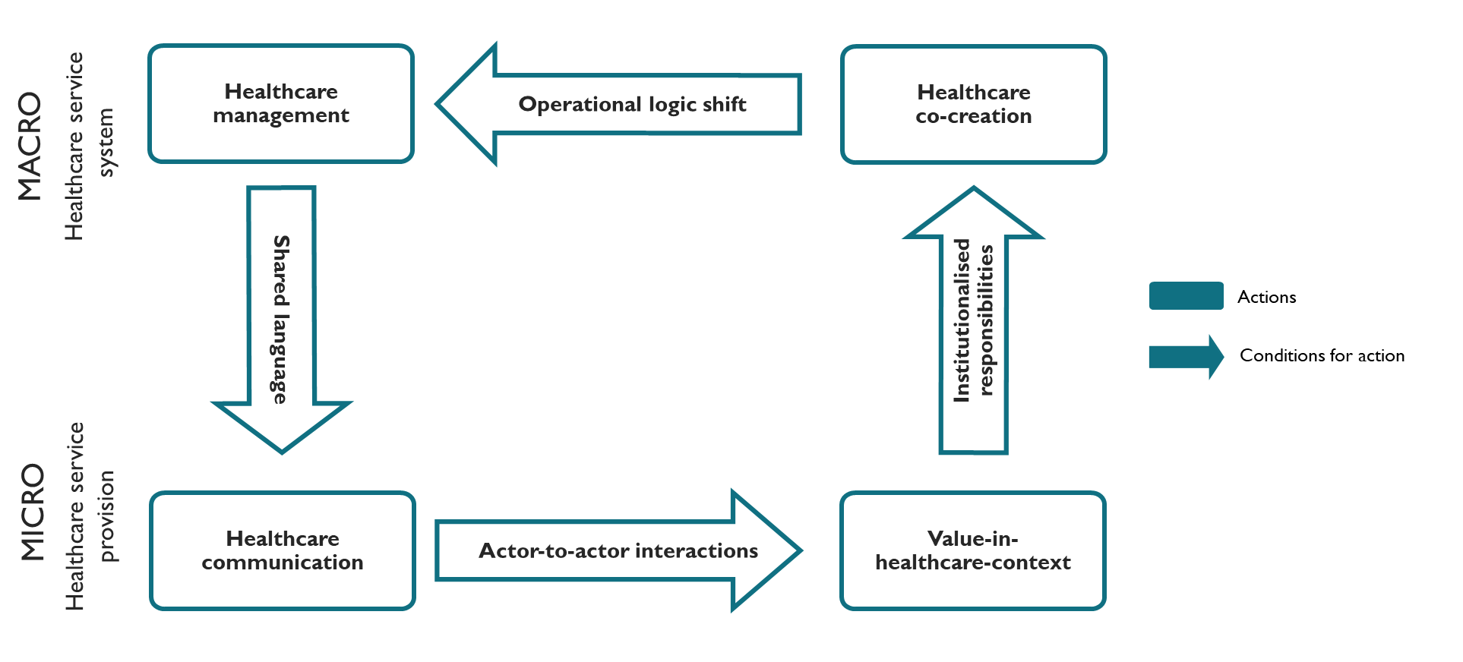
Conclusion
The framework serves as a conceptual tool for understanding and improving pathway design within complex healthcare ecosystems.

Slide 19
More information
Lessons learned
Key takeaway
Relevant publications

Slide 20
Lessons learned
Longitudinal patient mapping provides rich insight into lived care trajectories, but is highly sensitive to attrition, requiring careful study design and follow-up strategies.
Convenience-based sampling enables access in complex healthcare settings, yet limits representativeness and calls for cautious interpretation of findings.
A narrow empirical scope and strong theoretical framing support analytical depth, but constrain transferability beyond the studied context.
Virtual interviews increase feasibility and access, while potentially reducing contextual richness and opportunities for observational insight.
Applying Service-Dominant Logic in practice requires continuous analytical reflexivity; tendencies toward goods-dominant logic may persist despite theoretical grounding.
Addressing these challenges highlights the need for mixed methods, broader empirical designs, and sustained reflexivity when studying patient pathways as healthcare ecosystems.

Slide 21
Key takeaway
  Integrating a marketing perspective grounded in Service-Dominant Logic provides a richer understanding of healthcare management and communication across the continuum of care.
  Viewing patient pathways through a systemic perspective helps bridge the gap between predefined pathways and actual patient journeys by revealing how value is created through interaction rather than linear process execution.
  The study identifies previously underexplored dimensions of healthcare value creation, including value-in-healthcare-context, healthcare co-creation, aggregation levels, shared institutionalized language, institutionalized responsibilities, and actor-to-actor interactions.
  These dimensions demonstrate that patient pathways function as service ecosystems, where coordination, communication, and responsibility are continuously negotiated across micro, meso, and macro levels.
  The Healthcare Value Dynamics Framework conceptualizes this shift and signals an operational logic change in healthcare management - from efficiency-driven, linear thinking toward adaptive, interaction-based value co-creation.

Slide 22
Relevant publications
Master thesis:
  Gjermestad, K. (2023). Exploring the Intersection of Service-Dominant Logic and Patient Pathways: the Healthcare Value Dynamics Framework (Master's thesis, Inland Norway University).

