Slide 1


Multiple sclerosis patient pathway
Case study 4
Related toolbox element: M3 - Mapping of patient pathways (CJA)
Responsible: Märt Vesinurm, Aalto University
Date: Dec 1, 2025
Version: v2
Type: Patient pathway
Health condition: Multiple sclerosis
Language: English
© The authors, Pathway, 2025

Slide 2



Content
About
About the case study
Visuals/Diagrams/Content
More information
This document is part of the Pathway Toolbox www.cjml.no/health
Developed within the Pathway research project (2021–2025)
Project partners:
SINTEF Digital, Norway
University of Oslo, Norway
Aalto University, Finland
Funded by:
The Research Council of Norway

Slide 3

About the case study
Context
Researchers involved
Method

Slide 4

About the case study
Context
  A pilot study with n=3 healthcare professionals specialized in MS.
  Statistical analysis of MS digital care pathway using electronic health records
  Phase: From diagnosis through treatment
  Where: a major university hospital in Finland
  When: 2023-2024
Researchers involved
  Märt Vesinurm, Aalto University
  Essi Miettinen, Aalto University
  Paul Lillrank, Aalto University
Method
  Data collections: Workshops, EHR dataset
  Data analysis: Process mapping using CJML, statistical analysis

Slide 5
Visuals - diagram

Slide 6





Primary healthcare
Special care
Bed ward patient:
An almost certain case, studies have already been done
Go for a magnet or a spinal cord sample, if already from the department
Note clear signs of numbness or visual difficulties.
If the symptoms are strong, go to the emergency room, otherwise go to primary care.
Tells the general practitioner about their symptoms
Gets a referral to the ward or polyclinic depending on the symptoms.
Patient
Headache patient:
Cases where there is no proper certainty.
Most of the patients already come from the department.
Writes down the symptoms.
Clear cases: course of symptoms, autoimmune disease matches, descriptions reveal a lot.
Gives a referral to the department or polyclinic.
Sends a referral to specialized medical care.
GP in Primary healthcare
Receives a referral.
Checks age, gender, previous surgeries, e.g. leg surgeries.
MS Specialist
Appointment and Surgery Scheduler

Slide 7


Max. 2 weeks.
Special care
Special care
WAITING TIME
Gets information about imaging.
Gets a time for imaging.
Goes to imaging.
Meets for an appointment with MS specialist.
Hears about the diagnosis.
May suggest wishes regarding medication.
Gets instructions and a meeting with the nurse.
Patient
Refers to a spinal cord sample and a magnet if needed.
Requests to book imaging.
Evaluates the results of the imaging.
Meets the patient.
Tells the diagnosis and what MS is.
Discusses e.g. first-line medication, where to get support.
Instructs the patient to nurse.
Sends referral for a blood test.
MS Specialist
90% wave-like symptoms, 10% directly progressive.
Gets information about the patient.
Nurse
Takes care of the appointment.
Messages in MAISA or by letter about the upcoming appointment.
Makes an appointment for a blood test.
Appointment and Surgery Scheduler
Imaging is taken.
Tests results are recorded to the system.
Hospital

Slide 8

1 day
Special care
WAITING TIME
Meets for an appointment with the nurse.
Receives information.
Discuss about forms of medication.
Makes wishes.
Gets blood tests for medication.
Nurse
Evaluates blood test results and existing medication.
Goes to an MS treatment meeting.
Presents the patient's situation.
MS Specialist
Meets the patient.
Goes through nutrition, exercise, health issues.
Discuss about forms of medication.
Afraid of needles? Wish to get pregnant? Possible medications?
Nurse
Appointment and Surgery Scheduler
Gathering MS treatment meeting.
At the MS treatment meeting, regional MS doctors etc.
Consider a care plan.
Checks the status of existing medications.
Records the information.
Department pharmacist
Blood tests are taken.
Tests results are recorded to the system.
Hospital

Slide 9

1 month from the first appointment until the start of medication.
Special care
Start of medication
WAITING TIME
Gets information about the medication.
Gets tablet medication at the pharmacy with KELA card.
Meets nurse for injection instructions.
Gets first medication.
Responsible for the following medications themself.
Potilas
Suggests treatment.
MS doctor
Welcomes the patient.
Guides the first injection medication.
Nurse
Notifies about the start of medication.
Books an appointment if injection treatment.
Appointment and Surgery Scheduler
Gathering MS treatment meeting.
The treatment plan is approved.
Decides which medicines are korvattavia.
Creates a new KELA card.
Sends the new KELA card.
KELA

Slide 10
Ensitietoiltoja 2 x vuodessa.
Treatment started, in specialized hospital care
WAITING TIME
Gets information about the appointments.
Accepts the invitation.
Researches Digipolku for instructions on the initial phase.
Goes to primary information event, where the disease is explained in more detail.
Potilas
Request to book next magnet in 6 months & a call time in 3 months.
MS doctor
Hoitaja
Handles appointments.
Messages in MAISA or by letter about the upcoming appointment.
Invites to first hand information event.
Appointment and Surgery Scheduler

Slide 11



Ambiguous situations in treatment, e.g. symptoms worsen but not critically.
Uncertainty about the situation, or experiencing changes after the start of the medication.
Gets a call.
Gets the answer at MAISA.
Sends a message in MAISA.
Makes a call request from MAISA's call service, waits for the call.
Patient
Gets a question if it’s about medication.
Evaluates the situation.
Can also state the condition without all the additional tests.
Answers the questions in MAISA.
MS doctor
Knows how to respond to the situation.
Calls the patient and/or answers in MAISA.
Reads the message.
Nurse
If a worsening phase is noticed, direct responsibility to the doctor.
Forwards the question to the doctor.
Gets more information about the situation.
Answers the questions in MAISA.
Appointment and Surgery Scheduler
Gets a consultation request.
Investigates symptoms related to MS: sensory deficits, walking difficulties.
Informs the nurse.
Menecons doctor

Slide 12


The treatment not working, the symptoms get worse and have to go to the emergency.
The symptoms are clearly getting worse, cannot wait for an answer through MAISA.
Goes to the emergency according to the symptoms.
Gets a referral.
Gets a new appointment.
Goes to head magnet
Meets neurologist.
Patient
Receives the patient.
Evaluates the worsening: whether cortisone is needed.
What to do about the medication? Has it been used long enough?
Referral to the head magnet and neurologist
Doctor on call
For example, an ophthalmologist's emergency room and if the vision has decreased, you can get cortisone to help.
Books the appointment.
Messages in MAISA or by letter about the upcoming appointment.
Appointment and Surgery Scheduler
Receives a patient suspected of having an exacerbation.
Evaluates the situation.
Neurologist

Slide 13
Max. 2 months.
The treatment not working, the symptoms get worse and have to go to the emergency.
WAITING TIME
Gets a reminder.
Gets new times for testes.
Goes to take tests.
Patient
Receives information about the patient's condition.
Evaluates the worsening: the medication needs to be changed.
A lot of further research is needed for a new medication.
Gives nurse information on patient's case.
MS doctor
Receives a information on suspected exacerbation.
Reminds of all tests, exams, vaccines.
Nurse
Books times for tests.
Messages in MAISA or by letter about the new times.
Appointment and Surgery Scheduler
Records the results of the head magnet.
Neurologist

Slide 14

Starting the treatment of the exacerbation phase in specialized medical care
Is already a bed ward patient.
The waiting time for the initiation of exacerbation medication is more than 2 months.
Gets a new medication.
Patient
Meets for an appointment with MS specialist.
Gets a new medication.
Hears about additional treatments.
Tries to remember.
Gets an appointment for tysabar treatment.
Receives patient.
Gives information about new medication.
MS doctor
Tells about the tysabri treatments.
Requests an appointment for tysabar treatment.
Reminds about upcoming tests, etc.
for the subcutaneous tissue that are done every 1 month.
Nurse
Handles the appointment.
Informs about the tysabar appointment.
Appointment and Surgery Scheduler
immediately at the reception or later by message.
Takes a booth from the start of the medication.
Bed ward doctor

Slide 15
Symptoms are under control, no exacerbations
TIME GOES
Meets for an appointment with MS specialist.
Receives information.
Receives information.
Gets sick with a normal disease, e.g. pneumonia.
Comes to the primary care reception.
Patient
Receives patient.
Determines the steady phase of the disease.
Tells that the responsibility is transferred to primary health care.
Tells about the compatibility of medications
MS doctor
Receives patient.
Considers the compatibility of MS medication for the disease.
Consults an MS doctor about it.
Primary healthcare

Slide 16

Special situations
Meets for an appointment with MS specialist.
Okay.
Reads the message and assumes that MAISA's message is official.
Goes to the lab as MAISA reminds.
Doesn’t get lab tests.
Comes to the reception without labs.
Patient
Receives patient.
Sees that patient hasn’t the requested tests.
Let's set a new time and before then you will visit all of them.
Receives patient.
MS doctor
Automatically reminds of labs.
APOTTI

Slide 17
The patient belongs to the 10%, i.e. directly progressive, disease picture.
Patient
Meets for an appointment with MS specialist.
Receives information.
No.
2. Locally progressive, no separate exacerbations.
Receives patient.
The ability to move is almost gone. Is the patient over 50-60 years old?
Tells the patient the situation.
MS-lääkäri
Medication is of little use.
Yes.

Slide 18
The patient needs additional support & help.
Meets for an appointment with MS specialist.
Needs additional support for the disease.
Hears about different parties
Thank you.
Patient
Receives patient.
Listens to the situation.
Tells about different parties.
Gives links.
MS doctor
Here if you have an overactive bladder.
Urologist
Neuropsychologist
Mental health challenges.
A social worker is often readily available if you need help.
Social worker, qualified in psychiatry
Rehabilitation instructor, physiotherapist
Physical challenges and their rehabilitation.

Slide 19
Results of digital care pathway
The DCP for MS was launched in March 2020 and has since had a steady flow of new users. It was found to increase the use of support services such as rehabilitative services.

Slide 20
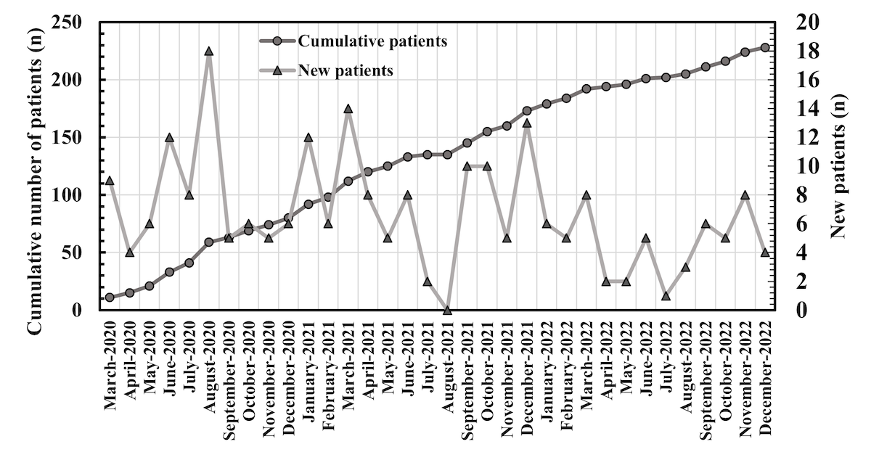
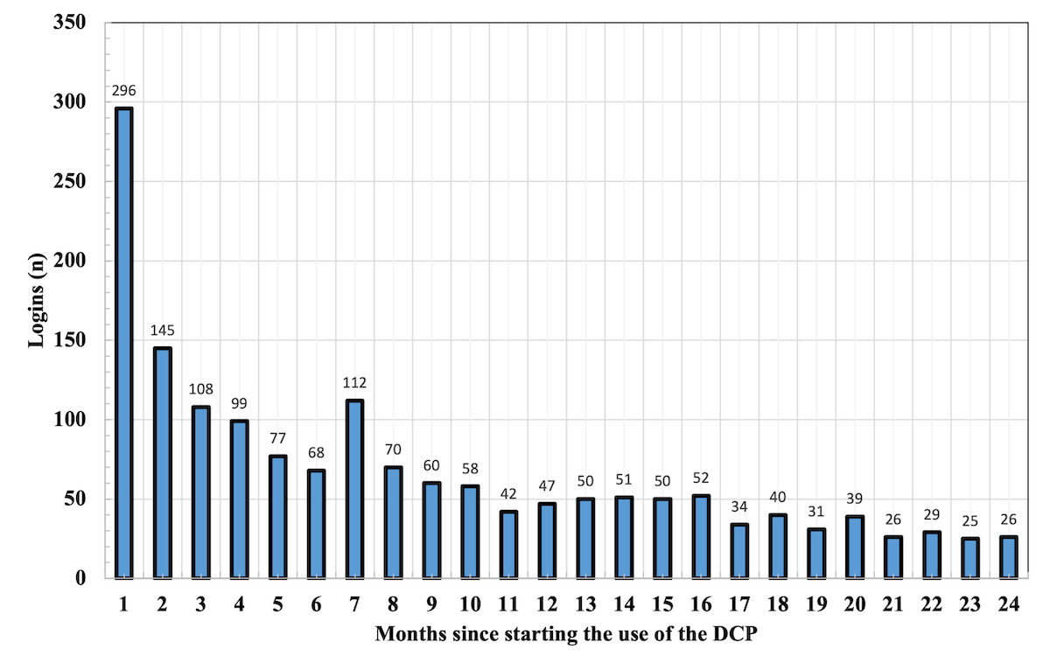
Results of digital care pathway
Figure 1. Cumulative number of patients (circle) and number of new patients (triangle) in the Neurology Outpatient Clinic using the DCP shown from March 2020 until December 2022. DCP: digital care pathway.
Figure 2. Summative number of logins to the DCP for all pwMS under follow-up in the Neurology Outpatient Clinic. The data are calculated from the time each individual first entered the DCP until 24 months. DCP: digital care pathway; pwMS: people with multiple sclerosis.

Slide 21
More information

Slide 22
Relevant publications
Further details can be found here:
Vesinurm, M., Maunula, A., Olli, P., Lillrank, P., Ijäs, P., Torkki, P., Mäkitie, L. and Laakso, S.M., 2024. Effects of a Digital Care Pathway for Multiple Sclerosis: Observational Study. JMIR human factors, 11(1), p.e51872.

