Slide 1


Survey about Pathways in Finland
Case study 5
Responsible: Märt Vesinurm, Aalto University
Date: Dec 1, 2025
Version: v2
Type: Patient pathway
Health condition: All included
Language: English
© The authors, Pathway, 2025

Slide 2



Content
About
About the case study
Visuals/Diagrams/Content
More information
This document is part of the Pathway Toolbox www.cjml.no/health
Developed within the Pathway research project (2021–2025)
Project partners:
SINTEF Digital, Norway
University of Oslo, Norway
Aalto University, Finland
Funded by:
The Research Council of Norway

Slide 3

About the case study
Context
Researchers involved
Method

Slide 4

About the case study
Context
A survey study with n=23 healthcare professionals
Where: all healthcare regions in Finland
When: 2023-2024
Researchers involved
Märt Vesinurm, Aalto University
Method
Data collection: Survey
Data analysis: Thematic and statistical analysis of survey responses

Slide 5
Framework for patient pathway usability
and utilization assessment

Slide 6
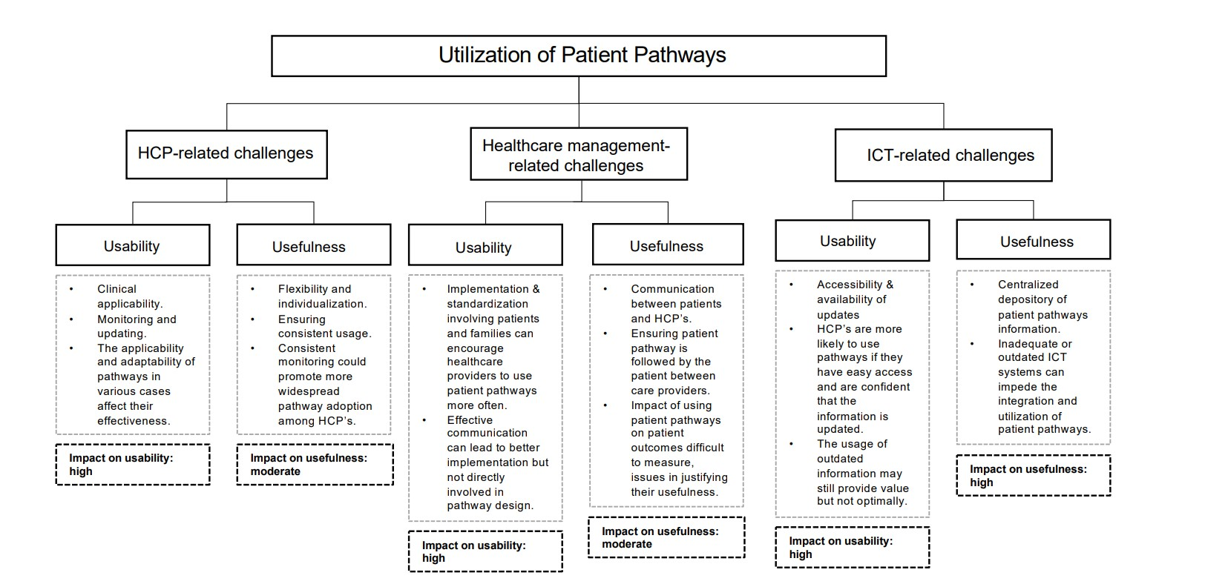

Slide 7
More information

Slide 8
Relevant publications
Further details can be found here:
Eklund, A., Vesinurm, M. and Torkki, P., 2024. Explorative study on the utilization of patient pathways in Finnish public healthcare.

