Slide 1


Kidney cancer patient journey
Case study 7
Related toolbox element: Method 2 - Mapping of patient journey (CJA)
Responsible: Anna Grøndahl Larsen, SINTEF Digital
Date: Dec 1, 2025
Version: v2
Type: Patient journey
Health condition: Kidney cancer
Language: Diagram in Norwegian
© The authors, Pathway, 2025

Slide 2



Content
About
About the case study
Diagrams
More information
This document is part of
the Pathway Toolbox www.cjml.no/health
Developed within the Pathway research project (2021–2025)
Project partners:
  SINTEF Digital, Norway
  University of Oslo, Norway
  Aalto university, Finland
Funded by the Research Council of Norway

Slide 3

About the case study
Context
Researchers involved
Method

Slide 4

About the case study
Context
  A longitudinal study with n=5 kidney cancer patients
  Phase: From diagnosis through treatment
  Where: a major university hospital in Norway
  When: 2024-2025
Researchers involved
  Anna G. Larsen, SINTEF Digital
  Kristine Gjermestad, SINTEF Digital
  Ragnhild Halvorsrud, SINTEF Digital
Method
  Data collection: Longitudinal study consisting of a start interview, a structured diary for detailed mapping of the patient journey, and a debrief interview
  Data analysis: Touchpoints were identified and categorized across diary and interview data. The resulting data was used to describe and model the kidney cancer patient journey using CJML.

Slide 5
Visuals - diagram
The next slides show an overview of one patient journey, including description and diagrams.
The diagram spans x pages.

Slide 6
Description of patient journey
The patient went to the GP due to a cough and was referred to a pulmonologist. The pulmonologist referred the patient to CT imaging. Months after the images were taken, the patient was notified of a potential kidney tumour. New images were taken, and the patient was referred to the Department of Urology at their nearest hospital.
After some back and forth, including a refused referral and several phone calls, the patient was contacted by a doctor at the Department of Urology, and informed about their options. The patient opted for immediate surgery and then received notifications about preoperative assessment and surgery appointments.
Weeks later the patient was admitted to hospital and underwent surgery. During the stay, the patient met with several nurses and doctors, providing care and information.
Some weeks after surgery, the patient met for a post-operative consultation. During the consultation, the patient was informed that the tumour had been malign but that the surgery had been successful. The patient then received notification of the first half yearly follow up (CT scan).

Slide 7
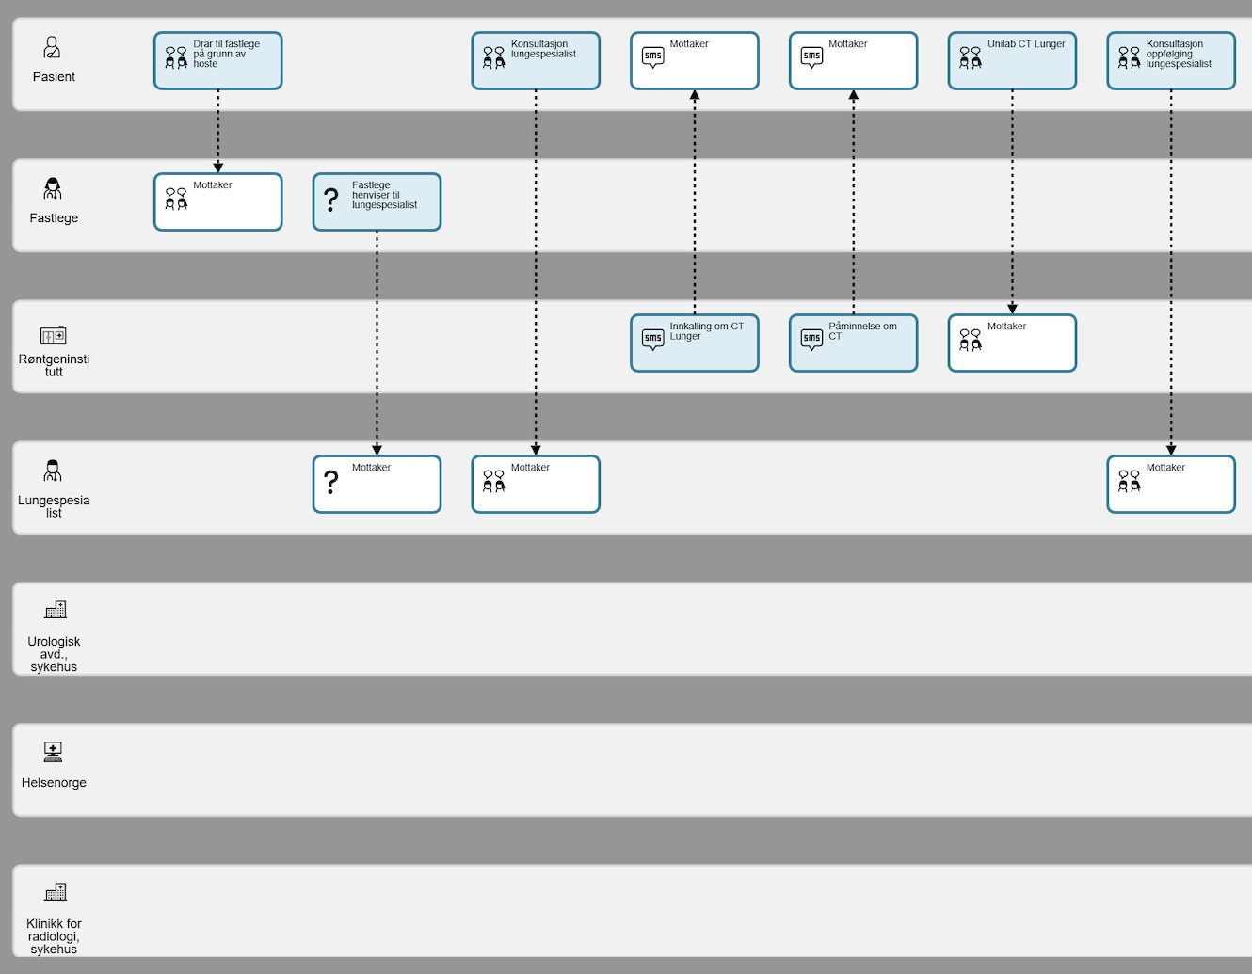
Diagram of patient journey (1/7)

Slide 8
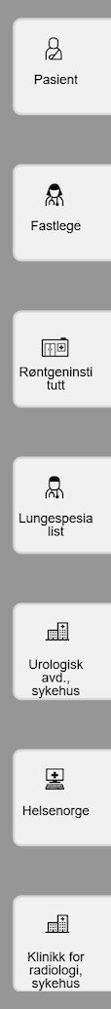
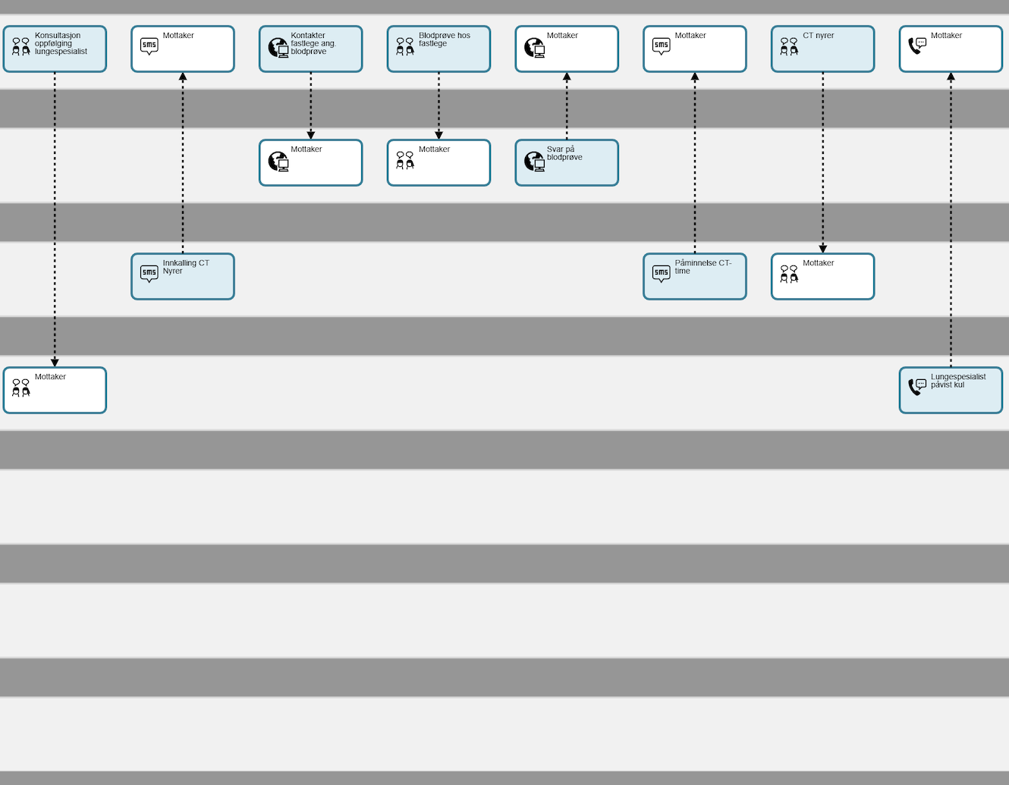
Diagram of patient journey (2/7)

Slide 9
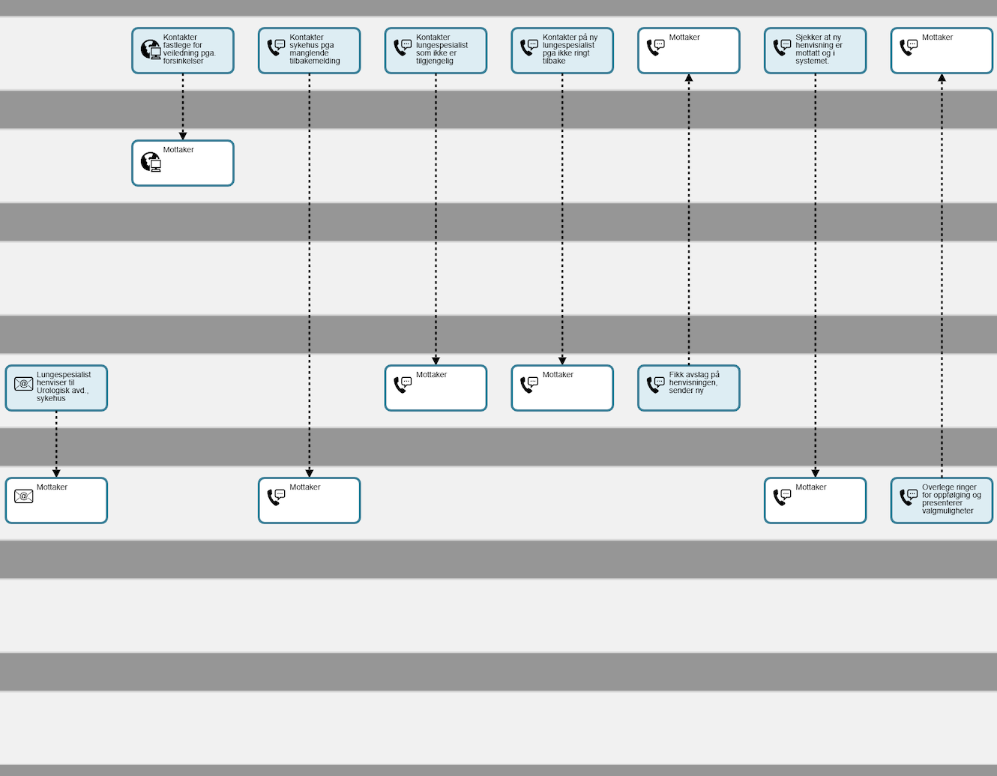
Diagram of patient journey (3/7)

Slide 10
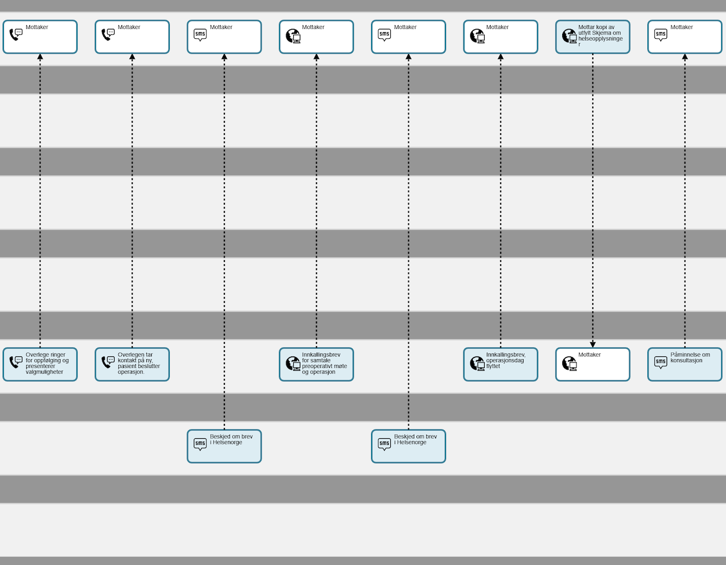
Diagram of patient journey (4/7)

Slide 11
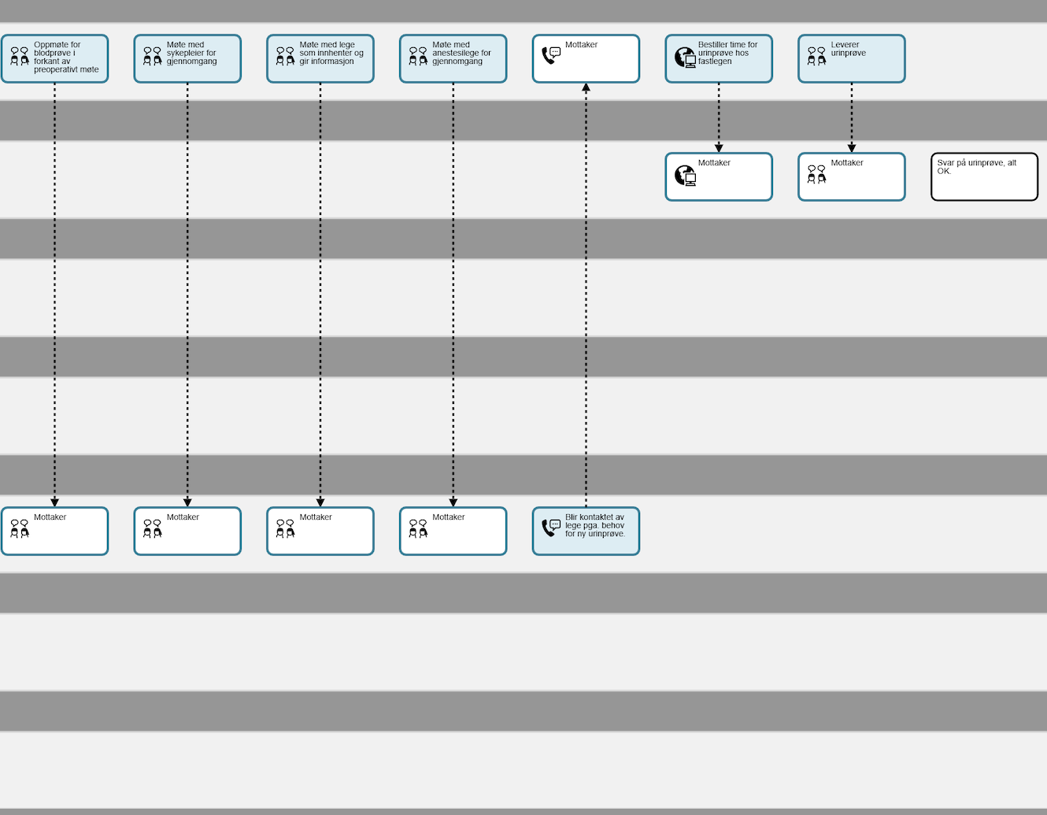
Diagram of patient journey (5/7)

Slide 12
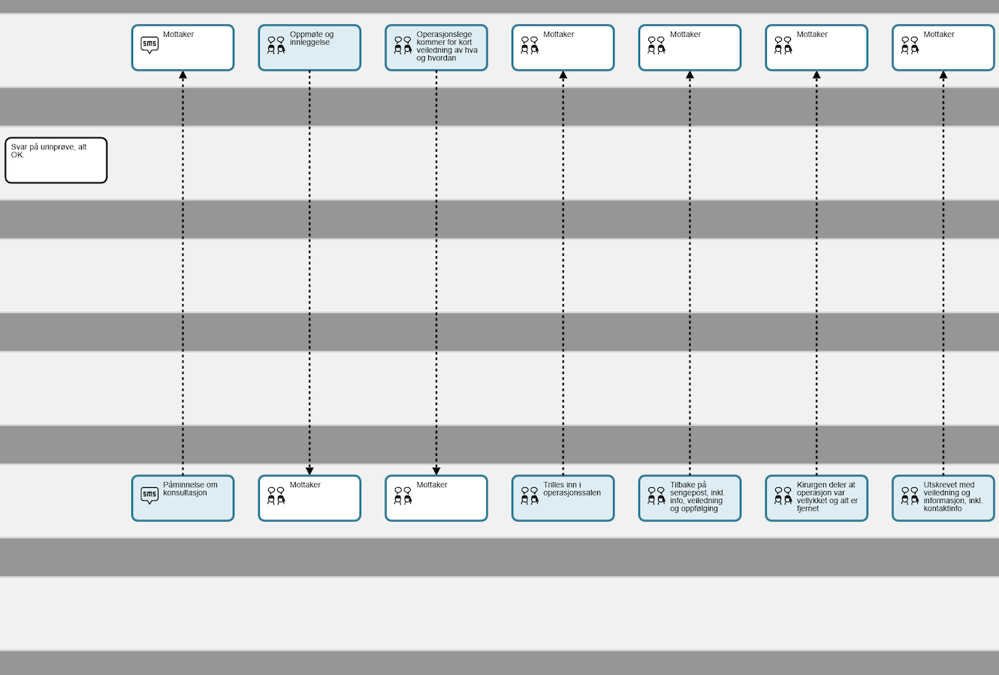
Diagram of patient journey (6/7)

Slide 13
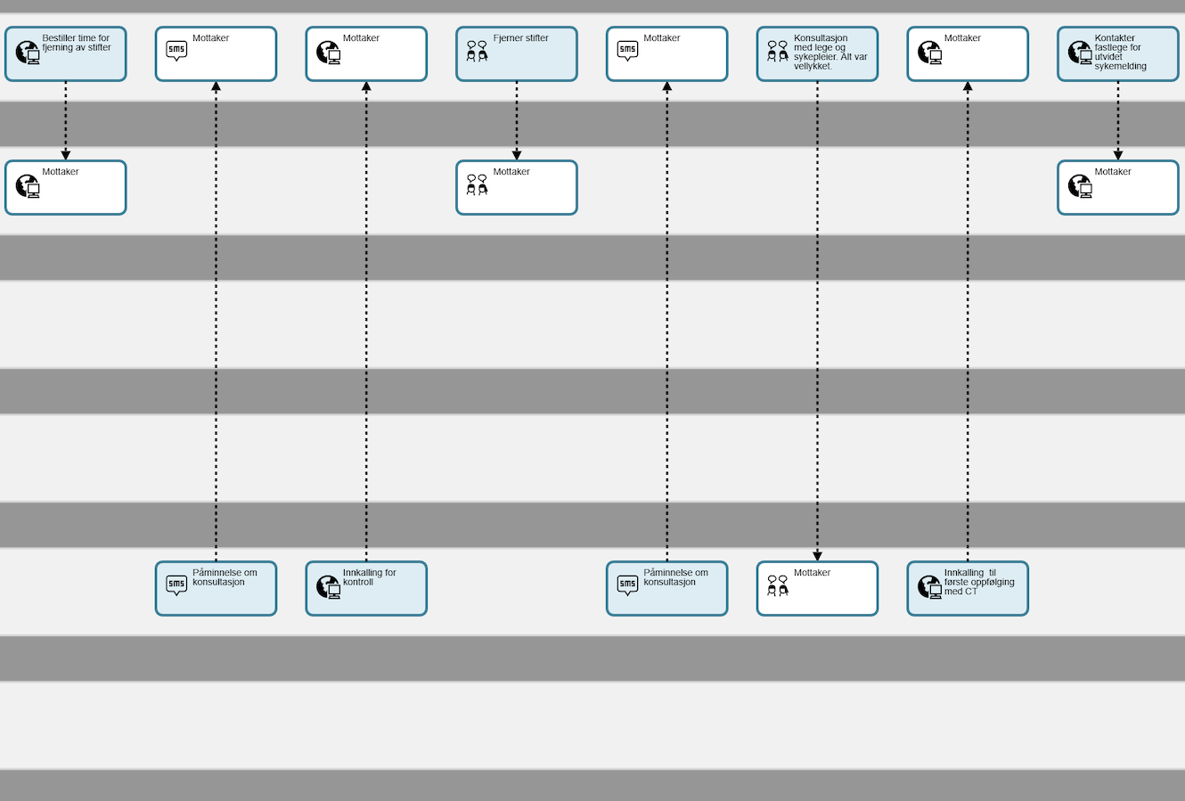
Diagram of patient journey (7/7)

