Slide 1


MS patient journey
Case study 8
Related toolbox element: Method 2 - Mapping of patient journey (CJA)
Responsible: Anna Grøndahl Larsen, SINTEF Digital
Date: Dec 1, 2025
Version: v2
Type: Patient journey
Health condition: MS
Language: English
© The authors, Pathway, 2025

Slide 2



Content
About
About the case study
Diagrams
More information
This document is part of
the Pathway Toolbox www.cjml.no/health
Developed within the Pathway research project (2021–2025)
Project partners:
  SINTEF Digital, Norway
  University of Oslo, Norway
  Aalto university, Finland
Funded by the Research Council of Norway

Slide 3

About the case study
Context
Researchers involved
Method

Slide 4

About the case study
Context
  A longitudinal study with n=9 MS patients
  Phase: From app. three years after diagnosis (5-6 months)
  Where: Norway
  When: 2024-2025
Researchers involved
  Anna G. Larsen, SINTEF Digital
  Kristine Gjermestad, SINTEF Digital
  Ragnhild Halvorsrud, SINTEF Digital
Method
  Data collection: Longitudinal study consisting of a start interview, a structured diary for detailed mapping of the patient journey, and a debrief interview
  Data analysis: Touchpoints were identified and categorized across diary and interview data. The resulting data was used to describe and model the kidney cancer patient journey using CJML.

Slide 5
Visuals - diagram
The next slides show an overview of one patient journey, including description and diagrams.
The diagram spans pages.

Slide 6
Description of patient journey
Some years prior to participation in the Pathway project, the patient was diagnosed with MS.
During the participation in the project, the patient experienced possible MS symptoms and contacted their GP, which referred the patient to the Department of neurology at the nearest hospital. After assessment by a neurologist, the patient was further referred to an opthalmologist at the hospital. There the patient received treatment and eventually got better.
The patient further received notification of the annual consultation with a neurologist at the hospital, including several reminders, and went to the consultation
Weeks later, the patient received medical treatment for MS at the hospital

Slide 7
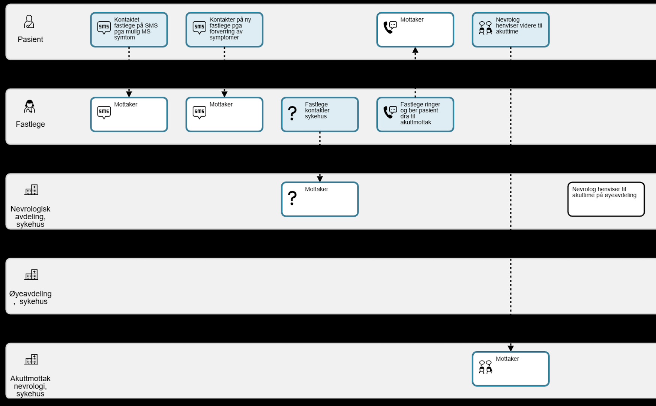
Diagram of patient journey (1/4)

Slide 8
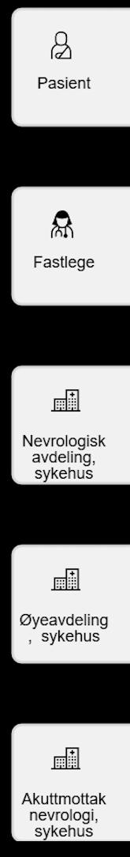
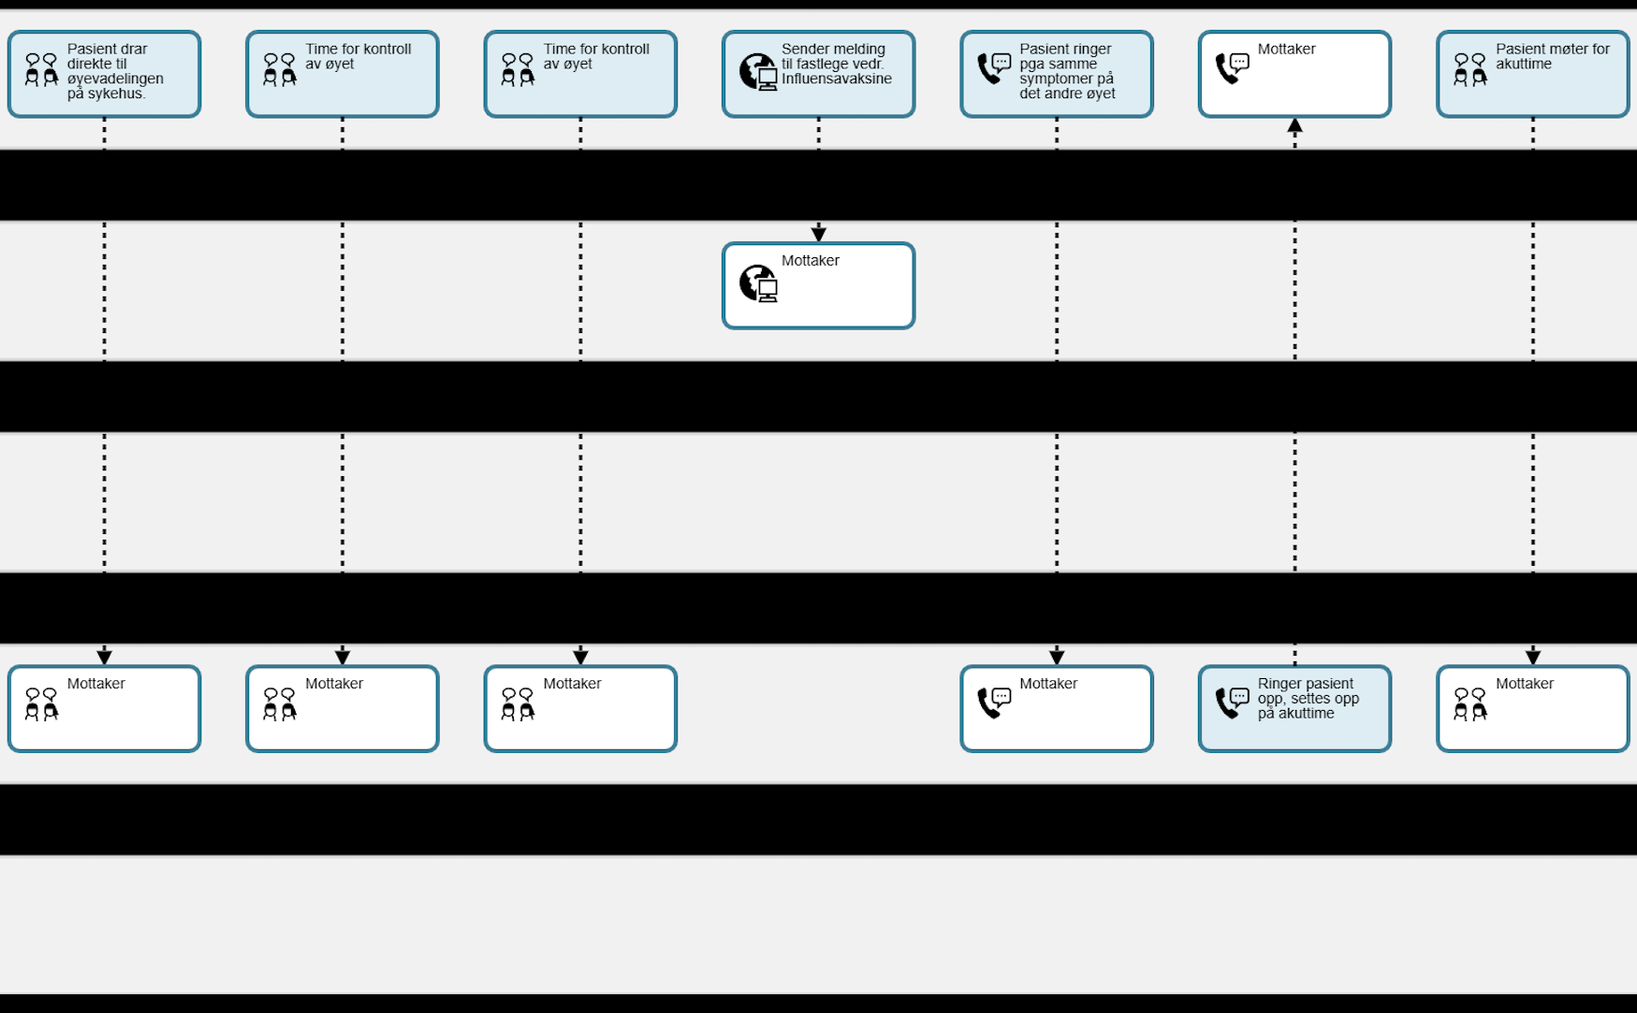
Diagram of patient journey (2/4)

Slide 9
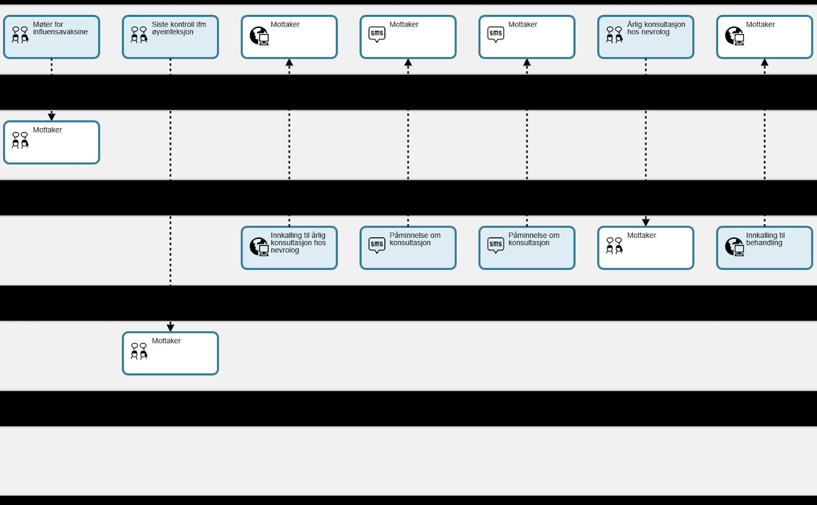
Diagram of patient journey (3/4)

Slide 10
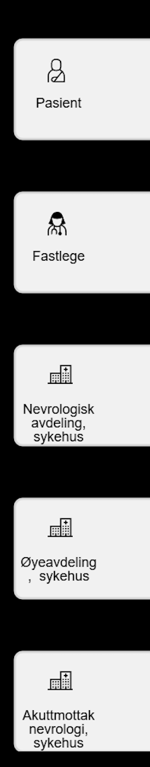
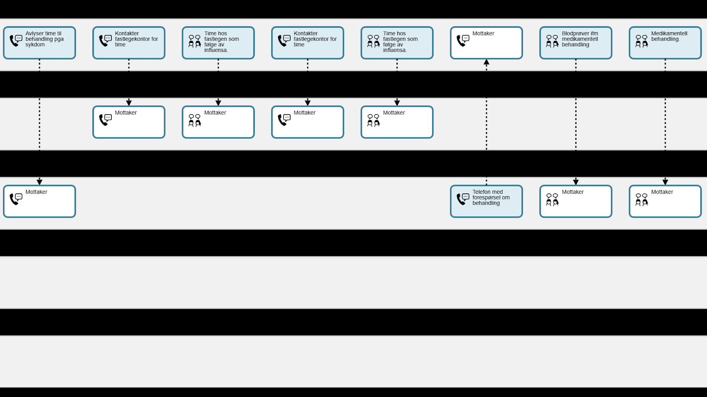
Diagram of patient journey (4/4)

