Slide 1


Critical Incident Technique
Method 1
Related toolbox element: Case study 6 - Results from CIT-study
Responsible: Ingrid K. Ledel Solem, SINTEF Digital
Date: Dec 2, 2025
Version: v2
Purpose: To explore key experiences throughout patient journeys
Applied by: Researchers
Target participants: Patients and their next of kin
Language: English
© The authors, Pathway, 2025

Slide 2



Content
About
About the method
Step-by-step guide
Lessons learned
More information
This document is part of the Pathway Toolbox www.cjml.no/health
Developed within the Pathway research project (2021–2025)
Project partners:
SINTEF Digital, Norway
University of Oslo, Norway
Aalto University, Finland
Funded by:
The Research Council of Norway

Slide 3

About the method
Purpose
Context and adaptations

Slide 4

Purpose
The Critical Incident Technique (CIT) is a method used to collect specific events that had a strong positive or negative impact on an individual’s experience.
First introduced in the 1950s in aviation psychology, CIT has later found broad use in service research and, more recently, in healthcare studies.
CIT focuses on concrete episodes remembered for their emotional intensity or practical significance.
By analyzing these impactful episodes, CIT helps identify strengths and weaknesses in care processes, highlighting what truly matters to patients.
CIT enables systematic identification of what contributes to or hinders quality in care, based on experiences reported by patients, professionals, and other stakeholders.

Slide 5
Context and adaptions
Patients with serious conditions face complex, long-lasting patient journeys involving multiple healthcare providers. However, traditional measures, like PROMs and PREMs only provide a snapshot of the patient experience.
In our study, CIT was adapted to extract and analyze impactful patient-reported episodes related to communication, information, and care coordination in the cancer care pathway.
We included both patients and their next-of-kin, acknowledging their complementary perspectives and experiences.

Slide 6
Context and adaptions
Key information
When: June 2022
Participants: 28 cancer patients and 13 next-of-kin
Recruitment: Through the Norwegian Cancer Society
Ethical consideration: Participation in the study was voluntary
and based on written informed consent.
Data collection methods
Online workshops
Questionnaires (following workshops)
Interviews
Data analysis
Deductive quantitative approach + inductive content analysis
Method adapted by
Ragnhild Halvorsrud, Ingrid Solem, and Line Melby (SINTEF Digital)

Slide 7
Step-by-step guide
The next slides provides a step-by-step walkthrough of how we applied CIT to collect critical incidents in the cancer patient journey.

Slide 8

Step 1: Define scope and focus
→ Identify critical incidents throughout the cancer patient journey focusing specifically on communication, information flow, and organizational aspects
Focus on real-life experiences from patients and next-of-kin
De-emphasizing clinical factors such as illness, pain, and medication
Data collection was conducted digitally to enable nationwide participation and reduce risk for vulnerable groups.

Slide 9
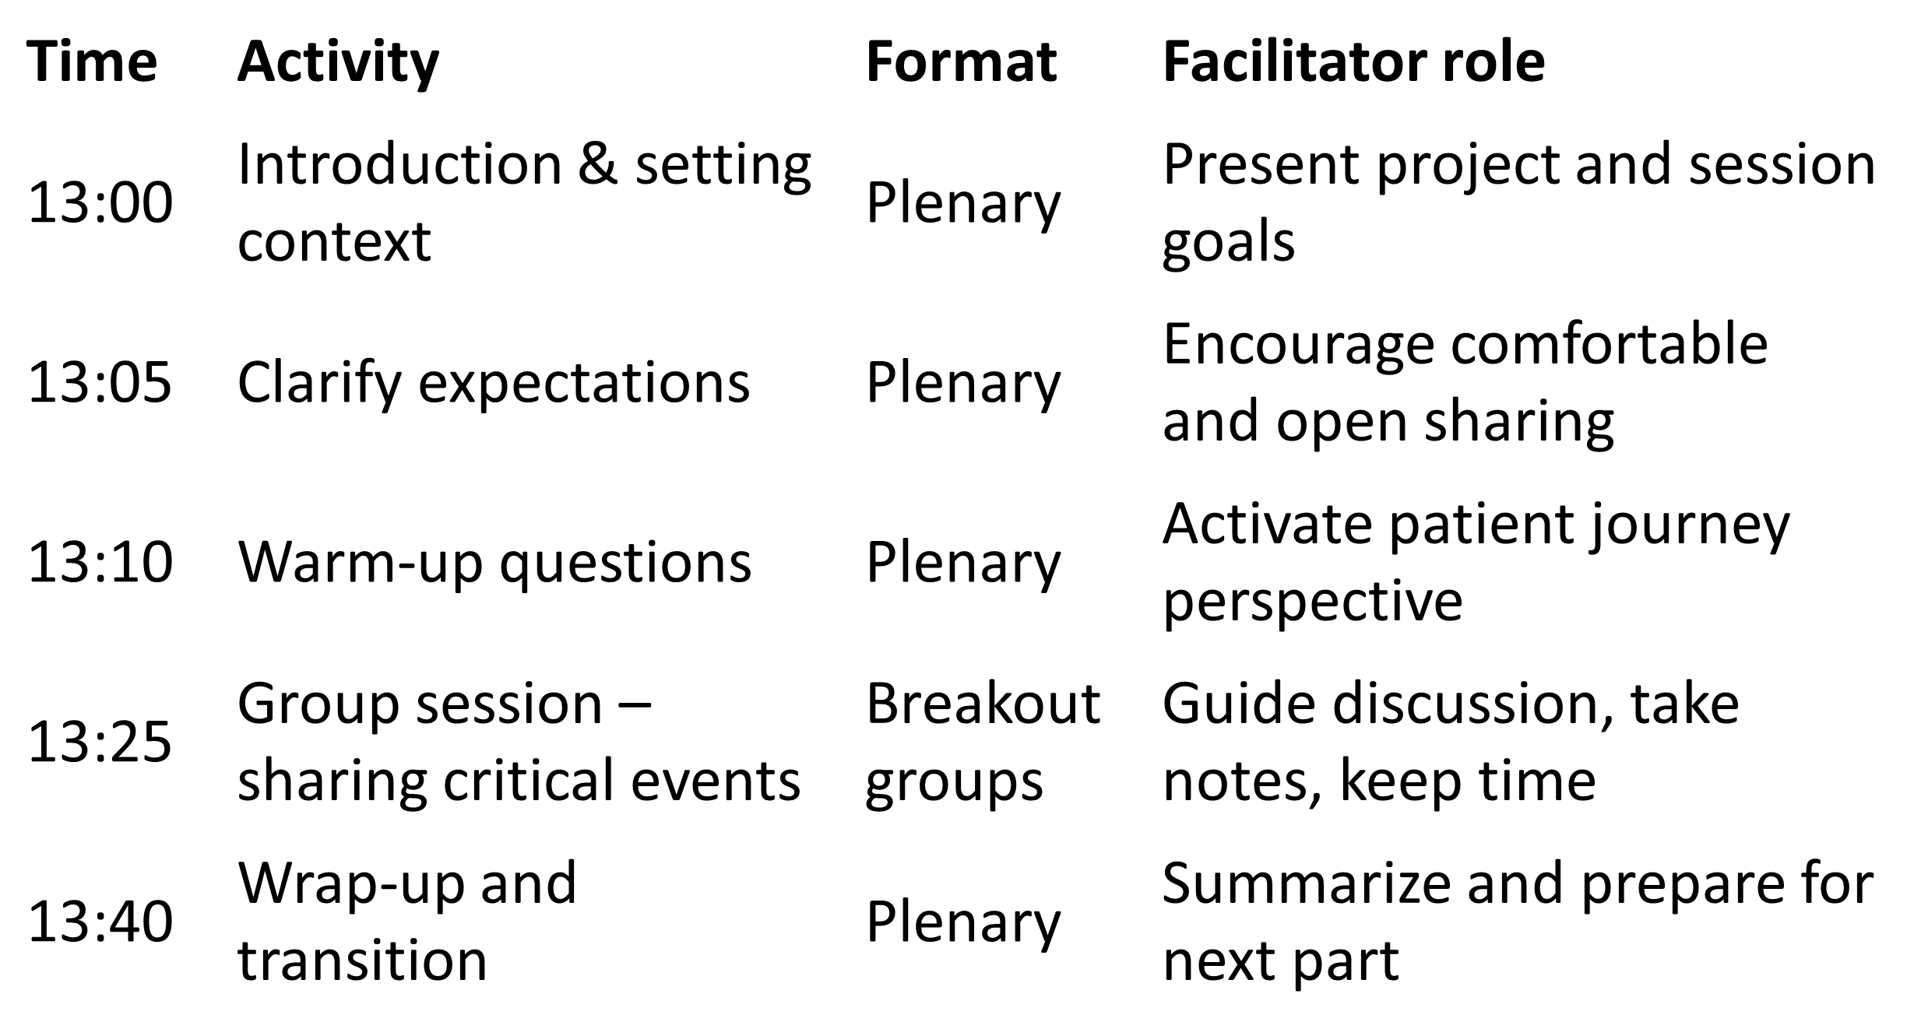
Step 2: Prepare design and data collection
Develop a detailed schedule and facilitation script for the online workshops
Design warm-up activities to activate reflection and build trust
Introduce a fictional patient journey to clarify key concepts and terminology
Use a shared trigger question to ensure consistency across workshop groups
“Think of a specific episode where communication or information flow was particularly satisfying, perhaps exceeding your expectations (round two: dissatisfying, perhaps causing an extra burden).”
Example Workshop schedule

Slide 10
Step 3: Data collection
Three complementary data collection methods were used the gather critical incidents:
Digital workshops (n=3) with patients and next-of-kin
Supplementary questionnaire sent to workshop participants, including background questions and the same trigger question
Individual interviews (n=6) with patients, to gain deeper insight into selected incidents
All methods aimed to capture real, specific incidents related to communication, information, and coordination
Using multiple formats (workshops, questionnaires, and interviews) allowed us to compare perspectives and enrich the overall insights

Slide 11
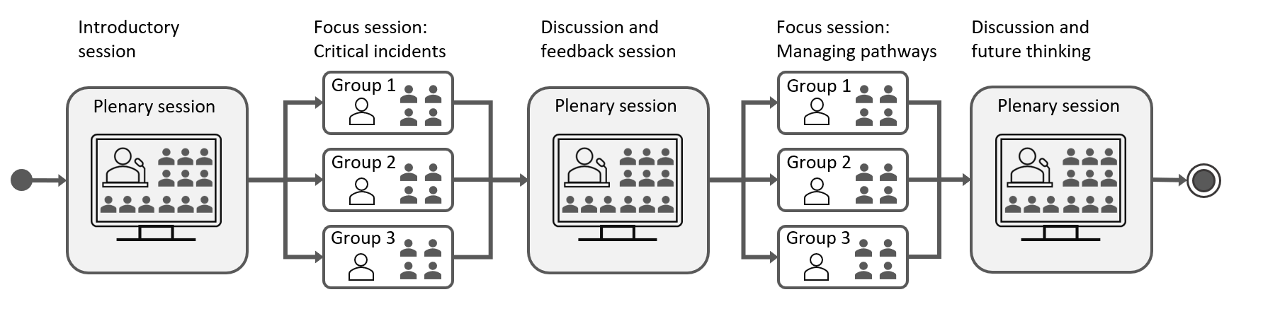
Step 3: Data collection – workshop structure
The main data source was a series of three structured online workshops. Each workshop included:
Plenary introduction and warm-up activities
Breakout sessions for sharing critical incidents (both positive and negative)
Plenary feedback and thematic discussion
The structured format enabled open sharing, peer validation, and iterative refinement of experiences.

Slide 12
Step 4: Data sorting and filtering
Transcripts from group sessions and interviews were compiled, guided by moderators’ notes
Questionnaire responses were included, and all data were sorted into positive and negative episodes
We developed criteria for identifying Critical Incidents (CIs):
C1. Critical: Directly emerging from the trigger statement, excluding secondary or associative episodes.
C2. Episodic: Involves one or more actors in a discrete event with sufficient detail.
C3. Scope: Focuses on communication, information, and organization
Long episodes were split into atomic units; duplicates were removed
Final dataset: 304 episodes → 187 Critical Incidents
For results; see “Case study: Critical incidents in cancer patient journeys”

Slide 13
Step 5: Data analysis - overview
We applied a two-part analysis:
Deductive, quantitative analysis: Critical incidents were quantified by counting involved actors and communication channels, using a semiotic communication model (see figure).
Inductive content analysis: Emergent themes were identified across incidents to capture recurring patterns and concerns.
Multiple iterations and consensus meetings ensured consistency.

Slide 14
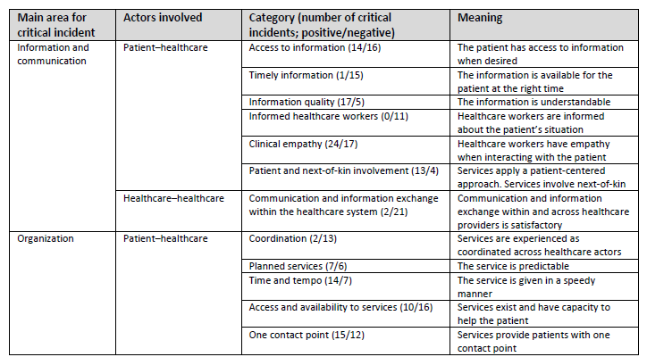
Step 5: Data analysis – derived categories
The content analysis resulted in 12 categories that highlight factors participants considered critical to a positive or negative cancer journey. These categories are transferable and can be reused in other studies or improvement efforts

Slide 15
Lessons learned

Slide 16
Lessons learned (1)
CIT is well suited to explore impactful experiences from the patient journey
Providing a journey-based perspective helps participants recall specific and meaningful episodes
Priming techniques such as warm-up exercises, fictive patient journey and trigger questions support the recall of detailed and specific incidents
Negative experiences are more elaborated: Across all formats, negative incidents were described in more detail than positive ones.
Clear inclusion criteria were essential to ensure consistent identification and sorting of critical incidents.

Slide 17
Lessons learned (2)
Digital workshops with breakout groups gave participants time and space to share personal stories
Smaller groups made it easier to speak freely and reflect more deeply
Workshops resulted in more complete and detailed incidents than questionnaires
Priming is essential for questionnaires: Questionnaires can be useful but require clear instructions and examples to ensure quality responses.
Interviews provided in-depth insights into specific incidents, but were more time-consuming

Slide 18
More information
Key takeaways
Relevant publications

Slide 19
Key takeaways
CIT is a suitable method to capture impactful real-life events in health service contexts
Enables identification of specific, emotionally salient episodes, rather than general impressions or satisfaction
Allows researchers to analyze care experiences within a broader system and pathway context
Supports a patient-centred approach by foregrounding the patient and next-of-kin perspective
Adaptable to different formats (workshops, interviews, questionnaires), allowing triangulation across methods
Structured criteria make it easier to filter and organize complex narratives.

Slide 20
Relevant publications
Full details of the methods and findings are available in:
Halvorsrud, R., Melby, L., Gjermestad, K., Bogale, B., & Solem, I. K. L. (2025). “I Became the Messenger Between the Hospitals”: A Study on the Journeys of People With Cancer Using the Critical Incident Technique. Health Expectations, 28(2), e70211. https://doi.org/10.1111/hex.70211

