Slide 1


Mapping of MS patient pathways (CJML)
Method 7
Related toolbox element: Case 9 and 10 - MS pathways at primary and specialist care; and rehabilitation center
Responsible: Binyam Bogale, University of Oslo
Date: Dec 15, 2025
Version: v2
Purpose: To map and model patient pathways from healthcare professionals' perspective
Applied by: Researchers
Target participants: Healthcare professionals
Language: English
© The authors, Pathway, 2025

Slide 2



Content
About
About the method
Step-by-step guide
Lessons learned
Key takeaways
Relevant publications
This document is part of the Pathway Toolbox www.cjml.no/health
Developed within the Pathway research project (2021–2025)
Project partners:
SINTEF Digital, Norway
University of Oslo, Norway
Aalto University, Finland
Funded by:
The Research Council of Norway

Slide 3

About the method
Purpose
Context and adaptations

Slide 4

Purpose
To map patient pathways:
Mapping of patient pathways is a method to identify how care processes are structured for a given patient group — across time, settings, and actors.
The method is based on Customer Journey Analysis (CJA). In a healthcare context, CJA has been adapted to map patient pathways, providing a structured model of how care is intended to be delivered across actors and communication channels.
To model using visual modeling language:
Visualization with Customer Journey Modelling Language (CJML) ensures the pathway is represented in a consistent and communicable way.
The patient pathway serves as a baseline model that can be later compared with actual instances, patient journeys.
In this case where we have unstructured patient pathways, it can also be used to develop a structured patient pathways that can serve as a blue print against which the patient journeys can be compared
Notes:
The purpose of mapping of patient pathways (planned) is to create a normative model of how a patient’s care trajectory is intended to proceed, from first contact to follow-up.
This model is grounded in clinical guidelines, standard operating procedures, organisational plans, and stakeholder assumptions.
By formalizing the planned pathway, we gain a baseline against which actual patient journeys can later be compared, enabling gap analyses and revealing potential inefficiencies or coordination issues.

Slide 5
Context and adaptions
Key information
Neurology care in this context is ‘unstructured’ or ‘unstandardized’ hence expected to be highly individualized
Method: mixed approach including iterative mapping and visual modeling
Participants: healthcare professionals (clinicians, coordinators, administrative staff).
Study period: weeks depending on pathway complexity and organizational scope.
Ethical consideration: participation in the study was voluntary and based on informed consent.
Data collection method
Desk top review of guidelines and organization of care, process mapping includes a pre-modeling interview using interview guide (a meeting agenda) and post-modeling interview and feedback to the .v1 CJML model
Results
Detailed listing of expected touchpoints, roles, and transitions.
Reduction of workflow to prepare for visual modeling for a group of patients (e.g., uncomplicated)
A baseline model of the intended patient pathway.
Method adapted by
The research team

Slide 6
Step-by-step guide

Slide 7

Overview of steps
Step 1. Desk review of available documents that inform about the care processes
1
Step 2: Develop overview of organization of care, identify points of discussion to be addressed by the stakeholders in next steps
2
Step 3: Conducting the ‘pre-modeling’ interview/workshop
3
Step 4: Analysis and visual modeling v1. using CJML
4
Step 5: Conducting the ‘post-modeling’ interview/workshop
5
Step 6: Analysis and visual modeling v2. using CJML
6
Step 7: Sharing the model to the participants for any (optional) feedback
7

Slide 8
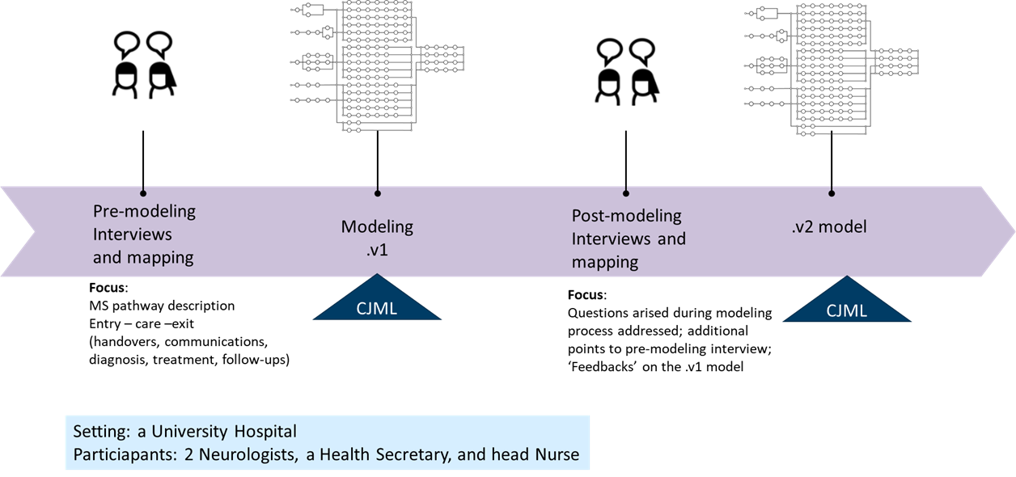
Summary of the visual modelling phase

Slide 9
Step 1: Desk review of available documents
Aim
To identify a comprehensive set of documents: clinical and procedural guidelines at national, regional, or institutional levels used in the treatment of MS cases.
Steps
Identified relevant sources, including directorate of health websites, professional associations, and patient organizations (e.g., International MS Federation).
Retrieved clinical recommendations, treatment guidelines, care process descriptions (e.g., Prioriteringsveileder), and national and international consensus documents.
Develop a high-level patient care process aligned with the organization of health services (example provided on the next slide).

Slide 10
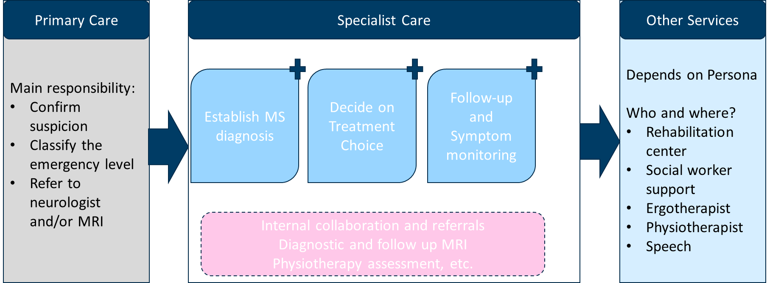
Step 2: overview of organization of care
An example overview from a simple desktop review This provided a high-level view of the continuum of care across different levels of the health system and outlined the main responsibilities at each level. Using this overview, the detailed care processes were later mapped and refined through stakeholder input.

Slide 11
Step 2: Overview …
This helps to:
Clearly define the focus and boundaries of the mapping activity: what stage of the care process (e.g. from referral to treatment), and which healthcare levels are included.
Identify the problem area and specify what you want to understand - for example, coordination challenges, decision points, or expected interactions between actors. Prepare guiding questions for the pre-modeling interview with stakeholder, specific to each stakeholder
Establish the start and end points of the pathway and determine whether the scope covers a single department, an entire hospital, or cross-organizational services.
This step sets the framework for subsequent data collection and ensures that the mapping aligns with the overall research questions.

Slide 12
Step 3: Conducting the ‘pre-modeling’ interview/workshop
Identifying stakeholders Stakeholders were selected based on the defined scope. We mapped the transition from primary to specialist care together and rehabilitation separately, ensuring all relevant roles were represented.
Engagement approach Interview and workshop guides were developed from the desk review while allowing participants to describe the care process as they experienced it.
Process clarity The purpose of each session was explained clearly so participants understood that the goal was to sketch the care process from their perspective.
Data collection Field notes were taken and interviews were recorded.

Slide 13
Step 4: Analysis and visual modeling v1. using CJML
Identify all steps described by the participant within the structure of the desktop review, including care levels and phases of care
List all stakeholders, touchpoints, and communication channels
Arrange the steps sequentially as a process, capturing key touchpoints and transitions
Create a visual model using CJML
Note unclear points to follow up in a post-modelling interview

Slide 14
Step 5: conducting ‘post-modeling’ interview/workshop
Present the draft model to stakeholders for verification and refinement
Ask follow-up questions to clarify issues identified during the modelling process
Work with participants to determine where the model needs improvement
Revise the model iteratively based on feedback until a shared understanding of the planned process is achieved
Take field notes and record the discussion for later use
This iterative cycle helps ensure that the final model reflects both formal guidelines and the practical, experience-based knowledge of healthcare professionals

Slide 15
Step 6: Analysis and visual modeling v2. using CJML
Revise the list of steps, actors, and touchpoints based on clarifications drawn from field notes and interview recordings
Translate the verified pathway into a formal Customer Journey Modelling Language (CJML) diagram
Refine the model through iterative review
Produce a second version of the patient pathway model
Identify and highlight areas requiring further clarification or improvement
Prepare a version that can be shared with participants

Slide 16
Step 7: Sharing the model to the participants for any (optional) feedback
Share a complete visual model with accompanying descriptions, if any with the stakeholders
Establish a communication channel if they want to reach out back to you for further improvement

Slide 17
More information
Lessons learned
Relevant publications

Slide 18
Lessons learned
The process of visually modeling requires iterative process
Post – modeling interview was useful to revisit ambiguity and overlooked information in the first interview
Persona creation was a challenge
Models are presented with assumptions
Feasible to model only the commonest processes
Whenever possible, using more ‘tangible’ modeling of patient pathways
Notes:
<focus on methodology>
[name method] is well/not suited for …
<what is important to think of?>
What worked and what would you do differently the next time?
<Data collection methods>
Some data collection methods more useful than others?

Slide 19
Relevant publications
Bogale B, Solem IKL, Celius EG, Halvorsrud R. Visual Modeling of Multiple Sclerosis Patient Pathways: The Healthcare Workers’ Perspectives. In: Särestöniemi M, Keikhosrokiani P, Singh D,Harjula E, Tiulpin A, Jansson M, et al., editors. Digital Health and Wireless Solutions. Cham:Springer Nature Switzerland; 2024. p. 303–17.
https://link.springer.com/chapter/10.1007/978-3-031-59080-1_22

