Slide 1


Actors involved in patient journeys
Method 9
Related toolbox element: Case 1, 7 and 8 - Kidney cancer and MS journeys
Responsible: Ragnhild Halvorsrud
Date: Dec 2, 2025
Version: v2
Purpose: To provide a classification of actors interacting with patients
Applied by: Healthcare professionals and researchers
Target participants: Patients
Language: English
© The authors, Pathway, 2025

Slide 2



Content
About
About the method
Classification of actors
More information
This document is part of the Pathway Toolbox www.cjml.no/health
Developed within the Pathway research project (2021–2025)
Project partners:
SINTEF Digital, Norway
University of Oslo, Norway
Aalto University, Finland
Funded by:
The Research Council of Norway

Slide 3

About the method

Slide 4

Purpose and background
Patient journeys typically involve many different actors — not only healthcare professionals.
In the Pathway project, detailed patient-reported touchpoints have been analyzed across multiple journeys.
A patient-oriented classification of actors was developed based on data from several studies.
Actors mentioned by patients were identified, sorted, analyzed, and grouped inductively into categories.
The resulting categorization can support multiple analytical and practical purposes
Developed by:
  Ragnhild Halvorsrud
  Anna Grøndahl Larsen
  Line Melby

Slide 5
Classification of actors

Slide 6

How the classification was developed
Based on longitudinal patient journeys spanning months and multiple healthcare settings.
Cases covered chronic conditions, acute illnesses, and public health contexts.
The classification was derived inductively from real patient accounts.
Whenever a new actor did not fit existing categories, a new category was introduced.
Some groups emerged naturally, such as next-of-kin and healthcare providers.

Slide 7
Actor categories identified
A total of eleven actor categories were identified.
Categories range from healthcare providers and digital systems to next-of-kin, public services, and support organizations.
Healthcare providers formed the largest category, covering all types of healthcare professionals.
A general “Other” category captured actors that did not fit elsewhere, including insurance companies and transport services.
Together, they represent the full spectrum of actors patients encounter across their journeys.
The next slide presents all identified categories.

Slide 8
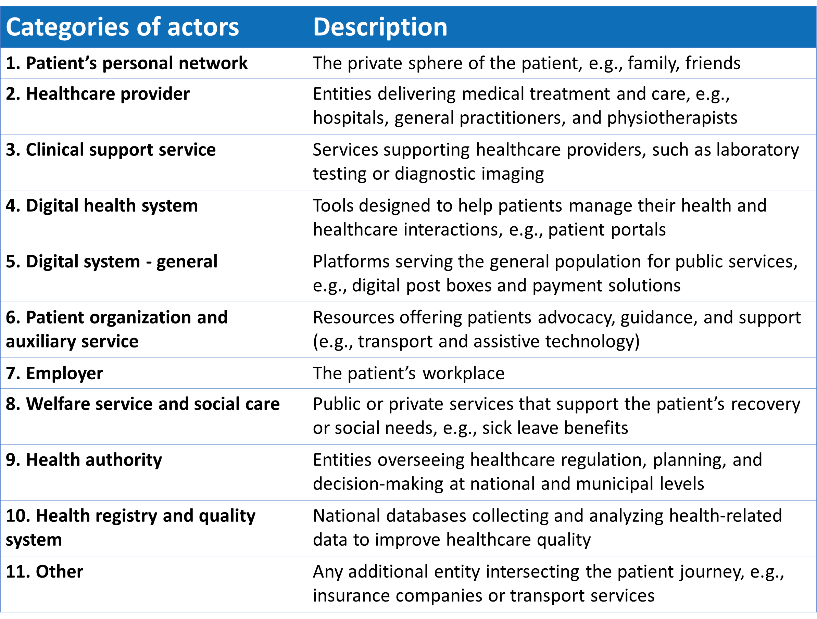
Actor categories with explanations

Slide 9
Lessons learned from a pilot study
Patients typically refer to healthcare providers at varying levels of detail — from broad terms like “hospital” to specific roles such as “nurse in the neurology department.”
The majority of actors belonged to Healthcare providers (74%) and Digital health systems (13%).
Together, these two categories represented most of the actors identified in the study

Slide 10
More information

Slide 11
Summary
Patient journeys involve a broad range of actors beyond formal healthcare roles.
Eleven actor categories were inductively identified from patient-reported touchpoints across multiple studies.
Most interactions relate to healthcare providers and digital health systems, showing how care depends on both human and digital actors.
Patients describe actors with varying specificity, revealing how they understand and navigate the system.
The classification strengthens journey mapping, modelling, and system-level improvement efforts.

Slide 12
More information is available here:
Halvorsrud, R., Larsen, A. G., Elvesæter, B., & Melby, L. (2025).
Towards a Formal Framework for Modeling Patient Journeys. In MEDINFO 2025—Healthcare Smart× Medicine Deep (pp. 1578-1579). IOS Press.
https://ebooks.iospress.nl/volumearticle/74138

