Slide 1

Kidney cancer patient journey
Case study
Responsible: Anna Grøndahl Larsen, SINTEF Digital
Date: Aug 5, 2025
Version: v2
Type: Patient journey
Health condition: Kidney cancer
Language: English

Slide 2



Content
About
About the case study
Visuals/Diagrams/Content
More information
This document is part of the Pathway Toolbox www.cjml.no/health
Developed within the Pathway research project (2021–2025)
Project partners:
SINTEF Digital, Norway
University of Oslo, Norway
Aalto University, Finland
Funded by:
The Research Council of Norway

Slide 3

About the case study
Context
Researchers involved
Method

Slide 4

About the case study
Context
  A pilot study with n=4 kidney cancer patients
  Phase: From diagnosis through treatment
  Where: a major university hospital in Norway
  When: 2022-2023
Researchers involved
  Anna G. Larsen, SINTEF Digital
  Kristine Gjermestad, SINTEF Digital
  Ragnhild Halvorsrud, SINTEF Digital
Method
  Data collection: Longitudinal study consisting of a start interview, a structured diary for detailed mapping of the patient journey, and a debrief interview
  Data analysis: Touchpoints were identified and categorized across diary and interview data. The resulting data was used to describe and model the kidney cancer patient journey using CJML.

Slide 5
Visuals - diagram
The next slides show an overview of one patient journey, including description and diagrams.
The diagram spans 4 pages.

Slide 6
Description of patient journey
The patient was in his fifties, worked full-time, and lived a busy life.
His patient journey began when he experienced severe abdominal pain while travelling. He visited a local emergency care unit and was subsequently referred to the nearest hospital, where he was diagnosed with an incarcerated hernia. Simultaneously, a CT scan revealed a tumor in his kidney. Consequently, the hospital referred the patient to his hometown hospital for follow-up and further evaluation.
Some weeks later, the patient was notified of a follow-up appointment at the Department of Urology at his hometown hospital. After some back and forth, including further consultations and testing, the patient received notifications about preoperative assessment and surgery appointments.
Approximately ten days post-surgery the patient received a phone call from the operating surgeon, informing him that he was considered cancer-free. This was confirmed during a scheduled hospital appointment a few weeks later, after which the patient was put on a schedule for half-yearly CT-scans as a routine post-surgery check-up.

Slide 7
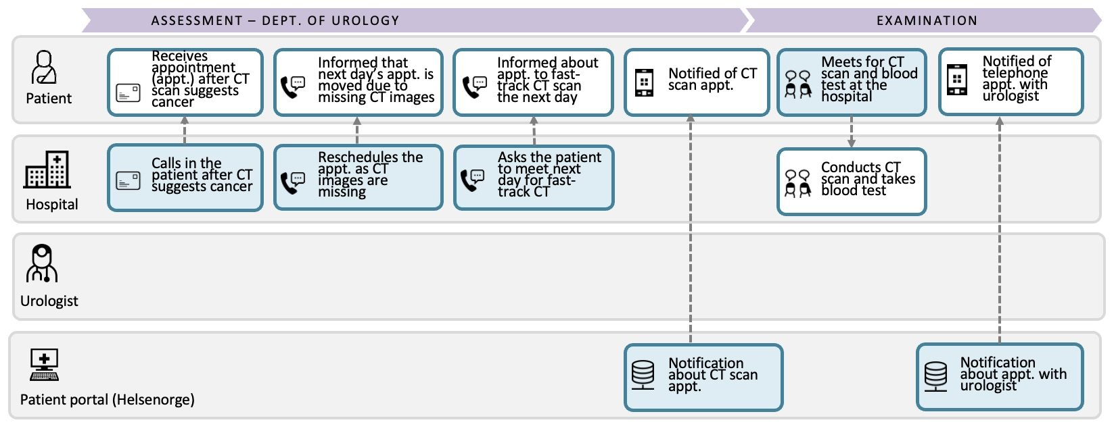
Diagram of kidney cancer patient journey kidney (1/4)

Slide 8
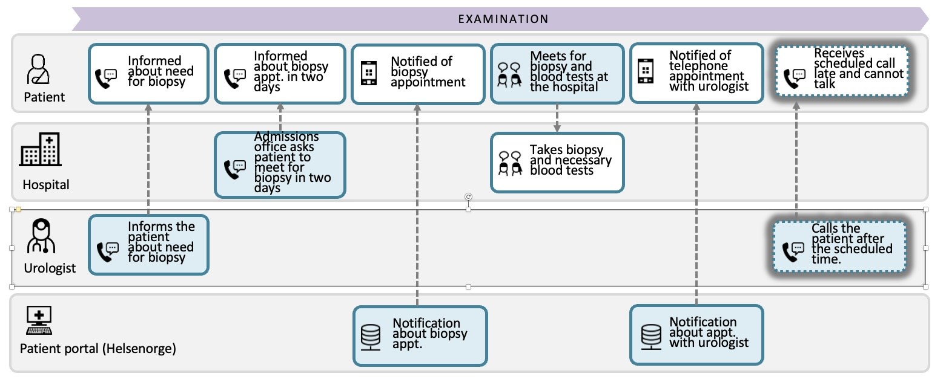
Diagram of kidney cancer patient journey kidney (2/4)

Slide 9
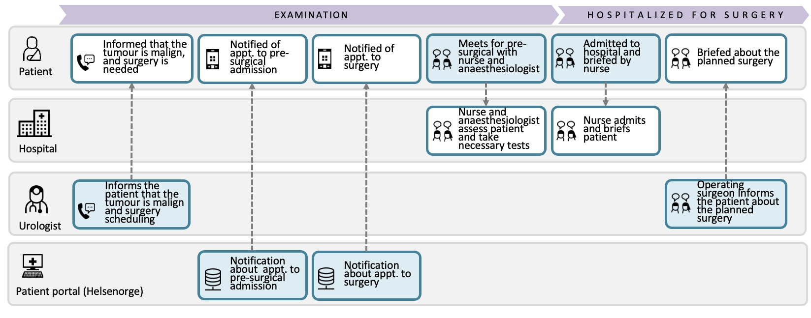
Diagram of kidney cancer patient journey kidney (3/4)

Slide 10
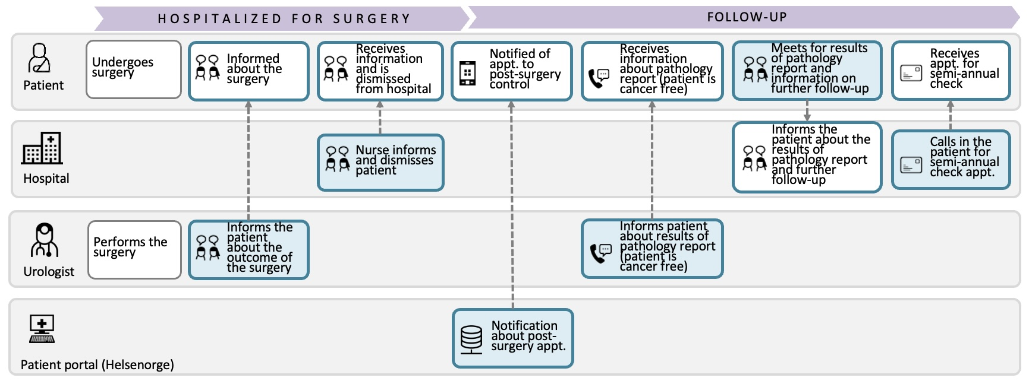
Diagram of kidney cancer patient journey kidney (4/4)

Slide 11
More information

Slide 12
Relevant publications
Further details can be found here:
Larsen, A.G., Halvorsrud, R., Berg, R.E., Vesinurm, M. (2024). Dual perspective modelling of patient pathways: A case study on kidney cancer. In: Särestöniemi, M., et al. Digital Health and Wireless Solutions. NCDHWS 2024. Communications in Computer and Information Science (CCIS,volume 2084)

