Slide 1

Kidney cancer patient pathway
Case study
Responsible: Anna Grøndahl Larsen, SINTEF Digital
Date: Aug 5, 2025
Version: v2
Type: Patient pathway
Health condition: Kidney cancer
Language: English

Slide 2



Content
About
About the case study
Diagrams
More information
This document is part of the Pathway Toolbox www.cjml.no/health
Developed within the Pathway research project (2021–2025)
Project partners:
SINTEF Digital, Norway
University of Oslo, Norway
Aalto University, Finland
Funded by:
The Research Council of Norway

Slide 3

About the case study
Context
Researchers involved
Method

Slide 4

About the case study
Context
  A study mapping kidney cancer pathway from hospital perspective
  Phase: From diagnosis through treatment
  Assumptions: model the patient pathway of patients that seek medical care due to hematuria and exclude patients that are diagnosed amid investigations for other conditions. We also focus on patients that undergo surgical treatment without post-surgery complications.
  Where: a major university hospital in Norway
  When: 2022-2023
Researchers involved
  Anna G. Larsen, SINTEF Digital
  Kristine Gjermestad, SINTEF Digital
  Ragnhild Halvorsrud, SINTEF Digital
  Line Melby, SINTEF Digital
  Binyam Bogale Bungudo, University of Oslo
Method
  Data collection: The mapping of the patient pathway was conducted through a combination of information search, observation, and workshops involving relevant healthcare personnel.
  Analysis: Carried out as a continuous, iterative process where initial data formed the basis of initial overviews of the pathway, which again were shown to practitioners and revised.

Slide 5
Visuals - diagram
The next slides show an overview of the patient pathway, including description and diagram.
The diagram spans 2 pages.

Slide 6
Description of patient journey
From the hospital perspective, the planned pathway typically begins when they receive a referral from a general practitioner, although sometimes the patient is referred from another hospital. The patient has usually undergone a CT scan that revealed a renal tumour. A urologist at the Department of Urology then assesses the referral and formally confirms the start of the kidney cancer patient pathway
A weekly multi-disciplinary team meeting (MDT) is held among healthcare professionals to discuss patient cases. Leveraging the combined expertise of each team member and considering the specific needs of each patient, the MDT recommends a treatment plan. This plan is documented and discussed with the patient via a telephone call or a follow-up appointment. The outcomes of the MDT meeting can include surgery, biopsy, and active monitoring. This case study focuses on the planned pathway for patients undergoing surgical treatment.
Approximately one week prior to the scheduled surgery, the patient attends a pre-surgical assessment appointment with a surgical intern, nurse and an anaesthesiologist.
The patient is admitted to the hospital on the day of surgery or the day before. Upon arrival, they are greeted by a nurse who explains the processes. Then, the patient meet the operating surgeon. After the surgery is completed, the patient is transferred to the recovery unit where they are closely monitored by a perioperative nurse. The patient meets with the surgeon to be informed of the outcome of the operation, before being moved to an inpatient room for postoperative care.
Patients are usually dismissed from the hospital 2-7 days after surgery. Upon discharge, they receive post-procedure instructions. Approximately 4 weeks after surgery, patients attend a scheduled appointment at the post-treatment clinic, where they are informed about the surgical pathology report and plans for further follow-up.

Slide 7
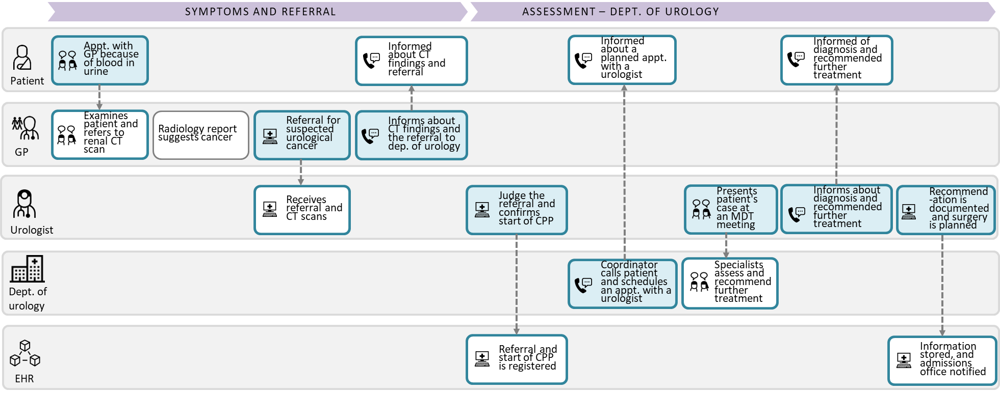
Diagram of kidney cancer patient pathway(1/2)

Slide 8
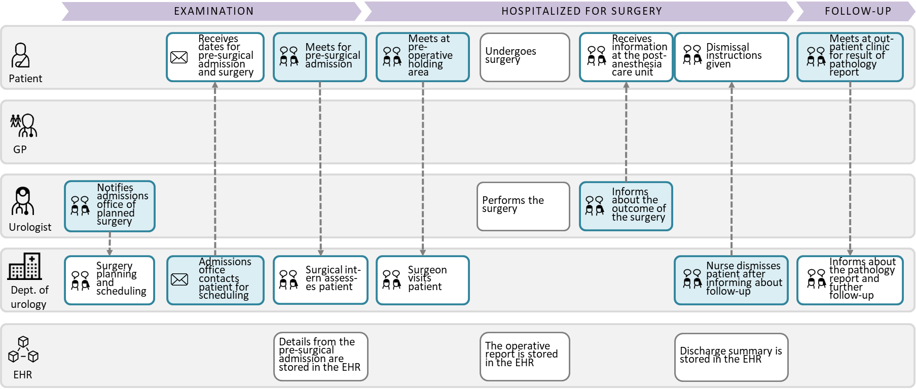
Diagram of kidney cancer patient pathway(2/2)

Slide 9
More information
Relevant publications

Slide 10
Relevant publications
Further details can be found here:
Larsen, A.G., Halvorsrud, R., Berg, R.E., Vesinurm, M. (2024). Dual perspective modelling of patient pathways: A case study on kidney cancer. In: Särestöniemi, M., et al. Digital Health and Wireless Solutions. NCDHWS 2024. Communications in Computer and Information Science (CCIS,volume 2084)

