Slide 1

Kidney cancer patient pathway
Case study
Responsible: Märt Vesinurm, Aalto University
Date: Aug 7, 2025
Version: v1
Type: Patient pathway
Health condition: Kidney cancer
Language: English

Slide 2



Content
About
About the case study
Visuals/Diagrams/Content
More information
This document is part of the Pathway Toolbox www.cjml.no/health
Developed within the Pathway research project (2021–2025)
Project partners:
SINTEF Digital, Norway
University of Oslo, Norway
Aalto University, Finland
Funded by:
The Research Council of Norway

Slide 3

About the case study
Context
Researchers involved
Method

Slide 4

About the case study
Context
  A pilot study with n=3 healthcare professionals specialized in kidney cancer and n=1 patient.
  Expert evaluation workshops (n=2) with total (n=9) participants.
  Phase: From diagnosis through treatment
  Where: a major university hospital in Finland
  When: 2023-2025
Researchers involved
  Märt Vesinurm, Aalto University
  Essi Miettinen, Aalto University
  Paul Lillrank, Aalto University
Method
  Empirical approach: the study followed a design science research (DSR) process, which included workshops, artefact development, and the collection and evaluation of the models

Slide 5
Visuals - diagram

Slide 6






Kidney cancer CJML model based on workshops on 5.4., 12.4. & 22.5.
Primary healthcare
Notices weight loss, anemia, usually minor symptoms
Goes to the doctor's office. Tells about the symptoms.
Lets measure.
Receives information and referral about further studies.
Patient
Receives patient. Evaluates symptoms.
Checks patient’s iron values.
Researches and excludes options based on the results.
Chooses next steps & examinations.
Refer the patient to follow-up imaging, if necessary.
Referral, based on urgency
GP in Primary healthcare
Receives a referral.
Evaluation of the case and urgency.
GP in Central Hospital
Receives patient. Evaluates symptoms.
Takes the same steps as on the public side.
Researches and excludes options based on the results.
Finds cancer on the private side.
Contacts cancer centre directly.
Private Dogrates doctor
can also send without urological phase.
Receives patient. Evaluates symptoms.
Takes the same steps as on the public side.
Researches and excludes options based on the results.
Chooses next steps & examinations.
Refer the patient to follow-up imaging, if necessary.
Referral to urologist, based on urgency.
The occupational health doctor
can make a referral to an urologist.

Slide 7




Primary healthcare
Special healthcare
WAITING TIME
Finds out about the tumour.
Finds out about the surgery.
Stage 1-2/3
Gets a time for imaging.
Goes to the imaging.
Patient
Stage 3-4
Finds about a spread tumour.
Request to book imaging.
GP in Central Hospital
Stage 1-2/3
Tumour has not spread.
Tells that a tumour is found.
Tells about the upcoming surgery.
Evaluates results from imaging.
Finds a tumour.
Urologist
Tumour has spread.
Sends referral to cancer centre.
Tells that a spread tumour is found, follow-up from cancer centre.
Stage 3-4
Books time for imaging.
Messages in MAISA or by letter about the upcoming appointment.
Receives the referral.
Ward Secretary
Appointment and Surgery Scheduler
Makes an imaging request to the urologist.
The occupational health doctor

Slide 8



Special healthcare
Special healthcare
2 weeks delay
Stage 1-2/3
Gets a time for surgery.
Goes to surgery.
Gets surgery.
WAITING TIME
Patient
Waits for more information.
Gets times for next steps.
Goes to additional examinations.
Chooses whether wants to get results beforehand.
Stage 3-4
Stage 3-4
Stage 1-2/3
Requests to book surgery.
Performs a surgery on the tumour.
Urologist
E.g., need to take a test piece? Performs a cross-scoring of the patient.
Stage 3-4
Receives the referral and checks patient’s case.
Goes to common cancer meeting.
Presents patient’s case. Choosing next steps & examinations.
Discussing what type of treatment would work?
Requests to book additional examinations.
Assesses the urgency of the situation!
Gives a recommendation for 1st line treatment.
Gives the opportunity to know in advance about the results.
Kidney Cancer Specialist 1
Forwards the referral.
Ward Secretary
Books time for surgery.
Messages in MAISA or by letter about the upcoming surgery.
Receives the request.
Books times for additional examinations.
and to the first appointment with the kidney cancer specialist.
Appointment and Surgery Scheduler
Evaluation of the situation.
Discussing.
Gathering cancer treatment meeting,

Slide 9
Special healthcare
Receives next appointment.
Meets for an appointment with KC* specialist.
Receives information on the next steps.
Gets forms to fill.
Goes to meet nurse
Patient
*Kidney Cancer
Gets ready to receive patient.
Nurse
Requests to book first appointment.
Presents the patient’s case to their own cancer doctor.
Kidney Cancer Specialist 1
Receives patient to take care.
Meets nurse.
Meets patient.
Tells about the situation, what happens next.
Gives forms to fill.
Hands the patient over to the nurse.
Kidney Cancer Specialist
Books the time.
Sends information to patient.
Ward Secretary

Slide 10
Special healthcare
Meets nurse.
Listens, asks, whatever comes to mind.
Gets information about the next steps.
Discussing with the nurse about possible medicines.
Hears information, gets support.
Gets contacts.
Gets a time.
Gets next appointment.
Patient
Meets patient.
Gives a lot of new information.
Instructs about the next steps.
Introduces possible medicines.
Focuses on improving immunity, etc. Supports the patient.
Gives contact information; meets with another nurse later.
Books a time for head scan.
Books next appointment: either a reception or a call time.
Nurse
Kidney Cancer Specialist

Slide 11


Special healthcare
Gets new appointment time.
Goes to head scan: mandatory for immunological treatment.
Fills in requested forms.
Goes to meet nurse.
Patient
Gets new appointment time.
Urgent case: reception within a few days.
Calls the patient.
Books new appointment based on urgency.
Gets ready to meet patient: Receives medication instructions.
Nurse
Sends a letter.
Unurgent case.
Goes through the given forms.
Makes a decision about starting medication.
Requests to invite to an appointment.
Meets nurse: gives medication instructions.
Kidney Cancer Specialist

Slide 12

Duration of effect: 1 month.
Special healthcare
Start of treatment
Surveillance of treatment
* See KELA Reimbursement Process
WAITING TIME
Pills
Gets a recipe and and next appointment time.
Waits until KELA Reimbursement has approved.*
Goes to pharmacy to get pills. Starts medication.
Before the second infusion:
Receives information on medication.
Gets blood tests.
Going to the drug tolerance appointment.
Patient
Will get a call about the reception time.
Gets time for the IV.
Goes to first infusion. Starts medication.
Gets time for next infusion.
Intravenous
Always before a new treatment and appointment.
Tells how to start the medication.
Gives information on next appointment.
Books time for the start of the IV medication.
Nurse
Gives infusion.
Books next infusion, every 4 weeks.
Infusion nurse
Receives patient. Tests tolerance.
Hospital lab
Treatment Surveillance Process

Slide 13
Surveillance of treatment
Medication didn’t work.
Meets for an appointment with KC specialist.
Gets a new treatment plan.
Receives information on next appointment.
Receives information.
Patient
Gets a call.
Gets information about next steps.
WAITING TIME
Medication worked.
2-3 months
Books based on requests.
Sends information to patient.
Books based on requests.
Sends information to patient.
Nurse
The disease progressed during treatment.
Requests to book an appointment.
Meets patient.
Instructs about transitioning to next* line treatment.
Requests to book next appointment.
The doctor decides the nature of the contact. It depends on the functionality of the medicine and e.g. the patient's condition
Evaluate the effectiveness of the medication.
Kidney Cancer Specialist
*2nd, 3rd, Etc.
The medication worked, the disease did not progress.
Requests to book a call time.
Calls the patient.
Decides on the next contact, the same treatment continues.
Treatment Surveillance Process.

Slide 14
Surveillance of treatment
Repeat of Treatment Surveillance Process
until medication works.
Gets blood tests.
Comes to control visit.
WAITING TIME
Patient
If nothing works, condition is maintained as well as possible until terminal care.
Nurse
Control visit: checks the situation.
Kidney Cancer Specialist
New meeting every 3 months after the 1st and 2nd meeting.

Slide 15

Continuation or end of treatment
The cancer has spread and the condition is maintained with medication.
Under surveillance for the rest of their life.
Patient A
Cancer tumour removed in surgery.
Is in surveillance for 5 years
OVER 5 YEARS
The symptoms start again and goes to the doctor.
Eoes the initial steps again.
Goes to imaging.
Gets surgery, again.
Patient B
If nothing comes up, patient is ”cancer free”.
Finds a new tumour.
If stage 1-2/3, will perform a surgery.
Performs the surgery.
Urologist
If stage 3-4, will take responsibility.
Kidney Cancer Specialist

Slide 16

Unclear situations in treatment, initial communication disruptions.
Does not want to share patient information.
Notices weight loss, anaemia, usually minor symptoms
Makes an appointment for primary healthcare.
Decides whether wants to share their data.
Gets the appointment.
Meets for an appointment with GP.
Patient
Agrees to the sharing of patient information.
Have to ask the patient's permission to request the data.
Requests if patient’s data can be shared.
Confirms the appointment.
Ward Secretary
If no patient data, next steps take longer.
Receives information
Notices that patient's information comes from a different recording system.
Asks the department secretary to request health information.
Receives patient.
GP in Central Hospital
If patient data OK, things progress smoothly.
The same also applies to lab results.

Slide 17

Unclear situations in treatment, uncertainty about the situation.
Calls to call back centre.
Gets a call back.
Okay => Goes to emergency.
Gets an answer.
Goes to emergency.
Cannot wait.
Uncertainty about the situation. Contacts help.
Patient
Sends a message in MAISA (or NOONA).
Gets a call. Decides whether can wait.
Can wait.
Gets information on the next steps.
Goes to blood test.
Responsible for MAISA's follow-up, forwards to the nurse if treatment related.
Ward Secretary
No.
Tells to go to emergency.
Call-back added.
Calls patient. Evaluates the issue: can patient wait?
Call Back Centre
Forwards to the nurse or secretary based on issue.
Yes.
Knows how to respond to the question; related to treatment.
Answers in MAISA.
Evaluates the situation.
Nurse
The situation is critical and doesn’t know how to respond (e.g., a lot of nausea).
Calls patient. Evaluates the urgency: can patient wait?
Consults doctor.
Books times.
Gives an appointment time; go to blood test before.
Discusses the options.
Invitation to the reception and referral to the labs.
Evaluates the blood test results.
Kidney Cancer Specialist

Slide 18
Treatment disruptions; patient tends to forget labs.
Get a reminder to visit the lab.
Gets extra reminder.
Goes to blood test.
Meets for an appointment with KC specialist.
Hears about the change of medication.
Get more information about new medication.
Patient
Asks after if still needed.
Ward Secretary
Receives patient.
Goes through the new medication and record.
Records information to Apotti.
Nurse
Hidden message in the calendar: has the patient been to the lab? Has not.
Calls the patient and asks to visit the lab.
Evaluates the test results.
Meets patient.
Let's change the medication.
Hands patient over to the nurse.
Kidney Cancer Specialist

Slide 19
Treatment disruptions; patient forgets the appointment.
Gets a call.
Forgets to come to the appointment.
Gets a call.
Tells the reason.
Goes to blood test.
Gets the new contact details.
Patient
Meets for an appointment with KC specialist.
A report on missing a meeting is always recorded in the Apotti.
Can also call after instead of the doctor.
Finds out why they didn’t come to the appointment.
Books the new contact time.
Sends details.
Documents in the register if the type of reception changes.
Nurse
Results OK, just need a new call time.
Calls patient and tells the situation.
Calls the patient and asks where they are.
Evaluates the blood test results.
Requests to book a new contact.
OR
Kidney Cancer Specialist
The results are NOT OK, an urgent new appointment is needed.
Receives patient.

Slide 20
The patient needs help or support services.
Goes to the first appointment.
Needs additional support, asks for it in the meeting.
Hears from different parties
Asks for referral to PhycSOS.
Receives the referral.
Uses PhycSOS’s services.
Patient
Needs additional support later.
Contacts the nursing staff.
Listens for the need for help
Suggests alternatives, e.g. about the PhycSOS
Handles the referral.
Requests to make the referral.
Nurse
Tells about the support options already at the first meeting.
Makes the referral.
Sends the referral to patient.
Kidney Cancer Specialist

Slide 21


Decision should come within a few days.
A new Kela Reimbursement
KELA Reimbursement Process
WAITING TIME
Gets a new Kela reimbursement statement.
Waits for the decision. Follows the process from OmaKanta.
Looks up the KELA reimbursements provided.
Receives decision and the new Kela card.
Gets medication at the pharmacy with Kela card.
Patient
Gets the statement.
Faxes the statement to Kela.
Ward Secretary
Writes a B statement.
Prints the statement.
Signs the statement.
Sends the statement forward.
If it's a hectic day, this can be missed.
Kidney Cancer Specialist
Gets the faxed statement.
Uploads KELA reimbursement provided to Kela e-service.
Sends the approval and new Kela card.
Can get stuck to the system.
KELA
KELA Reimbursement Process

Slide 22

Renewal of Kela Reimbursement decision
Medication on break for a while, etc., Kela card expired/expiring: patient responsible of the renewal.
Goes to pharmacy.
Okay.
Can't get medicine with reimbursement / Gets medicine but needs a new statement soon.
Gets the new time.
Meets for an appointment with KC specialist.
Patient
Notices that the Kela Reimbursement has expired.
KELA-reimbursed medicines cannot be given.
Serves the customer.
Notifies the customer.
The pharmacist can also call the doctor and inform.
Pharmacy
Notices that the Kela Reimbursement is about to expire.
Books the new time.
Notifies the patient of the new B-statement time.
Ward Secretary
Gets a call and information about expiration.
Requests to book a new B statement appointment in a few days.
A new compensation decision is being worked on. => KELA Reimbursement Process
Kidney Cancer Specialist

Slide 23
CJML development ideas
This case study also developed possible improvement points for CJML

Slide 24
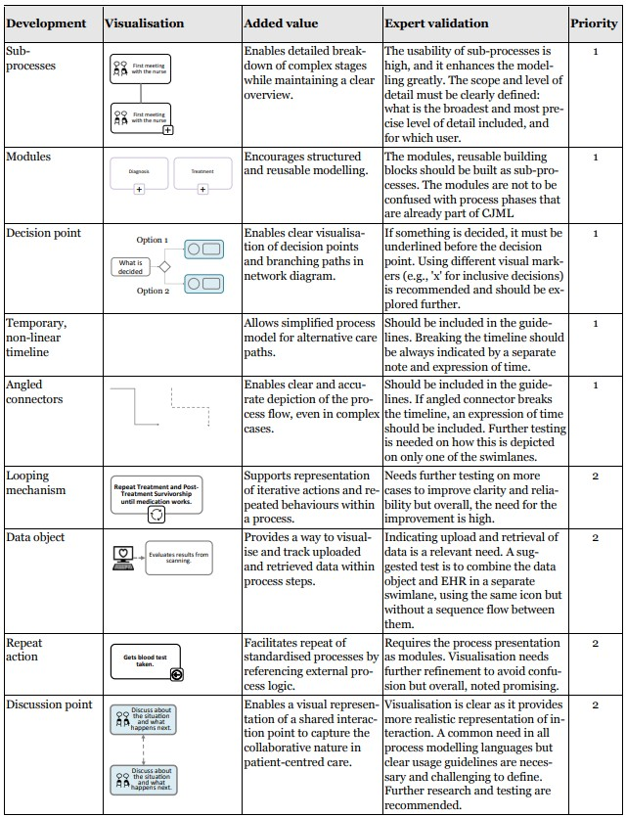
Improvement
proposals

Slide 25
More information

Slide 26
Relevant publications
Further details can be found here:
Miettinen, E. (2025). Modelling Complex Patient Proceses in a Multi-Producer Environment. A Design Science Approach Using Patient-Centered Modelling for Kidney Cancer Care Process. Master’s Thesis. Aalto University.

