Slide 1

Critical incidents in cancer patient journeys
Case study
Related toolbox element: <method:Critical Incident Technique>
Responsible: Ingrid K. Ledel Solem, SINTEF Digital
Date: August 29, 2025
Version: v1
Type: Patient journey
Health condition: Cancer
Language: English

Slide 2



Content
About
About the case study
Applying CiT in the cancer patient journey: results and visualizations
More information
publications
This document is part of the Pathway Toolbox www.cjml.no/health
Developed within the Pathway research project (2021–2025)
Project partners:
SINTEF Digital, Norway
University of Oslo, Norway
Aalto University, Finland
Funded by:
The Research Council of Norway

Slide 3

About the case study

Slide 4
About the case study
Context
Aim: Using CIT to collect positive and negative critical incidents in cancer patients’ journeys
41 participants; 28 cancer patients and 13 next-of-kins
When: 2022-2023
Researchers involved
Ingrid K. Ledel Solem, SINTEF Digital
Line Melby, SINTEF Digital
Kristine Gjermestad, SINTEF Digital
Ragnhild Halvorsrud, SINTEF Digital
Methods
Framework: the critical incident technique
Data collection: applying CiT in online workshops (n=3), interviews (n=6) and questionnaires
Data analysis: deductive quantitative approach + inductive content analysis

Slide 5

Collecting critical incidents: Data collection methods
Three complementary data collection methods were used the gather critical incidents:
Digital workshops with patients and next-of-kin (n=3)
Supplementary questionnaire to participants included in the workshops, providing background questions and the same trigger questions
Individual interviews with patients (n=6)
All methods aimed to capture real, specific incidents related to communication, information, and coordination
Using multiple formats allowed us to compare and enrich the insights

Slide 6
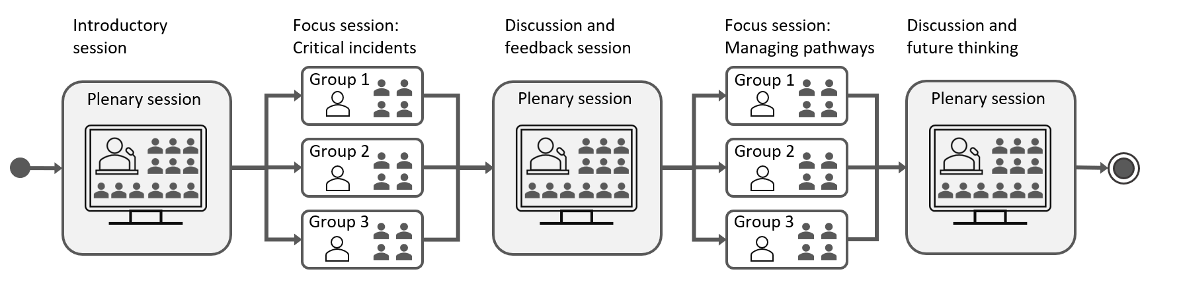
Workshop structure and flow
The main data source was a series of three structured online workshops
Each workshop included:
Plenary introduction and warm-up
Breakout sessions to share critical incidents
Plenary feedback and thematic discussions
Participants reflected on both positive and negative incidents
The structure enabled open sharing, peer validation and iteration

Slide 7
Results and visualizations
Examples of critical incidents
Data processing and extraction of incidents
The patient as messenger
Results from the deductive quantitative analysis
Results from the inductive qualitative analysis

Slide 8
Examples of critical incidents
Positive
Negative
My GP has been a stable rock while everything else has been chaotic. Even though he is not necessarily very involved in the actual treatment process, he always makes time, clears his schedule, and even gave us his private number. We haven't used it, but just the fact that he offered it is reassuring.
It started with a doctor from [hospital] calling and telling my wife: Your cancer is very serious. I don't know anyone who has survived, so you should expect this to be your last Christmas. He said this on December 15th. [She lived for 10 more years].
It was the doctor who both informed me that I had breast cancer and whom I also spoke with before and after the surgery. He was very, very supportive and explained everything very well. Unfortunately, he has now retired. They called him a “living Valium.” He was so calming; he was absolutely wonderful.
Before I was told that I had a serious illness, I was given an MRI report that described widespread cancer spread, without anyone talking to me about it or going through the report with me. So, I literally had to Google to find out that I had metastatic cancer.

Slide 9
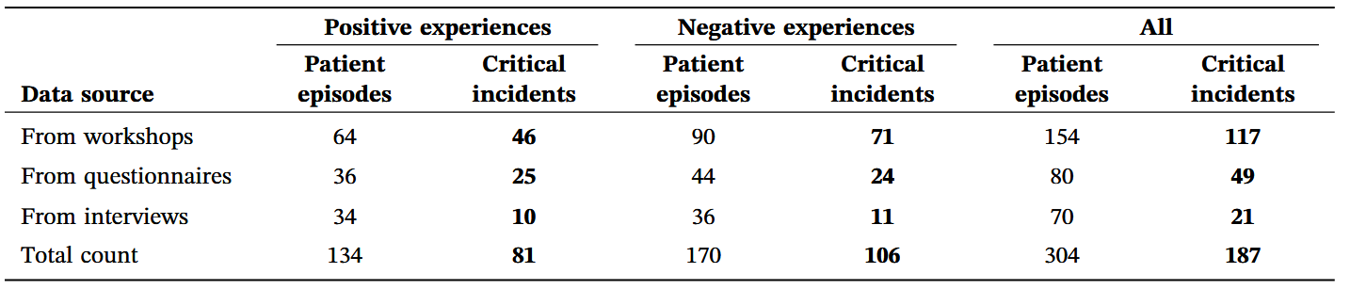
Data processing and extraction of incidents
304 episodes collected:
187 classified as critical incidents → 81 positive, 106 negative incidents

Slide 10
The patient as messenger
In almost 39% of negative incidents, patients had to act as messengers between healthcare providers
This occurred due to poor communication and coordination between hospitals, departments, and care levels
These incidents reflected fragmented health services, disrupted continuity of care, and organizational shortcomings
The chief doctor sent text messages in the evening
and almost around the clock, which was very good.
There was very open communication about my
situation—both about what was good and what was not good.
They tried to send my CT scans from the local
hospital to the regional hospital. This was not
possible. (…) I received a CD (…) and had to drive to
another local hospital which was able to send
[the CD content] to the regional hospital so it was
ready the next day when I arrived and inquired.
Clearly, there is room for improvement.

Slide 11
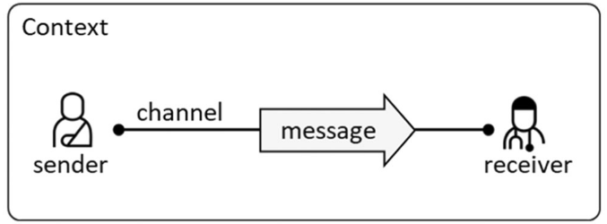
Results from the deductive quantitative analysis
Quantified actors and communication channels involved
Analyzed the incidents using a semiotic communication model, exemplified by a patient sending a message to a doctor
My GP has been a stable rock while everything
else has been chaotic. Even though he is not
necessarily very involved in the actual treatment
process, he always makes time, clears his
schedule, and even gave us his private number.
We haven't used it, but just the fact that he offered
it is reassuring.
My husband was admitted on a Thursday, and the
nurse on duty said I could stay with him as long as
I wanted. On Friday afternoon, however, a new
nurse told me I could only stay two hours each day.
Therefore, I went home after my allotted time on
Saturday. When I returned on Sunday, I was told to
inform our children that he was dying.

Slide 12
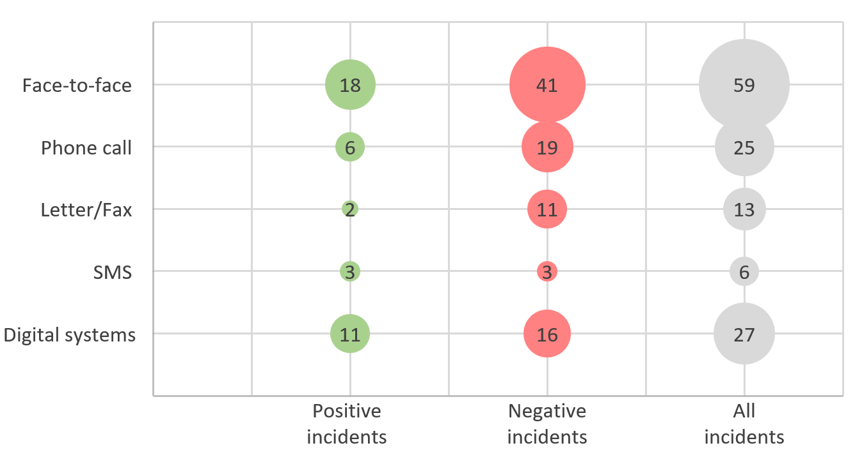
Results from the deductive quantitative analysis: Communication channels
Face-to-face communication was most frequent
Phone calls were valued when they offered quick access or continuity
Letters and faxes were almost entirely negative
Digital systems produced mixed experiences

Slide 13
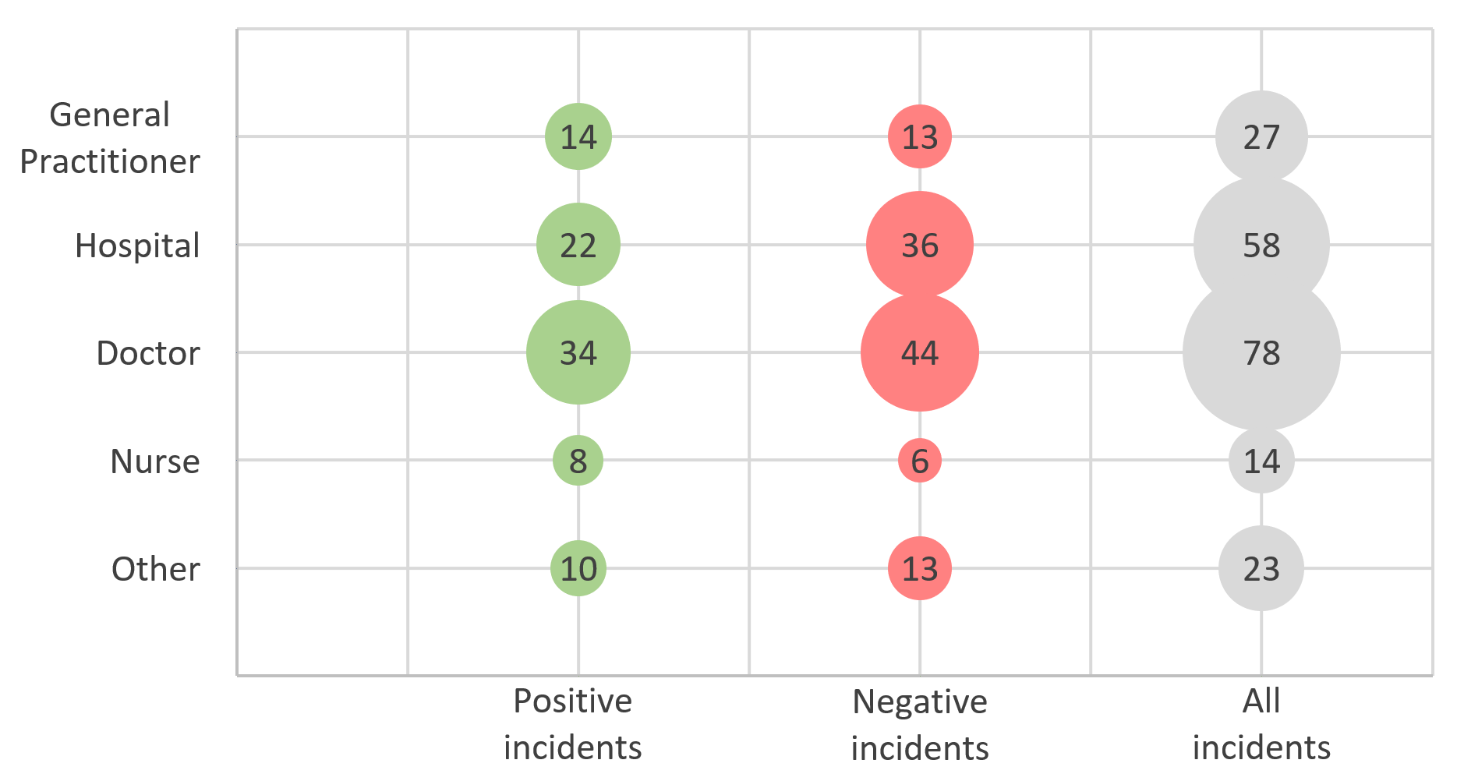
Results from the deductive quantitative analysis: Actors
Doctors were the most frequently mentioned actors, appearing in both positive and negative episodes
Hospitals were also central - patients valued coordinated care and clear explanations
General practitioners were described as “stable rocks,” providing reassurance, though some disappeared after diagnosis

Slide 14
Results from the inductive qualitative analysis
The analysis resulted in 12 categories reflecting aspects participants considered crucial to their perceptions of cancer care as positive or negative.
Categories | Meaning
Access to information | The patient has access to information when desired
Timely information | The information is available for the patient at the right time
Information quality | The information is understandable
Informed healthcare workers | Healthcare workers are informed about the patient's situation
Clinical empathy | Healthcare workers have empathy when interacting with the patient
Patient and next‐of‐kin involvement | Services apply a patient‐centred approach. Services involve next‐of‐kin
Communication and information exchange within the healthcare system | Communication and information exchange within and across healthcare providers is satisfactory
Coordination | Services are experienced as coordinated across healthcare actors
Planned services | The service is predictable
Time and tempo | The service is given in a speedy manner
Access and availability to services | Services exist and have capacity to help the patient
One contact point | Services provide patients with one contact point

Slide 15
More information
Relevant publications
Summary/Key takeaways

Slide 16
Relevant publications
Our application of the method is described in detail in:
Halvorsrud R, Melby L, Gjermestad K, Bogale B, Ledel Solem IK. “I Became the Messenger Between the Hospitals”: A Study on the Journeys of People With Cancer Using the Critical Incident Technique. Health Expectations 2025;28:e70211. https://doi.org/10.1111/hex.70211
More information can be found on: https://cjml.no/health/

Slide 17
Summary/Key takeaways
CIT is a suitable method to capture impactful real-life events in health service contexts
Enables identification of specific, emotionally salient episodes, rather than general impressions or satisfaction
187 critical incidents were identified
More negative (n=106) than positive (n=81) incidents
The negative incidents were more detailed than the positive ones
Incidents found in interviews were longer, while incidents found in questionnaires were shorter
Clinical empathy is crucial when delivering traumatic content such as cancer diagnosis
Safeguards are necessary to prevent patient diagnoses from accidental or premature disclosure through health portals

