Slide 1

MS patient journey
Case study
Responsible: Anna Grøndahl Larsen, SINTEF Digital
Date: September 24, 2025
Version: v1
Type: Patient journey
Health condition: MS
Language: English

Slide 2



Content
About
About the case study
Diagrams
More information
This document is part of the Pathway Toolbox www.cjml.no/health
Developed within the Pathway research project (2021–2025)
Project partners:
SINTEF Digital, Norway
University of Oslo, Norway
Aalto university, Finland
Funded by the Research Council of Norway

Slide 3

About the case study
Context
Researchers involved
Method

Slide 4

About the case study
Context
A longitudinal study with n=9 MS patients
Phase: From app. three years after diagnosis (5-6 months)
Where: Norway
When: 2024-2025
Researchers involved
Anna G. Larsen, SINTEF Digital
Kristine Gjermestad, SINTEF Digital
Ragnhild Halvorsrud, SINTEF Digital
Method
Data collection: Longitudinal study consisting of a start interview, a structured diary for detailed mapping of the patient journey, and a debrief interview
Data analysis: Touchpoints were identified and categorized across diary and interview data. The resulting data was used to describe and model the kidney cancer patient journey using CJML.

Slide 5
Visuals - diagram
The next slides show an overview of one patient journey, including description and diagrams.
The diagram spans pages.

Slide 6
Description of patient journey
Some years prior to participation in the Pathway project, the patient was diagnosed with MS.
During the participation in the project, the patient experienced possible MS symptoms and contacted their GP, which referred the patient to the Department of neurology at the nearest hospital. After assessment by a neurologist, the patient was further referred to an opthalmologist at the hospital. There the patient received treatment and eventually got better.
The patient further received notification of the annual consultation with a neurologist at the hospital, including several reminders, and went to the consultation
Weeks later, the patient received medical treatment for MS at the hospital

Slide 7
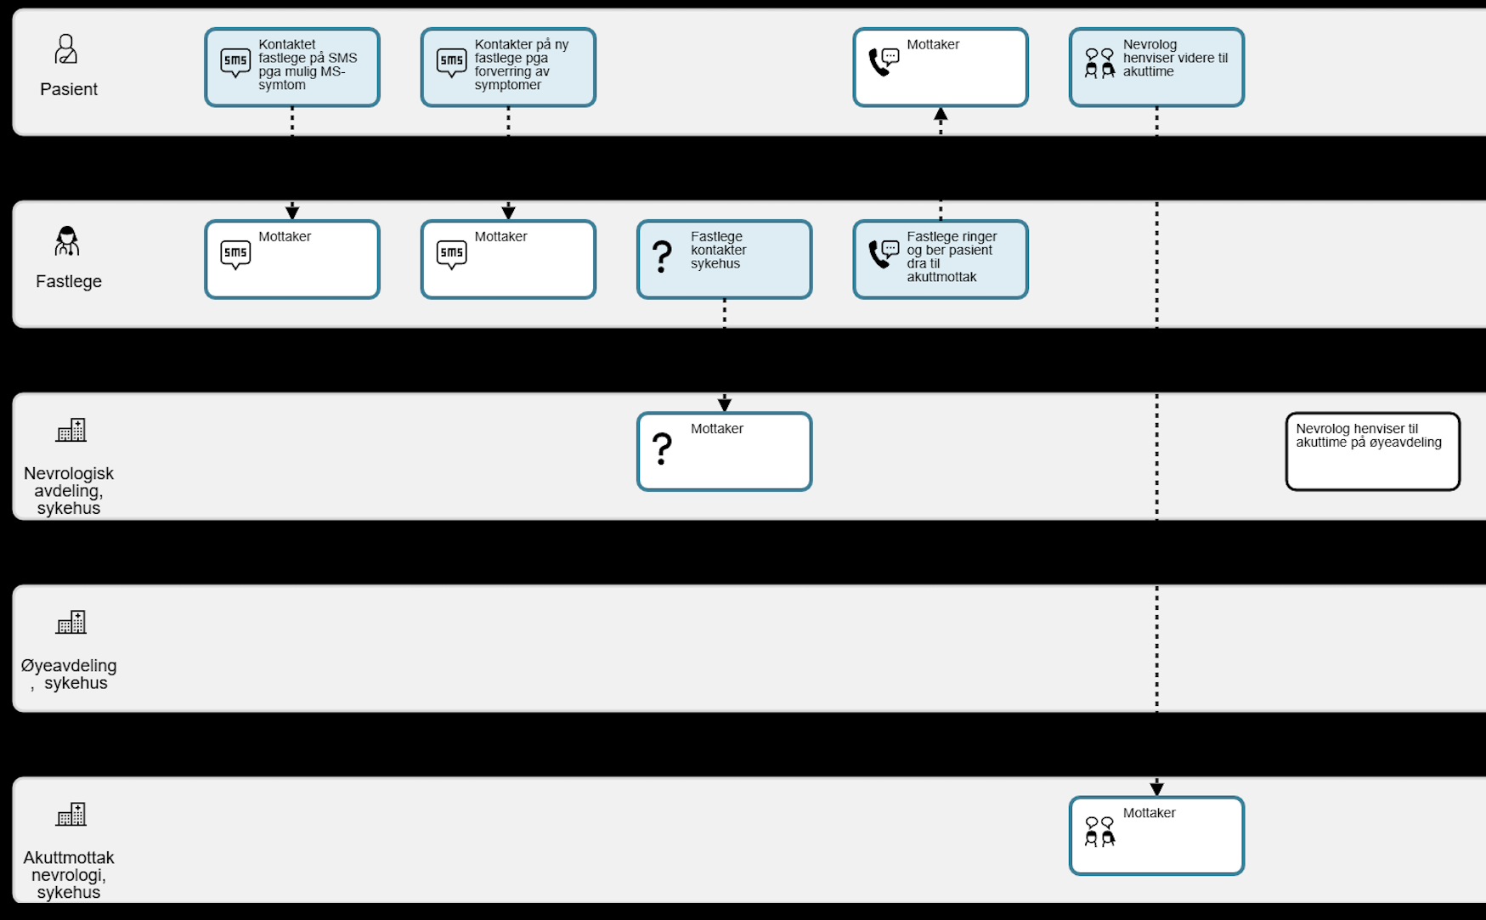
Diagram of patient journey (1/4)

Slide 8
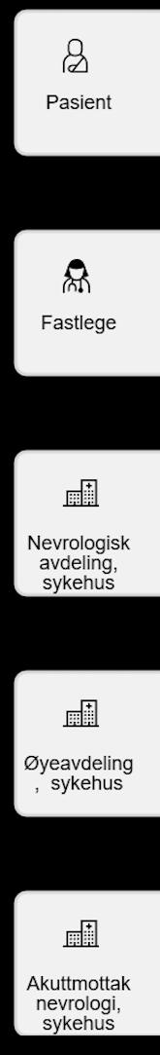
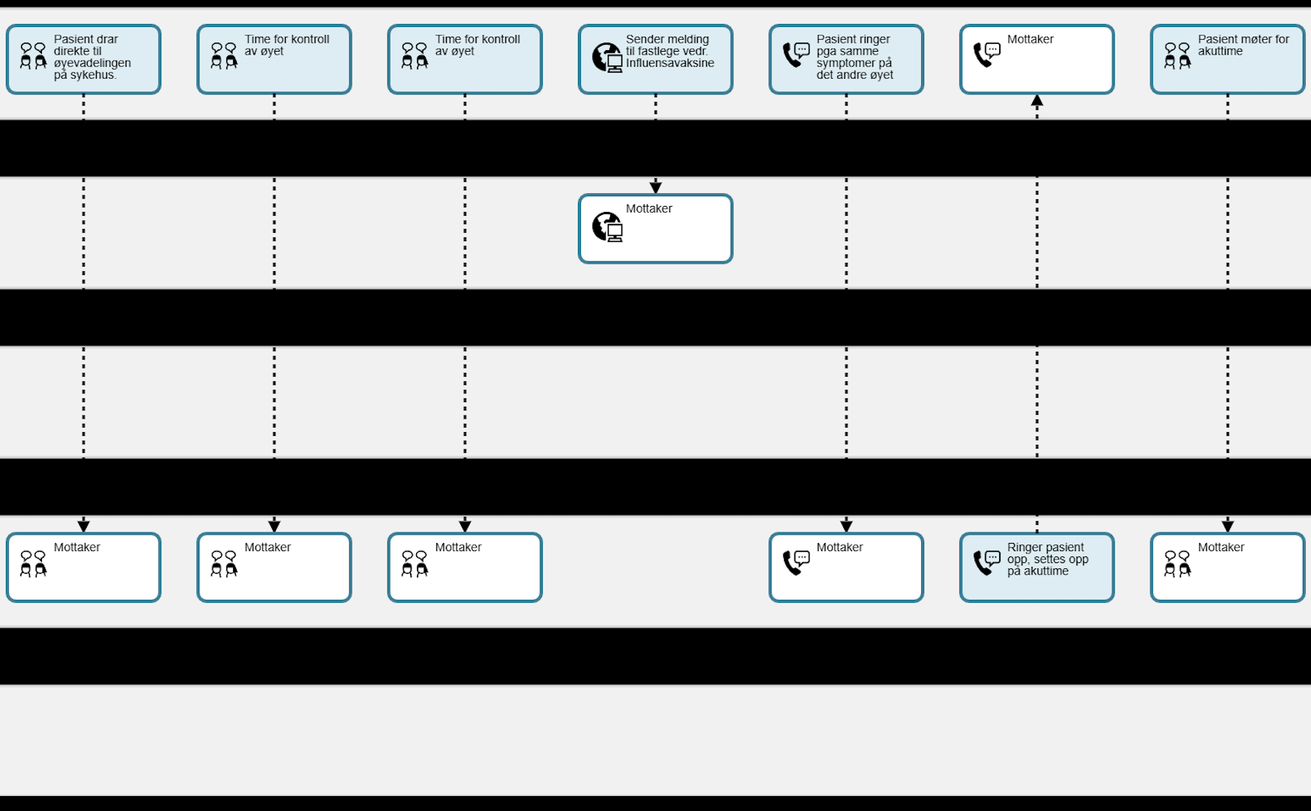
Diagram of patient journey (2/4)

Slide 9
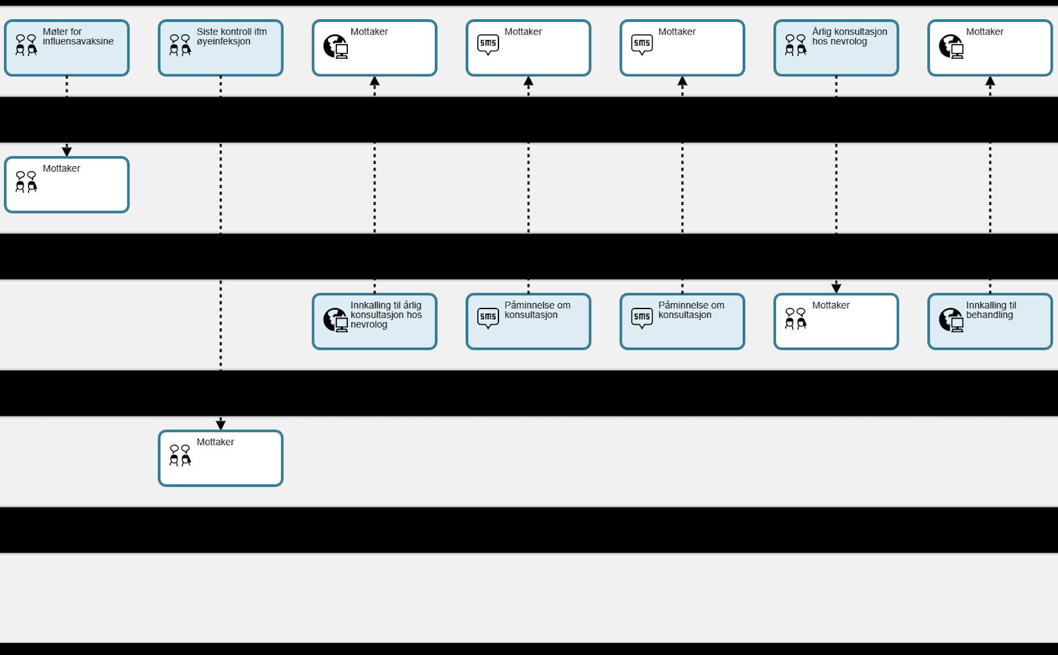
Diagram of patient journey (3/4)

Slide 10
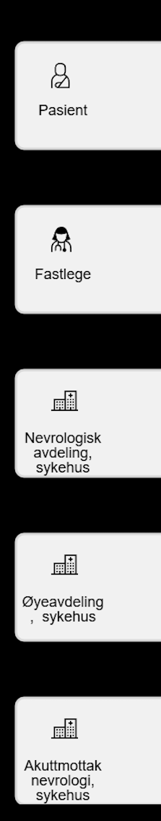
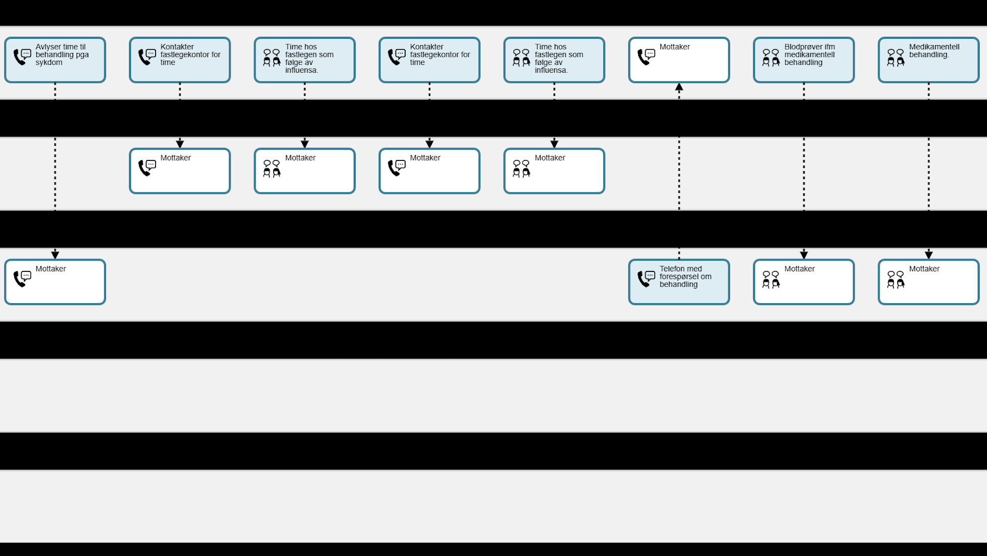
Diagram of patient journey (4/4)

