Slide 1

Patient Journey Disruptions
Method
Related toolbox element: Conceptual analysis of patient journey disruptions
Responsible: Märt Vesinurm, Aalto University
Date: October 2, 2025
Version: v1
Purpose: To identify development points in care processes
Applied by: Researchers and HCPs
Language: English

Slide 2



Content
About
About the concept
Step-by-step guide
Lessons learned
More information
This document is part of the Pathway Toolbox www.cjml.no/health
Developed within the Pathway research project (2021–2025)
Project partners:
SINTEF Digital, Norway
University of Oslo, Norway
Aalto University, Finland
Funded by:
The Research Council of Norway

Slide 3

About the method
Purpose
Context and adaptations

Slide 4

Purpose
Patient Journey Disruptions (PJD) are events that deviate the patient journey from what can reasonably be expected, leading to delays, fragmentation, or unnecessary burden.
Developed in the Pathway project, PJDs provide a systematic way to describe and analyze harmful events in care processes that are primarily managerial rather than clinical.
The concept emphasizes situations where coordination, information flow, or supporting activities fail, even if medical care itself is delivered correctly.
By identifying PJDs, healthcare organizations can better understand obstacles to integrated and seamless care
The PJD framework supports structured improvement efforts by revealing where pathways break down, helping managers target interventions that ensure smooth, value-creating patient journeys.

Slide 5
Context and adaptions
Patients with complex, long-term conditions often encounter fragmented journeys where plans and reality diverge.
In our study, PJDs were refined through expert panels, comparison with related concepts, and pilot interviews with patients and professionals in home care.
This adaptation ensures that PJDs capture both organizational and experiential shortcomings, highlighting where managerial failures derail patient journeys.

Slide 6
Context and adaptions
Key information
  When: 2022-2023
  Participants: Expert steering group, literature review, and semi-structured interviews with home care professionals and patients
  Recruitment: Experts invited via project network; interview participants recruited in collaboration with home care providers
  Ethical consideration: Voluntary participation with informed consent; conceptual work supplemented by empirical feasibility testing
Data collection methods
  Expert group workshops
  Comparative analysis of related concepts
  Semi-structured interviews (professionals & patients in home care)
Data analysis
  Wilsonian concept analysis
  Thematic analysis of interview data
Method adapted by
  Märt Vesinurm and Paul Lillrank (Aalto University)

Slide 7
Step-by-step guide
The next slides provide a step-by-step walkthrough of how to find PJDs in patient journeys.

Slide 8
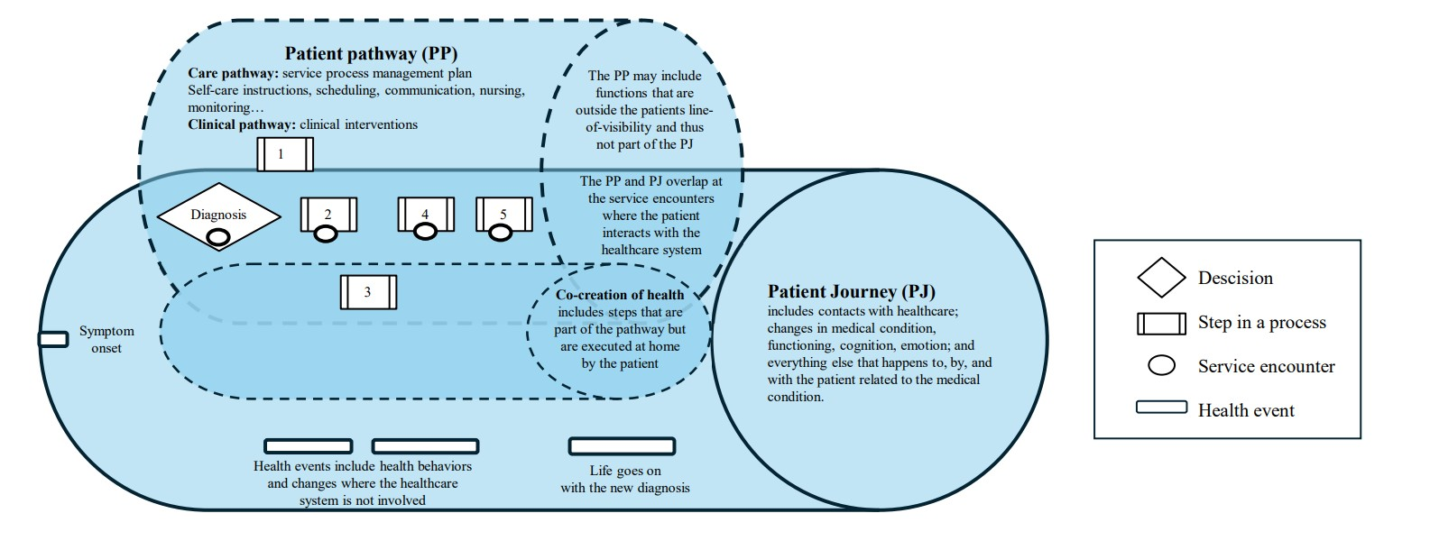
Step 1: Define pathway and journey
Vesinurm, M. (2025). Managing complex patient journeys: A healthcare operations management perspective. p. 23. Doctoral Thesis. Aalto University
A pathway is the planned sequence of clinical and care activities (diagnostics, treatment, information, scheduling, support).
A journey is the realized process: what was done, what happened to the patient, and what was experienced.

Slide 9
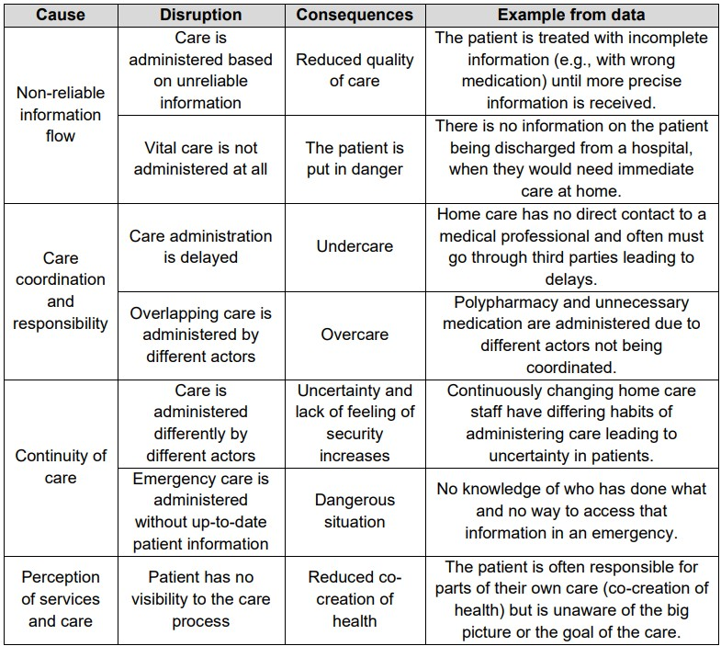
Step 2: Identify disruptions
Example disruptions
Collect events where the journey deviated from reasonable expectations.
Sources: expert workshops, interviews with patients and professionals, electronic health records.
Vesinurm, M., Sylgren, I., Bengts, A., Torkki, P., & Lillrank, P. (2024). Concept analysis of patient journey disruptions: the obstacle of integrated care. Journal of Integrated Care, 32(5), 37-58.

Slide 10
Step 3: Classify disruptions
Distinguish managerial/process disruptions (handover failures, coordination gaps, information delays) from clinical errors.
Define PJDs as agency-based, harmful, and avoidable events in patient journeys.
Use PJDs as a management tool to detect, describe, and prevent breakdowns in patient journeys.
Provides a structured lens for pathway design and journey management.

Slide 11
Lessons learned

Slide 12
Lessons learned (1)
Reasonable Expectation Requirement
A disruption qualifies as a PJD only if it violates what can reasonably be expected in the care process.
Sets a boundary: not every inconvenience or delay is a PJD. Only those beyond normal variability.
Anchors the concept in fairness and feasibility, balancing patient expectations with system realities.
Prevents “over-reporting” of minor deviations, focusing attention on meaningful, avoidable breakdowns.
Provides a practical standard for managers to judge whether an event signals a problem in pathway design or execution.
Weakness: can be a subjective metric in some cases

Slide 13
More information
Key takeaways
Relevant publications

Slide 14
Key takeaways
PJD is a suitable method to capture harmful events in patient journeys
Focuses on deviations from expected care processes, rather than isolated clinical outcomes
Enables systematic classification of breakdowns in coordination, information, and service flow
Positions care experiences in relation to the planned pathway versus the realized journey
Supports a management-oriented perspective by highlighting avoidable process failures
Adaptable to multiple data sources (expert panels, literature, patient/professional interviews, EHRs) for triangulation
Structured attributes (agency, harmfulness, reasonable expectation) make it easier to filter and organize complex disruptions

Slide 15
Relevant publications
Vesinurm, M., Sylgren, I., Bengts, A., Torkki, P., & Lillrank, P. (2024). Concept analysis of patient journey disruptions: the obstacle of integrated care. Journal of Integrated Care, 32(5), 37-58.
Vesinurm, M. (2025). Managing Complex Patient Journeys: A Healthcare Operations Management Perspective.

