Slide 1
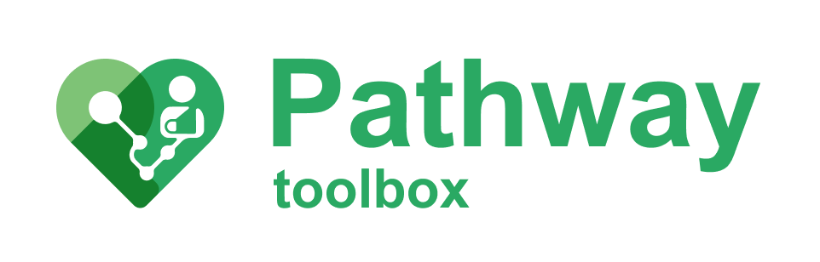
Developing CJML
Method
Related toolbox element: -
Responsible: Märt Vesinurm, Aalto University
Date: October 2, 2025
Version: v1
Purpose: To develop new features to CJML for it better model healthcare processes
Applied by: Researchers
Language: English

Slide 2



Content
About
About the method
Step-by-step guide
Lessons learned
More information
This document is part of the Pathway Toolbox www.cjml.no/health
Developed within the Pathway research project (2021–2025)
Project partners:
SINTEF Digital, Norway
University of Oslo, Norway
Aalto University, Finland
Funded by:
The Research Council of Norway

Slide 3

About the method
Purpose
Context and adaptations

Slide 4

Purpose
To explore how Customer Journey Modeling Language (CJML) can be adapted for modeling complex patient processes in kidney cancer care.
Challenge: fragmented care across multiple producers, requiring a patient-centered modeling tool.
Goal: refine CJML through iterative modeling and validation with experts, producing both practical models and methodological improvements.

Slide 5
Context and adaptions
Setting: Kidney cancer care at Helsinki University Hospital.
Design Science Research (DSR) approach:
  Define problem and objectives through literature & workshops.
  Evaluate candidate languages (UML, BPMN, CJML).
  Select CJML for patient-centric fit.
  Iteratively model and refine through expert feedback.
Stakeholders: clinicians, pathway coordinators, researchers.

Slide 6
Context and adaptions
Key information
  When: 2024-2025
  Participants: Urologist, oncologist, cancer nurse, patient, modeling experts
Data collection methods
  Expert workshops
  Document analysis of care process.
  Modeling of patient journeys
Data analysis
  Iterative modeling
  Expert evaluation
  Refinement
Method adapted by Märt Vesinurm and Essi Miettinen (Aalto University)

Slide 7
Step-by-step guide
The next slides provide a step-by-step walkthrough of how to find PJDs in patient journeys.

Slide 8
Step-by-step walkthrough
Map baseline process (patient pathway & patient journey elements).
Build initial CJML diagrams from documentation and interviews.
Validate with experts (workshops, feedback loops).
Identify shortcomings (e.g., weak representation of decision points, sub-processes).
Propose extensions

Slide 9
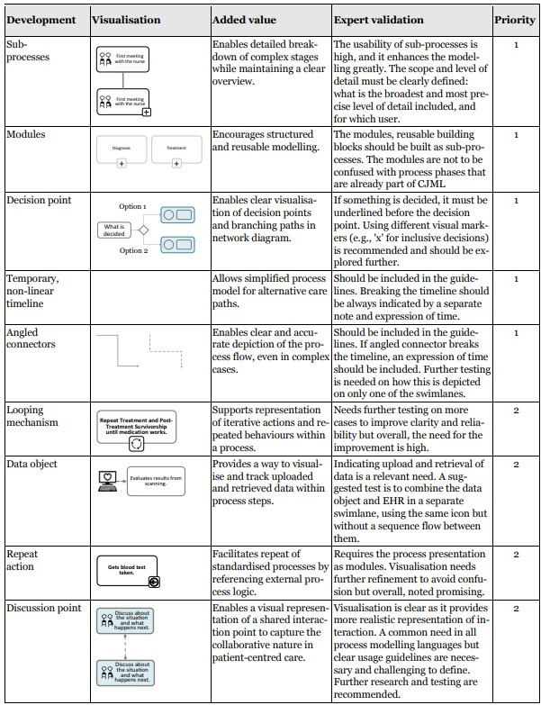
Main results
CJML proved suitable for patient-centric healthcare process modeling.
Identified limitations & improvement needs:
  Representation of decision-making
  Handling modularity & sub-processes
  Depicting repeated phases
Main output: A compiled results table summarizing proposed CJML developments and expert feedback.

Slide 10
Lessons learned

Slide 11
Lessons learned (1)
CJML supports patient-centred visualizations, bridging planned pathways and actual journeys.
Iterative expert validation ensures relevance and accuracy.
Limitations highlight the need for domain-specific adaptations in healthcare modeling.
Modeling exercises can act as a co-design tool, aligning clinicians and managers around the patient perspective.

Slide 12
More information
Key takeaways
Relevant publications

Slide 13
Key takeaways
CJML is promising for modeling complex patient processes with a patient-centered lens.
Iterative expert validation is crucial: it reveals gaps in representing decision-making, modularity, and repeated phases.
The results table provides concrete proposals for refining CJML to fit healthcare contexts.
Modeling exercises can double as a co-design tool, engaging clinicians and managers in improving pathways.
Future work: develop domain-specific extensions of CJML for healthcare operations.

Slide 14
Relevant publications
Miettinen, E. (2025). Modelling Complex Patient Processes in a Multi-Producer Environment.

