Slide 1
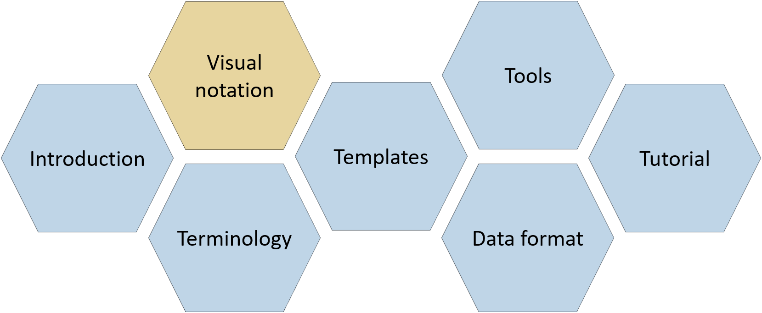
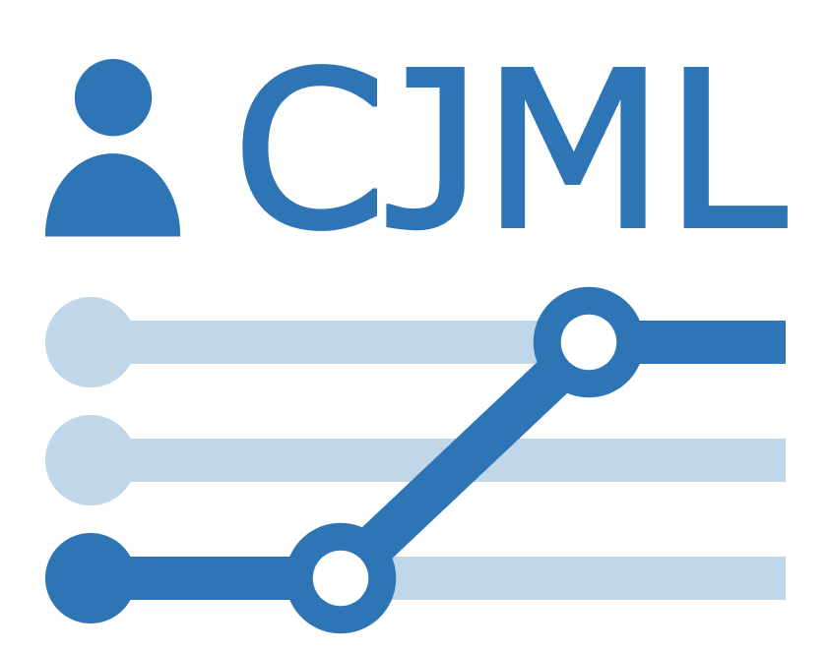
Visual notation
CJML – Customer Journey Modeling Language
Version 3.0 • June 2026
SINTEF Digital | Human-Computer Interaction Research Group

Slide 2
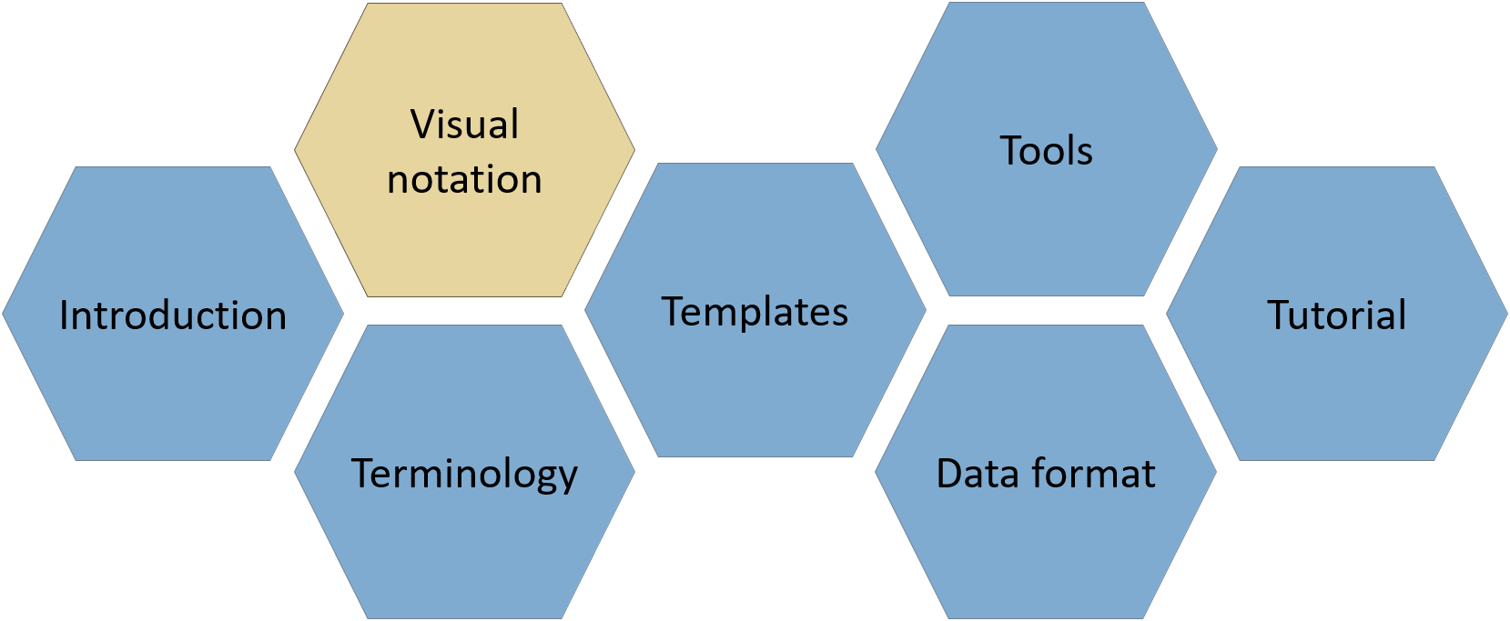

About
CJML consists of several modules, each covering a different aspect of the language. All resources are available at www.cjml.no
Diagram types, symbol gallery, visual features, and examples
Tools for creating and working with journeys
Overview of CJML, its conceptual foundation, and a quick tour of the visual notation
Guidance on journey thinking, journey data, approaches to analysis, and use cases
Definitions, metamodel, class diagrams, and model attributes
Machine-readable model structure, XML format, and data exchange
PowerPoint templates for quick, flexible diagramming with examples
Contact us: For questions or feedback, contact us at CJML<at>sintef.no
CJML v3 was developed as part of the research project Smart Journey Mining, funded by the Research Council of Norway (grant no. 312198).
How you may use this material: © SINTEF, licensed under
CC BY-SA 4.0. You may use, share, and adapt it with attribution, with adaptations shared under the same license.

Slide 3
Content
Overview
  Core visual elements
  The two diagram types and basic attributes
Symbol gallery
  About the use of symbols
  Actors and customer experience
  Communication channels
Customer journey diagram
  Touchpoints and attributes
  Compliance
  Journey phase
  Decision point
  Summary of visual syntax
Journey network diagram
  Touchpoints and attributes
  Compliance
  Journey phase and time
  Summary of visual syntax
Customer experience
  About customer experience
  Representing customer experience
  Examples
Appendix 1: CJML additions
  Cybersecurity
  Cybersecurity example
  Data privacy
  Data privacy example
Appendix 2: Extra visual features
  Sub-symbols
  Timeline
  Uncertainty
  Placeholder
  Concurrency
  Example journeys

Slide 4



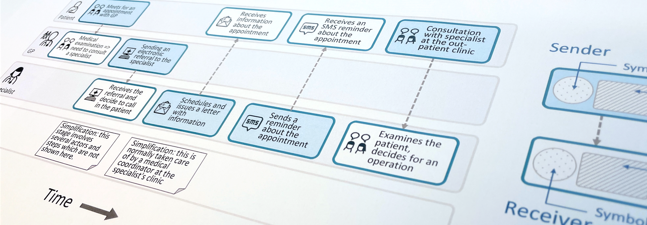
Customer Journey Modeling Language
CJML is a visual language for modeling the journey of an individual, regardless of whether the person has the role of customer, user, employee, patient, or citizen.
CJML consists of terminology, visual notation, a machine-readable data format, methods, and supporting tools.
Customer journey
User journey
Employee journey
Patient journey
Citizen journey
4

Slide 5

Overview
How to navigate this document
Core visual elements
The two diagram types
Representation of basic attributes

Slide 6
How to navigate this document
The visual notation is centered around the two diagram types:
  Customer journey diagram
  Journey network diagram (swimlane diagram).
Each diagram type has its own diagram elements, such as flow objects and connectors, while symbols are shared across the diagram types.
This section briefly introduces the diagram elements, the two diagram types, and their basic attributes.
The next section presents a gallery of symbols, including both common and domain-specific symbols, such as healthcare actors.
Two sections are then dedicated to the two diagram types and their basic features.
Customer experience is presented in a separate section.
The appendix introduces
  Cybersecurity and data privacy
  Additional visual features demonstrated through example journeys.

Slide 7
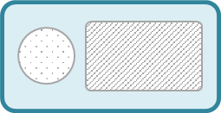

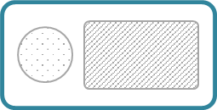
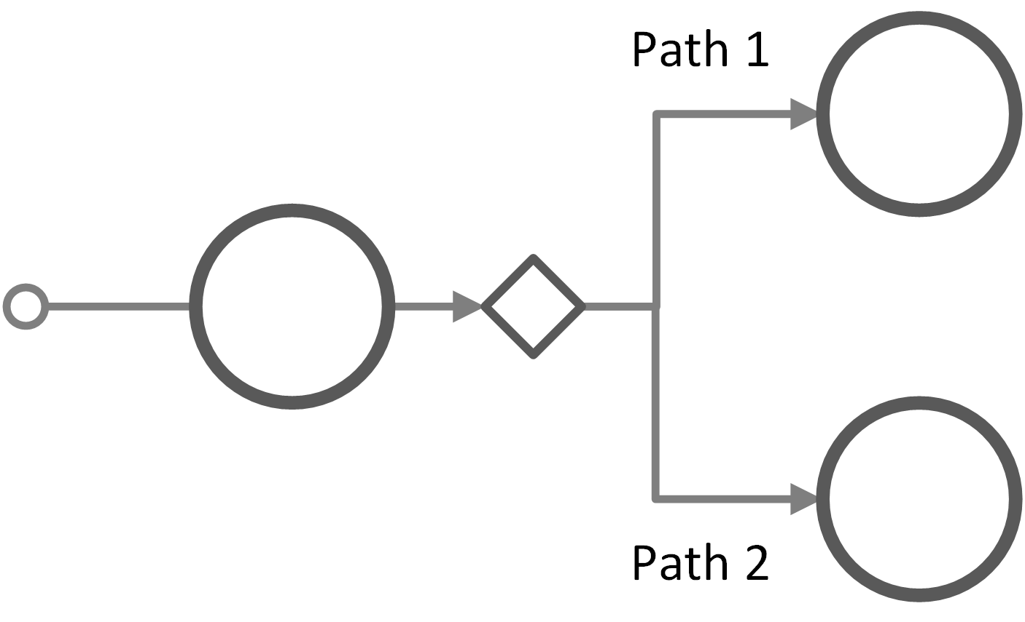








Core visual elements of CJML
Flow objects - customer journey diagram
Flow objects - journey network diagram
Start of journey
Communication point
Action
Communication point
Action
text area
Color rules
text area
Symbol
Direction of the message
text area
End of journey
Channel symbol
text area
Connecting object
Decision point
Connecting objects
Swimlane
Sequence flow
Sequence flow (optional)
Message flow
Actor
Symbols - both diagram types
Special symbols
Actors
Communication channels
Experience
Overview
Symbols
Customer journey diagram
Journey network diagram
Customer experience
Appendix

Slide 8

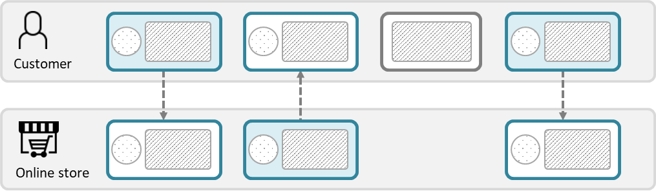
Diagram types – planned journey
Customer journey diagram
Suitable when focusing only on the end user
Suitable when few actors are involved
Journey network diagram (“swimlane diagram”)
Suitable when several actors are involved
Reveals both the sender and the receiver of a communication point
Emphasizes the direction of the message flow
The boundary color reflects the initiating actor. Colors can be chosen freely but must be used consistently. CJML uses orange as the default color for the end user.
This diagram type has two predefined colors, distinguishing the initiator from the receiver.
There is an implicit time axis running from left to right.
Time
💡
Note the difference in how a communication point appears in the two diagram types.
Overview
Symbols
Customer journey diagram
Journey network diagram
Customer experience
Appendix

Slide 9
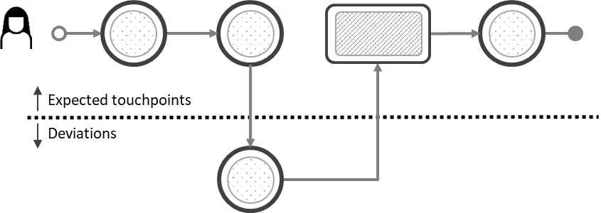
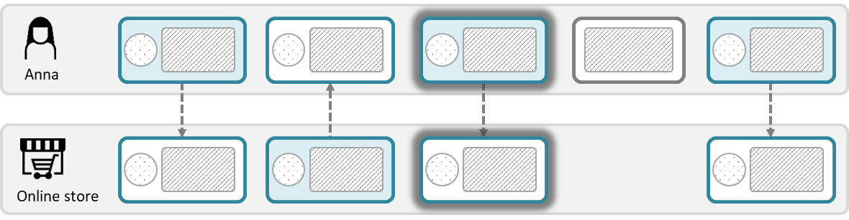
Diagram types – actual journey
Customer journey diagram
Suitable when focusing only on the end user
Suitable when few actors are involved
Suitable when emphasizing deviations from the planned journey
Journey network diagram (“swimlane diagram”)
Suitable when several actors are involved
Reveals both the sender and the receiver of a communication point
Emphasizes the direction of the message flow
💡
Ad hoc touchpoints also appear differently in the two diagram types.
Overview
Symbols
Customer journey diagram
Journey network diagram
Customer experience
Appendix

Slide 10
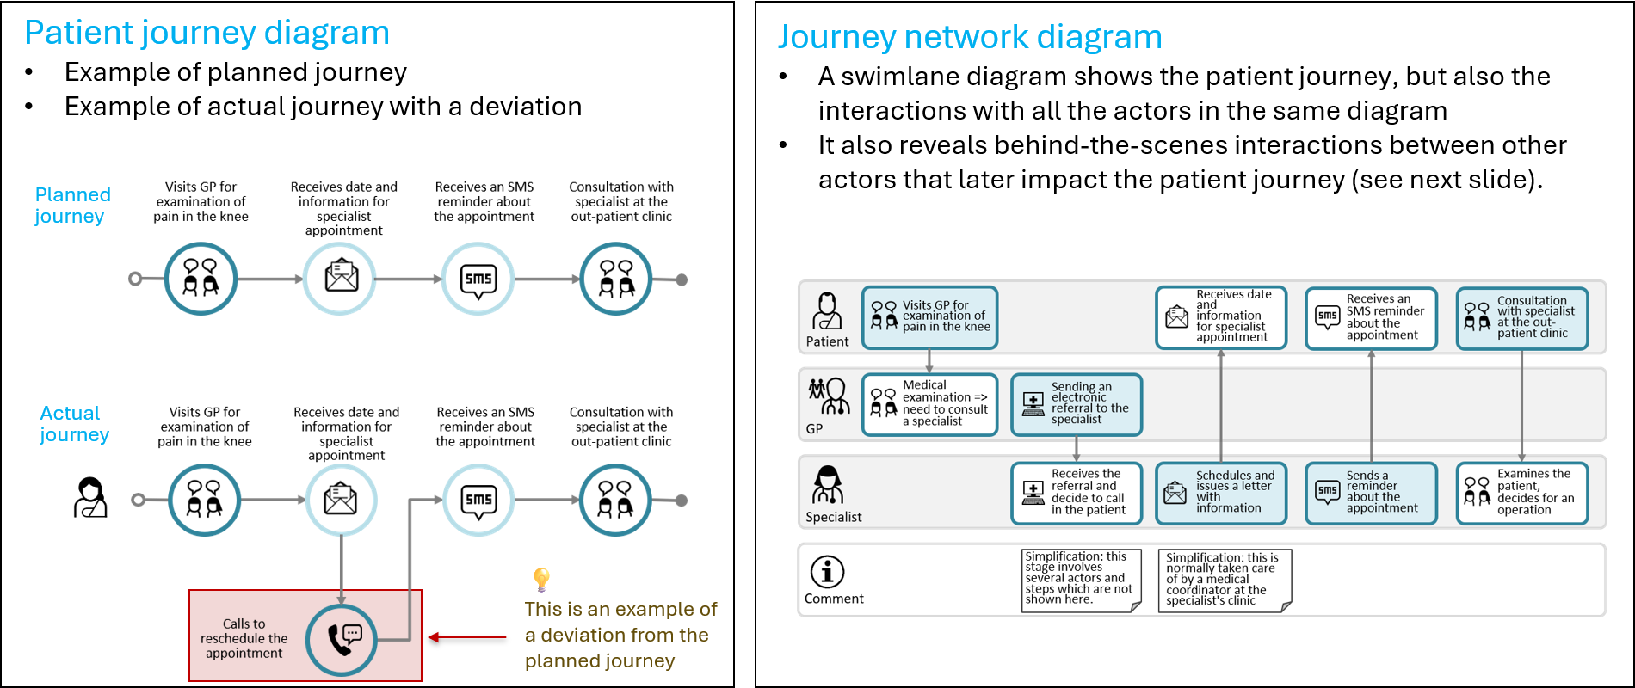
Example: Referral to a specialist
Overview
Symbols
Customer journey diagram
Journey network diagram
Customer experience
Appendix

Slide 11
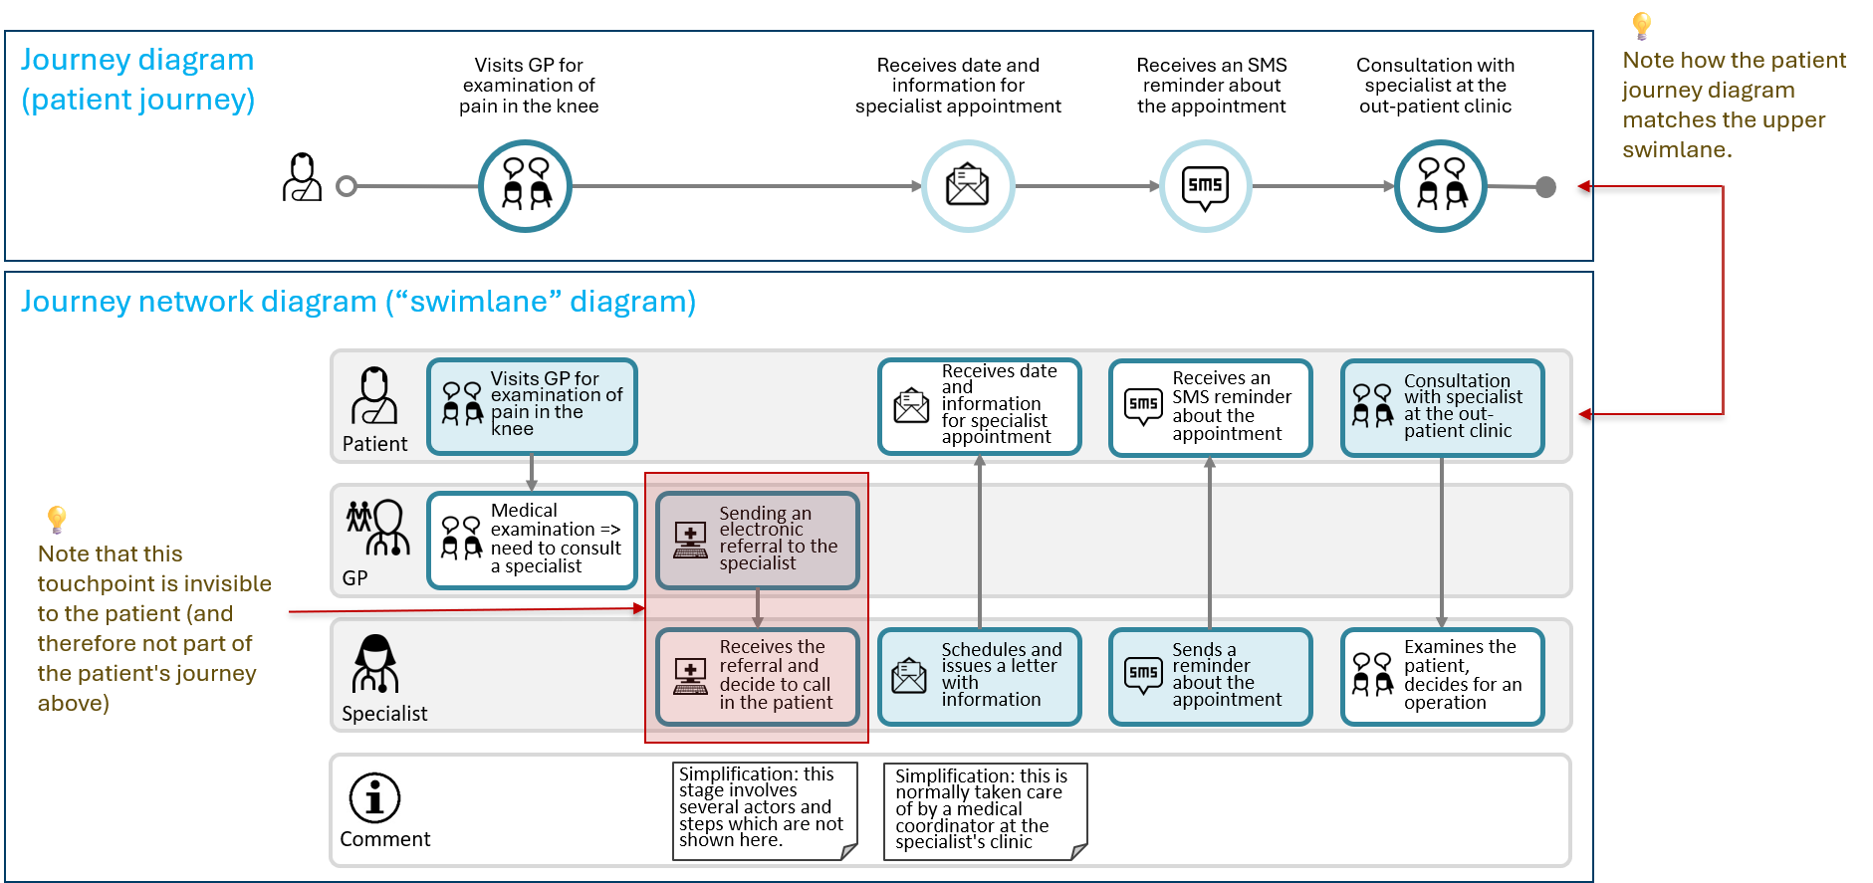
Comparison of diagram types
Overview
Symbols
Customer journey diagram
Journey network diagram
Customer experience
Appendix

Slide 12


Representation of basic attributes
CJML offers two ways to represent a communication point, corresponding to the two distinct diagram types.
The figure illustrates how the representation changes according to the direction of the communication.
From Actor 1 to Actor 2
From Actor 2 to Actor 1
Message
Message
Communication channel
Communication channel
Actor 1
(initiator)
Actor 2
(receiver)
Actor 1
(receiver)
Actor 2
(initiator)
Diagram type 1
Diagram type 2
Diagram type 1
Diagram type 2
Communication channel
Communication channel
text area
text area
Actor 1
(initiator)
Actor 1
(receiver)
direction
direction
Actor 2
(receiver)
text area
Actor 2
(initiator)
text area
Overview
Symbols
Customer journey diagram
Journey network diagram
Customer experience
Appendix

Slide 13
Symbol gallery
About the use of symbols
Actors and customer experience
Communication channels
Healthcare symbols
Cybersecurity symbols
Data privacy symbols

Slide 14


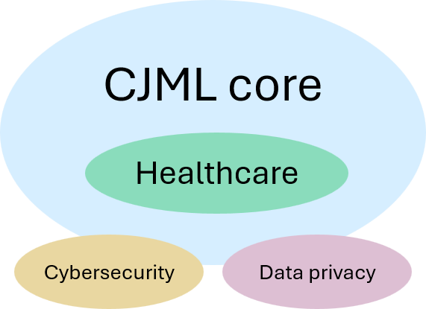
About the use of symbols
The symbols are used mainly for three purposes:
  To represent actors
  To represent communication channels
  To represent end user experience.
Symbols for communication channels
  CJML provides a set of preferred symbols, as well as alternatives.
Actor symbols are provided for various contexts:
  General service context (core)
  Healthcare (core)
  Cybersecurity
  Data privacy.
Some special-purpose symbols are also provided.
Actor
Citizen
Communication channel
E-mail
Customer experience
Dissatisfied
Overview
Symbols
Customer journey diagram
Journey network diagram
Customer experience
Appendix

Slide 15



























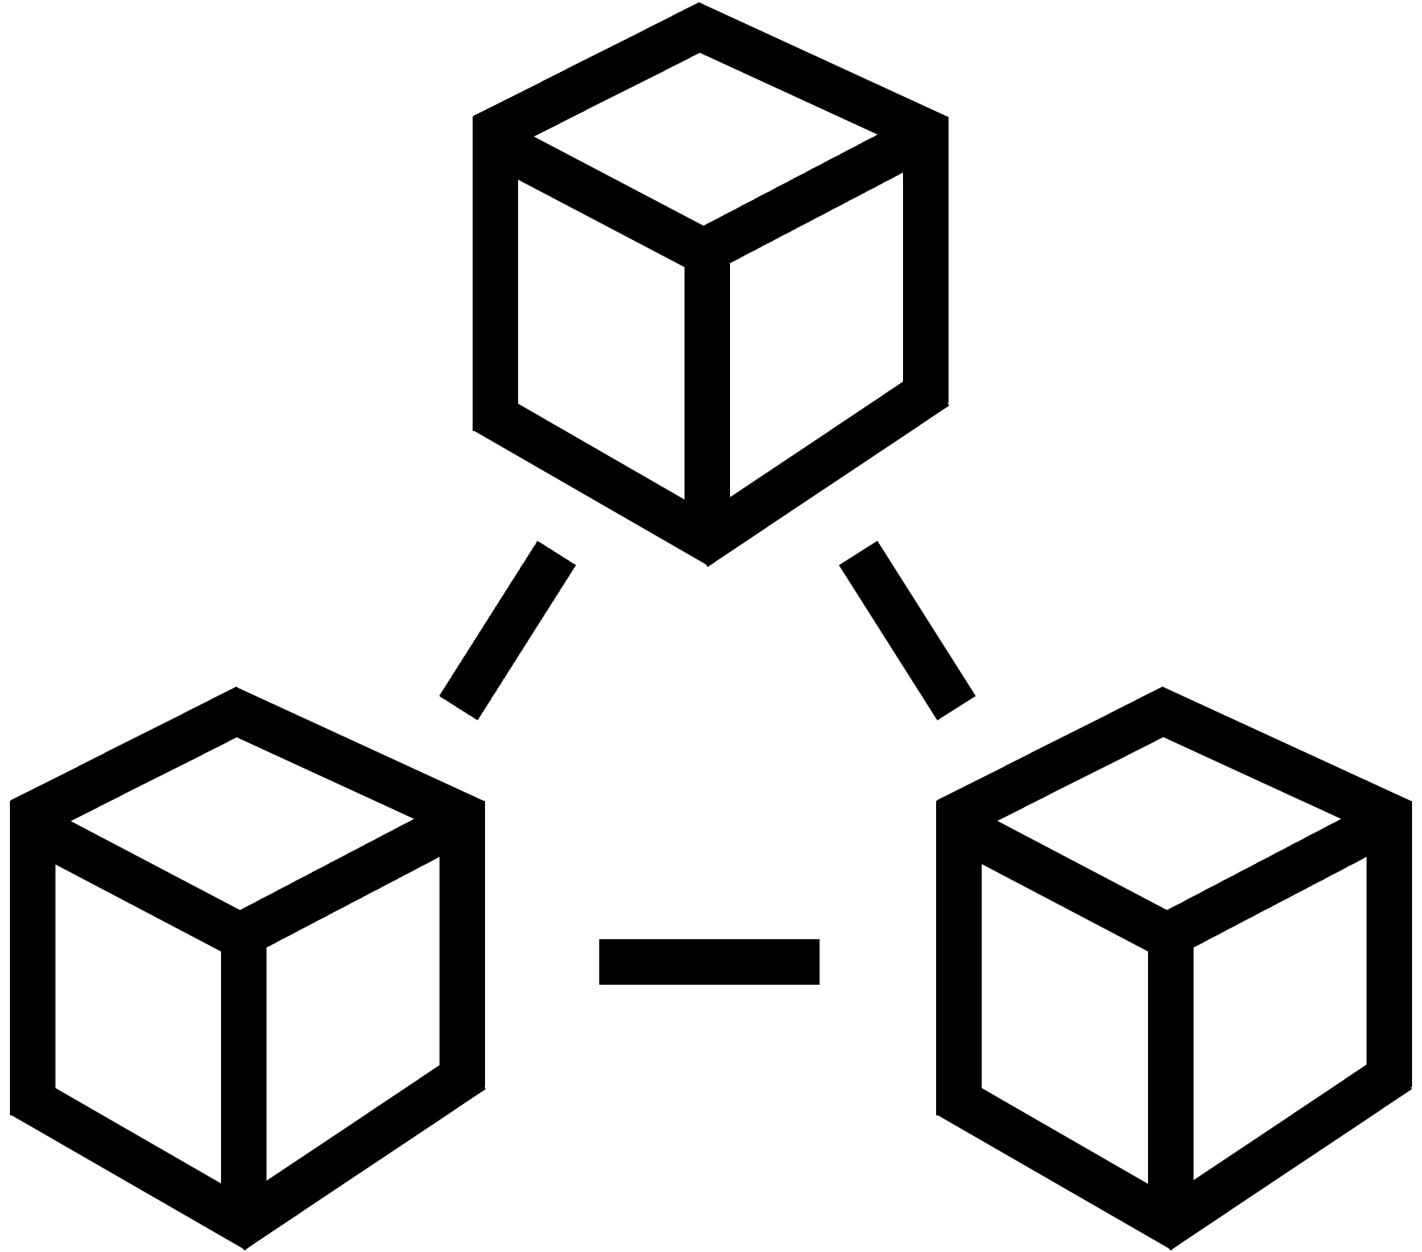


Actors and customer experience
Core
Users and customers
user1
user2
user3
user4
user5
user6
user7
user8
Service providers
service provider1
service provider2
service provider3
service provider4
service provider5
store1
store2
store3
online store1
bank1 online
bank2 online
bank3
bank4
bank5
bank6
Employee - general
employee1
employee2
employee3
employee4
employee5
employee6
IT staff and technicians
staff IT1
staff IT2
staff3 IT3
staff tech1
staff tech2
staff tech3
Platforms and systems
Customer experience
tech1 database
tech2 database
tech3 server
tech4 virtual machine
tech5 cloud
tech6 network
tech7 system
tech8 system cloud
1 very dissatisfied
2 dissatisfied
3 neutral
4 satisfied
5 very satisfied
Overview
Symbols
Customer journey diagram
Journey network diagram
Customer experience
Appendix

Slide 16















Communication channels
Core
telephone conversation
face-to-face interaction
payment channel
SMS
shop counter
letter
e-mail
service desk
self-service machine
chat
social media message
fax message
package delivery
message service
internet/globe
app on smartphone
internet via smartphone
unknown channel
app on PC
internet via PC
app on tablet
internet via tablet
16
Overview
Symbols
Customer journey diagram
Journey network diagram
Customer experience
Appendix

Slide 17






Additional symbols
Additional
Communication channels
social-media-
message-2
face-to-face-2
face-to-face-3
payment-channel-2
payment-channel-3
payment-channel-4
Invoice
Actors
user9
user10
user11
user12
user13
user14
17
Overview
Symbols
Customer journey diagram
Journey network diagram
Customer experience
Appendix

Slide 18

















Healthcare actors and channels
Healthcare
Patients
Healthcare systems
patient-1
patient-2
patient-3
patient-4
hospital-computer-system
hospital-post-office
Doctors and surgeons
Health secretaries
doctor-1
doctor-2
doctor-3
doctor-4
health-secretary-1
health-secretary-2
secretary-receptionist-1
secretary-receptionist-2
Nurses
Communication channels
nurse-1
nurse-2
nurse-3
nurse-4
chief-nurse
Health-portal
on-PC
Health-portal-
on-smartphone
Medical record
Hospitals and health systems
hospital-1
hospital-2
hospital-3
hospital-4
Overview
Symbols
Customer journey diagram
Journey network diagram
Customer experience
Appendix

Slide 19








































Additional healthcare symbols
Additional
Actors
Channels
doctor - general practitioner
doctors
surgeons
anesthesiologists
nurses
chief nurses
health secretaries
secretaries/receptionists
medical practices
patient-medical-record-2
patient-medical-record-3
Overview
Symbols
Customer journey diagram
Journey network diagram
Customer experience
Appendix

Slide 20













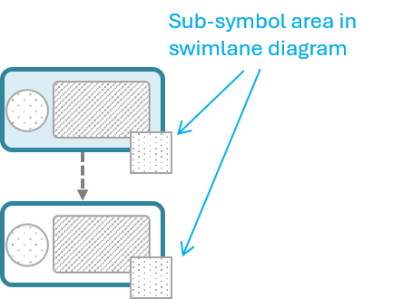
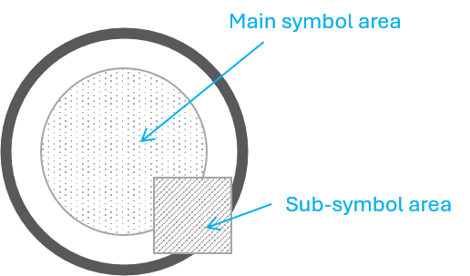






Cybersecurity symbols
Cybersecurity
Cybersecurity experts
Cybersecurity expert 1
Cybersecurity expert 2
Cybersecurity expert 3
Cybersecurity expert 4
Cybersecurity expert 5
Cybersecurity expert 6
Cybersecurity expert 7
Cybersecurity expert 8
Cybersecurity expert 9
Attackers / cybercriminals
attacker
attacker network
attacker physical
attacker software
attacker social engineering
Special symbols (used as touchpoint sub-symbols)
threat
unwanted incident
vulnerability lock
vulnerability unlock
firewall
danger2
Overview
Symbols
Customer journey diagram
Journey network diagram
Customer experience
Appendix

Slide 21



Data privacy symbols
Data privacy
Special symbols
Touchpoint with sub-symbols
Data collected
Data processed
Data shared
Privacy Comment
A dedicated swimlane for data privacy comments
DC: Description of data collected + purpose
DP: Description of data processed + purpose
DS: Description of data shared + purpose
DC: Description of data collected + purpose
DP: Description of data processed + purpose
DS: Description of data shared + purpose
DC: Description of data collected + purpose
DP: Description of data processed + purpose
DS: Description of data shared + purpose
DC: Description of data collected + purpose
DP: Description of data processed + purpose
DS: Description of data shared + purpose
DC: Description of data collected + purpose
DP: Description of data processed + purpose
DS: Description of data shared + purpose
Privacy
Comment
Overview
Symbols
Customer journey diagram
Journey network diagram
Customer experience
Appendix

Slide 22
Customer journey diagram
Touchpoints and attributes
Compliance
Journey phase
Decision point
Summary of visual syntax

Slide 23

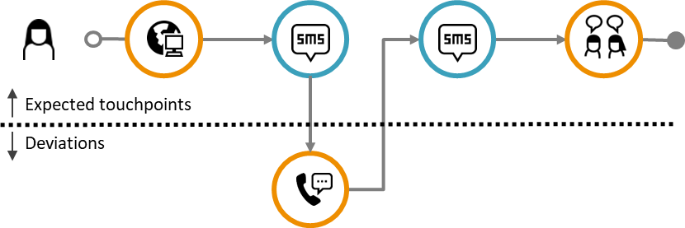
Introducing the customer journey diagram
This is the simplest journey diagram, with a dedicated focus on the end user.
The diagram comes in two variants:
  Plain journey diagram: A linear chain of touchpoints in the order they appear. No attention is given to deviations or conformance.
  Deviation diagram: This diagram emphasizes any deviation from the planned journey.
Plain journey diagram
💡
The deviation diagram is used for actual journeys, making deviations easier to spot, such as an unexpected call from the customer.
Deviation diagram
Planned journey
Actual journey
Actual journey
💡
The end user’s icon is always included for actual journeys (otherwise the actual journey would be identical to the planned journey with no deviations).
Overview
Symbols
Customer journey diagram
Journey network diagram
Customer experience
Appendix

Slide 24
Communication points
Communication point boundary
💡
By convention, CJML uses orange for customers and teal blue for patients.
Communication points are represented as a circle
The circle's boundary style carries information about
the actor initiating the touchpoint
the status of the touchpoint
The symbol in the middle represents the communication channel or the device being used
symbol area
Examples
Actor
The color indicates the actor who initiated the communication point.
Orange is often used for the customer or end user
If many actors are involved, a journey network diagram may be more suitable
Customer
Service providers
Anna calls the service company
Service company sends an e-mail
Patient
Doctor
Patient meets for a medical consultation
Hospital sends an SMS reminder
Compliance (actual journeys only)
The boundary style indicates the status of the communication point
solid boundary: completed (as expected) or ad hoc
dashed boundary: missing
crossed touchpoint: failing
Completed and ad hoc
Missing
Failing
Customer fails to buy a train ticket
Customer didn’t receive the call
Overview
Symbols
Customer journey diagram
Journey network diagram
Customer experience
Appendix

Slide 25
Actions
💡
Distinguishing external actions from regular actions is not mandatory. It is an option when greater nuance is important.
Actions are touchpoints that do not involve communication.
Actions are visually represented as rounded squares containing text.
Two types of actions may be distinguished:
  Actions that involve parts of the service system (e.g. looking at the display of arrivals at the train station).
  External actions that don’t involve the service system (e.g. writing down questions for the doctor before the appointment).
Action
text area
text description
text description
Action (involving service system)
External action (not involving the service system)
External action
text area
Overview
Symbols
Customer journey diagram
Journey network diagram
Customer experience
Appendix

Slide 26
Labels and touchpoint IDs
Touchpoint ID
T1
T2
T3
T4
Label
<Text describing T1>
<Text describing T2>
<Text describing T3>
<Text describing T4>
Touchpoint IDs provide an unambiguous reference to touchpoints in a journey.
For planned journeys, we recommend using T1, T2, etc.
For actual journeys, we recommend using T1, T2, etc. for expected touchpoints and D1, D2, D3, etc. for deviations.
Labels add a description of the context:
We recommend keeping the description short
When rich descriptions are needed, the diagram can be accompanied by a table holding the explanations and a reference to the identifiers.
Overview
Symbols
Customer journey diagram
Journey network diagram
Customer experience
Appendix

Slide 27
Compliance
Compliance can be addressed globally at the level of a journey, but also locally at the level of touchpoints.
Journey compliance
  An actual journey may contain all the planned touchpoints, but in the wrong sequence. Such sequence errors are easily spotted in a deviation diagram (see separate slide about this).
  An actual journey may have deviations in the content of the touchpoint, e.g., in the message or objects carried by communication points. This content compliance is not visually emphasized.
Touchpoint compliance
  A communication point in an actual journey can be compliant (planned) or non-compliant (deviating). The types of deviations are:
  ad hoc (unbroken circle boundary)
  failing (crossed)
  missing (dashed boundary)
Completed and ad hoc
Missing
Failing
Overview
Symbols
Customer journey diagram
Journey network diagram
Customer experience
Appendix

Slide 28
Sequence error
Actual journey
A touchpoint occurring earlier or later than expected results in a sequence error.
Sequence errors are visualized using connectors:
  Jump forward: from the bottom of the originating touchpoint to the bottom of the subsequent touchpoint (A).
  Jump backward: from the top of the originating touchpoint to the top of the subsequent touchpoint (B).
  From a deviation: when a sequence error originates from an ad hoc, missing, or failing touchpoint, the connector starts on the right side of the touchpoint and ends at the bottom of the subsequent touchpoint for a forward jump (C).
The actual sequence of touchpoints is determined by following the connectors.
connector B
connector A
connector C
Overview
Symbols
Customer journey diagram
Journey network diagram
Customer experience
Appendix

Slide 29
Journey phase
A customer journey can be divided into phases when convenient. The journey phases can, for example, be based on touchpoints that occur at a certain location.
Example: air travel
  Phase 1: Ordering ticket and preparing for the trip
  Phase 2: At the airport
  Phase 3: During the flight
  Phase 4: Arrival at the destination airport
Example: healthcare service
  Phase 1: Diagnosis
  Phase 2: Treatment
  Phase 3: Rehabilitation
Journey phase 1
Journey phase 2
Overview
Symbols
Customer journey diagram
Journey network diagram
Customer experience
Appendix

Slide 30
Decision point
Examples
Does the customer wish to receive information from the service provider by e-mail?
Decision points are used in planned journeys where the journey may branch into two or more alternative paths.
A decision may be made by the customer.
A decision may also be made by the service provider.
Yes
No
Path 1
How does the customer wish to receive information from the service provider?
By email
Path 2
By SMS
Overview
Symbols
Customer journey diagram
Journey network diagram
Customer experience
Appendix

Slide 31
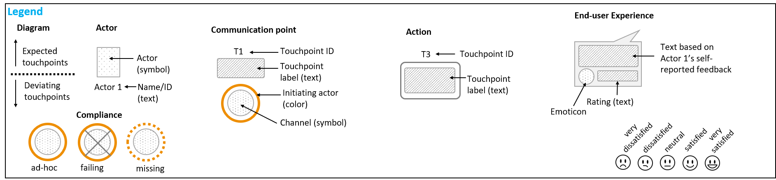
Summary of visual syntax - Customer journey diagram
Phase 1
Phase 2
T1
T2
T3
T4
T5
Actor 1
Actor 1 = initiator
Actor 2 = initiator
D2.1
D2.2
Overview
Symbols
Customer journey diagram
Journey network diagram
Customer experience
Appendix

Slide 32
Journey network diagram
Touchpoints and attributes
Compliance
Journey phase and time
Summary of visual syntax

Slide 33
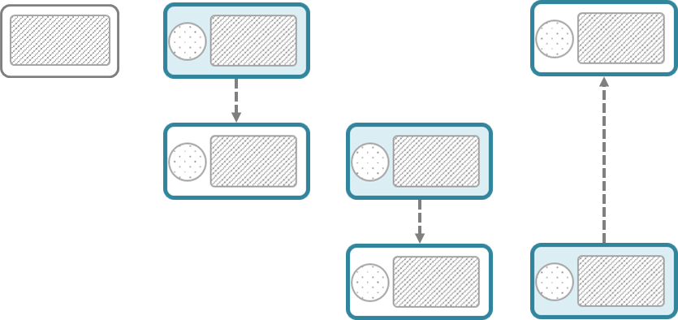


Basics – journey network diagram (1/2)
💡
This diagram is also referred to as a “swimlane diagram”.
Touchpoints
The actors involved in the journey appear in separate swimlanes.
Actor 1
Direction of the message flow
Actor 2
Actor 3
time
💡
Note that there is an implicit time axis in the diagram running from left to right.
Overview
Symbols
Customer journey diagram
Journey network diagram
Customer experience
Appendix

Slide 34



Basics – journey network diagram (2/2)
💡
A communication point has an initiator and a receiver, each positioned in the corresponding actor swimlane.
Action
Communication point
Communication point
Communication point
Sender
text area
Communication channel
direction
Actor 1
text area
Receiver
💡
Add an extra swimlane for comments if explanations are needed.
Actor 2
💡
An action is used for non-communicating touchpoints.
Actor 3
Text area
Comment
Overview
Symbols
Customer journey diagram
Journey network diagram
Customer experience
Appendix

Slide 35
Compliance
Sender
Receiver
For actual journeys, compliance can be addressed as deviations from the planned journey.
The shape's boundary style carries information about the touchpoint status, as illustrated to the right.
When it is important to outline deviations relative to a planned journey, a customer journey deviation diagram may be more suitable.
Journey network diagrams are generally not suitable for sequence errors.
Normal
Missing
Failing
Ad hoc
Overview
Symbols
Customer journey diagram
Journey network diagram
Customer experience
Appendix

Slide 36
Journey phase and time
Phases and timestamps can be added to the diagram.
Waiting time can be visualized to show expected periods of waiting between touchpoints.
Date and time
Date and time
Duration
Date and time
Date and time
Phase 1
Phase 2
WAITING TIME
Actor 1
Actor 2
Actor 3
Comment
Overview
Symbols
Customer journey diagram
Journey network diagram
Customer experience
Appendix

Slide 37

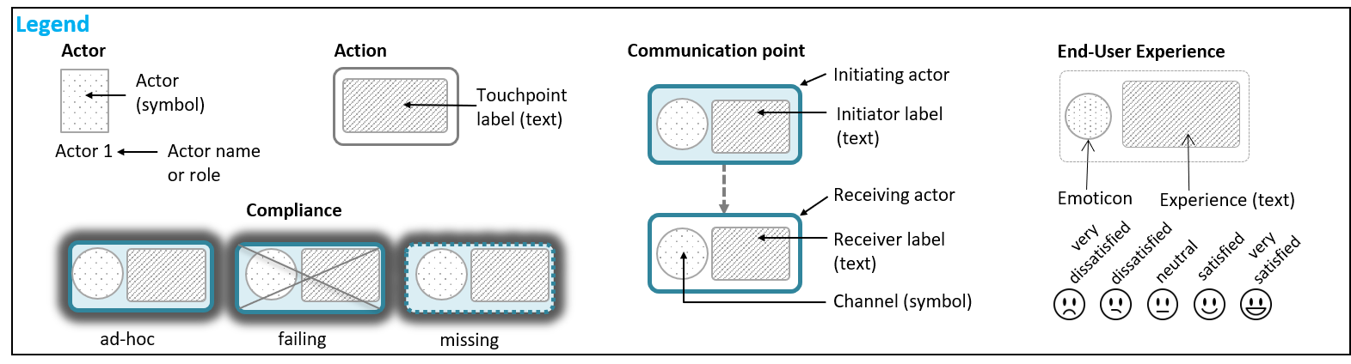
Summary of visual syntax - Journey network diagram
Phase 1
Phase 2
T1
T2
T3
D3
T4
Actor 1
Actor 2
Actor 3
This is a comment for this specific touchpoint
Comment
Overview
Overview
Symbols
Symbols
Customer journey diagram
Customer journey diagram
Appendix
Journey network diagram
Appendix
Journey network diagram
Customer experience
Customer experience

Slide 38
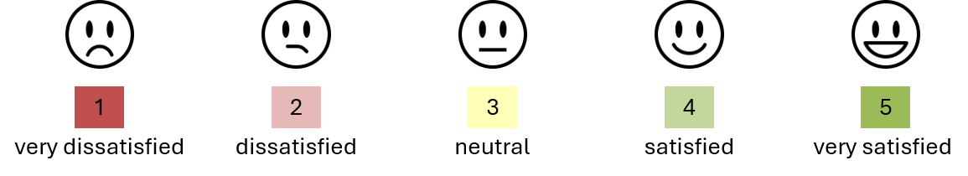
Customer experience
About customer experience
Representing customer experience
Examples

Slide 39
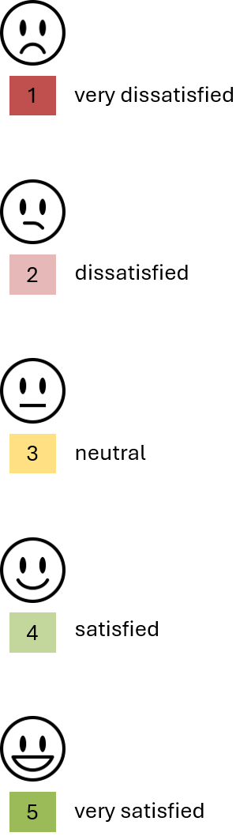
About customer experience
💡
Customer experience (CX) is the most established term in the literature, but the end user may also be a user, patient, citizen, or other.
When representing end user experience, CJML adheres to principles
from HCI research on user experience (UX)*:
  UX is subjective.
  UX is dynamic.
  UX is context dependent.
In CJML, experience is therefore associated with actual journeys only.
Experience data in CJML is based on the end user's self-reported input.
This input may include:
  Text: the end user's own description of the experience.
  Rating: a rating of the experience represented by symbols.
Experience data should preferably be collected for as many individual touchpoints as possible, as well as for the journey as a whole.
*) Law, E. et al. (2009). “Understanding, scoping and defining user experience: A survey approach.” Proceedings of the 27th SIGCHI Conference on Human Factors in Computing Systems, pp. 719–728.
Overview
Symbols
Customer journey diagram
Journey network diagram
Customer experience
Appendix

Slide 40
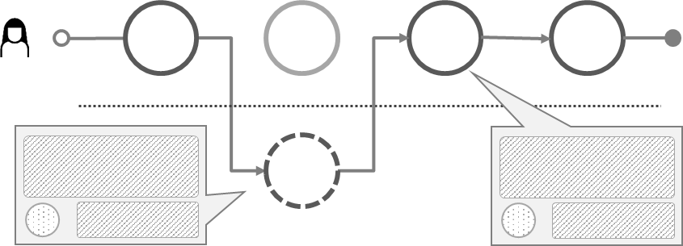
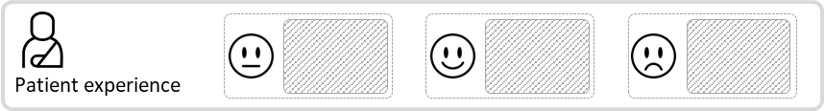
Representing customer experience
End user experience is represented differently depending on the diagram type:
  Customer journey diagram: in callouts connected to individual touchpoints
  Journey network diagram: in a separate swimlane
Ratings can be visualized using smiley symbols
The symbols can be used with both 3-point and 5-point rating scales.
The CJML language supports CX in customer journey diagrams (using callouts or tables), as shown in the following slides.
Customer journey diagram
Journey network diagram
Smiley based on the rating
Text based on the user's self-reported input
Text based on the user's self-reported input
Smiley based on the rating
Overview
Symbols
Customer journey diagram
Journey network diagram
Customer experience
Appendix

Slide 41
Example: end user experience in callouts
Customer journey diagram - callout
The example shows the use of callouts to express customer experience.
T1
T2
T3
T4
T5
order and pay for ticket via web
e-mail confirmation
SMS confirmation
retrieve ticket
ticket control at entrance
It was easy to order the tickets. I just chose the movie I wanted to see, selected a seat, and put in my payment details.
Very satisfied
I don't understand why I receive this information by SMS when I also received it by e-mail.
Dissatisfied
The queue for getting into the movie theater was a bit long, but the person at the entrance was very friendly and helpful.
Satisfied
Overview
Symbols
Customer journey diagram
Journey network diagram
Customer experience
Appendix

Slide 42
Example: end user experience in table
Customer journey diagram - table
If the text takes up too much space, it can instead be presented in a table.
T1
T2
T3
T4
T5
order and pay for ticket via web
e-mail confirmation
SMS confirmation
retrieve ticket
ticket control at entrance
Label | Touchpoints | Customer experience | Score
T1 | Order and pay via web | It was easy to order the tickets. I just chose the movie I wanted to see, selected a seat, and put in my payment details. | 5
T2 | E-mail confirmation | It was nice to get an e-mail confirming my ticket purchase. | 4
T3 | SMS confirmation | I don't understand why I receive this information by SMS when I also received it by e-mail. | 2
T4 | Retrieve ticket | I got a bit confused because the ticket machine was not so intuitive, but it went OK and I managed to retrieve my tickets. | 3
T5 | Ticket control at entrance | The queue for getting into the movie theater was a bit long, but the person at the entrance was very friendly and helpful. | 4
Overview
Symbols
Customer journey diagram
Journey network diagram
Customer experience
Appendix

Slide 43


Example – patient experience
Journey network diagram
BOOKING OF APPOINTMENT
OUTPATIENT CLINIC
I need to book a new appointment at the outpatient clinic, but it is already too late.
Calls the outpatient clinic to book an appointment.
Receives a reminder.
Meets at the outpatient clinic.
Sara
General practitioner
Neurologist
Schedules an appointment for April 30.
Sends a reminder.
Takes blood samples and administers infusion.
Nurse, MS clinic
Calling hours are from 8 -11 a.m. Too limited. I would like to call after lunch!
I could not get the time that suited me best.
A reminder with the date, time, and link to the exact location.
I met a new nurse. He was skilled and very friendly.
Sara's experience
Overview
Symbols
Customer journey diagram
Journey network diagram
Customer experience
Appendix

Slide 44
Appendix 1: CJML additions
Cybersecurity
Data privacy

Slide 45
Cybersecurity
Cybersecurity
The swimlane diagram is particularly suitable for cybersecurity journeys, as these often involve multiple actors.
Actors may include regular users or employees, cybersecurity experts, and attackers.
Threat and unwanted incident symbols are mostly used for actual journeys.
Customer journey diagram
Journey network diagram
Action (threat)
Action
(unwanted incident)
Communication point
(threat)
Communication point
(unwanted incident)
Action (threat)
Action
(unwanted incident)
Communication point
(threat)
Communication point
(unwanted incident)
The symbol can be placed on one or both sides of a communication point.
Overview
Symbols
Customer journey diagram
Journey network diagram
Customer experience
Appendix

Slide 46







Man-in-the-middle-attack
Cybersecurity example
Eric works in an SME developing e-health systems as a customer consultant. Cindy, a general practitioner, has problems uploading patient health records. Eric has brought his laptop to a coffee shop and unknowingly connects to a fake Wi-Fi network. Eric's login credentials for the e-health system are intercepted by the attacker.
E
Eric visits the local coffee shop to do some work on his PC.
Eric unknowingly connects his laptop via the fake WiFi network.
He receives the call and asks for system logs and error messages.
He receives the system logs and error messages.
He logs in to the EHR system to reconfigure the user account.
He explains the error and confirms that it is solved.
Eric (consultant)
The EHR user account is now configured correctly.
EHR system
Cindy has problems when synchronizing new patient information in the EHR system.
She calls Eric, her regular consultant, to solve the problem.
She sends system logs and error messages.
She receives a confirmation that the problem is solved.
Cindy (customer)
In a coffee shop, Eve has set up a fake WiFi connection with a legitimate-sounding SSID.
Eve intercepts the message received by Eric.
Eve intercepts Eric's login credentials to the EHR system.
Eve (attacker)
Overview
Symbols
Customer journey diagram
Journey network diagram
Customer experience
Appendix

Slide 47
Data privacy
Data privacy
💡
This is work in progress. More information is provided in the CJML Terminology and Templates modules.
Privacy policies are often long and complex, making it difficult for users to understand how their personal data are handled.
CJML aims to make the handling of personal data more transparent and easier for end users to understand through intuitive visualizations.
Data privacy-specific concepts can be represented at two levels: globally for the journey as a whole and locally for individual touchpoints.
Global elements include an overview of the scenario and the following:
  Data collection: Which personal data (as defined by GDPR) are collected and for what purpose? Are the personal data sensitive or non-sensitive?
  Data processing: Who processes personal data and for what purpose?
  Data sharing: With whom are the personal data shared, and for what purpose?
Local elements: Individual touchpoints are annotated with text and symbols in a dedicated privacy swimlane.
Data collected
Data processed
Data shared
Communication point
The symbol can be placed on one or both sides of a communication point.
<Text describing data collection (DC), data processing (DP) and/or data sharing (DS)>
<Relevant sub-symbol>
<Text describing data collection (DC), data processing (DP) and/or data sharing (DS)>
<Relevant sub-symbol>
<Text describing data collection (DC), data processing (DP) and/or data sharing (DS)>
<Relevant sub-symbol>
<Text describing data collection (DC), data processing (DP) and/or data sharing (DS)>
<Relevant sub-symbol>
Privacy Comment
Overview
Symbols
Customer journey diagram
Journey network diagram
Customer experience
Appendix

Slide 48

Book purchase
Data privacy example
The scenario follows a buyer purchasing a used book through a C2C marketplace. The buyer places an order, pays by credit card, and receives confirmation from the marketplace that the seller has accepted the request. A delivery partner then handles the shipment and keeps the buyer updated until the book is delivered to the mailbox.
Search and buy
Delivery
Finds a book and requests to buy it
Pays for the book by credit card
Notified that the seller has accepted the request
Notified that the book has been picked up from the seller.
Notified that the package is on its way
Notified that the package is delivered to the mailbox
Buyer
Purchase request registered
Payment registered
Seller acceptance registered
Sends delivery request to delivery partner
C2C marketplace
Receives delivery request
Notifies buyer that the book has been picked up from the seller
Notifies buyer that the package is on its way
Notifies buyer that the package has been delivered to the mailbox
Delivery partner
DC: Product information (book selection)
DP: IP address, device information, contact information (book selection)
DC: Product information, billing address, credit card details (payment)
DP: Contact information, billing address, credit card details (payment)
DP: Product information, contact information, billing address (order fulfillment)
DS: Contact information, billing address, product information (order fulfillment)
DP: Contact information, billing address (delivery)
DP: Contact information, billing address (delivery)
DP: Contact information, billing address (delivery)
Privacy
comment
48
Overview
Symbols
Customer journey diagram
Journey network diagram
Customer experience
Appendix

Slide 49
Appendix 2: Extra visual features
Some examples use an earlier version of the visual notation, but the principles they illustrate remain valid.
Extra features:
Sub-symbols
Timeline
Unordered sequence
Variation and uncertainty
Placeholder
Concurrency
Example journey
Unordered sequence
Journey phase
Timeline
Deviations (missing or failing touchpoints)
Sequence error

Slide 50



Special situations: Using sub-symbols
Sometimes a journey contains a number of seemingly similar, repeated touchpoints that are visually identical.
  Example: if a service provider sends four e-mails in a row, the touchpoints look the same unless a label and ID are provided.
A sub-symbol in the lower right position can be used to make the touchpoints visually distinct.
The sub-symbol should provide a visual clue about the content of the touchpoint.
Main symbol area
Example: Sub-symbols are convenient for distinguishing repeated e-mails received from the service provider.
Sub-symbol area in swimlane diagram
Sub-symbol area
Sub-symbols from The Noun Project:
Warning designed by Christopher Holm-Hansen
Check Box designed by Katie M Westbrook
Hour Glass designed by Laura Beggs
Overview
Symbols
Customer journey diagram
Journey network diagram
Customer experience
Appendix

Slide 51
Timeline
Planned and actual journey
A timeline can be introduced to emphasize the timing of touchpoints.
The touchpoints are positioned according to the relevant time scale.
A timeline can be used for all types of journeys, except for actual journeys that contain sequence errors.
day 1
day 2
day 3
day 12
Overview
Symbols
Customer journey diagram
Journey network diagram
Customer experience
Appendix

Slide 52
Unordered touchpoint sequence
Planned journey
An unordered touchpoint sequence is a group of touchpoints that can occur in an unspecified order.
It is useful when the order of the touchpoints is not predefined.
The notation can only be used in generic and planned journeys.
No connector between the unordered touchpoints
Brackets that group the unordered touchpoints
Overview
Symbols
Customer journey diagram
Journey network diagram
Customer experience
Appendix

Slide 53

Arbitrarily occurring touchpoint
Planned journey
An arbitrarily occurring touchpoint is a touchpoint in a planned journey that has no fixed position and can occur at any time within a given sequence of touchpoints.
The notation can only be used for planned journeys.
Example: The service provider calls the customer for an onboarding conversation
at some point during an interval in which other mandatory touchpoints
occur (indicated by the brackets).
Sequence of touchpoints (with connectors) in which the arbitrary touchpoint can occur
Arbitrarily occurring touchpoint
;
;
Brackets that group the sequence of touchpoints in which the arbitrary touchpoint can occur, and the arbitrary touchpoint itself
Semicolon followed by the arbitrarily occurring touchpoint, placed after the sequence of touchpoints in which the arbitrary touchpoint can occur
Overview
Symbols
Customer journey diagram
Journey network diagram
Customer experience
Appendix

Slide 54
Handling uncertainty
Planned journey
Some service processes are associated with uncertainty in exactly which touchpoints to expect, or even whether they will occur at all.
Example: A C2C reselling platform that connects a seller and a buyer. After the actors have connected, it remains uncertain, from the service provider's perspective, who initiates further contact, the number of communication points that will occur, and which communication channel will be used.
?
Uncertain initiator:
It may be uncertain who initiates the communication point.
Uncertain number
of occurrences:
It may be uncertain how many instances of communication occur.
Uncertainty in occurrence:
It may be uncertain if a communication point occurs or not.
Uncertainty in channel:
It may be uncertain which communication channel mediates the message.
Overview
Symbols
Customer journey diagram
Journey network diagram
Customer experience
Appendix

Slide 55
Placeholder for a repeated sequence
Planned and actual journey
When customer journeys include repeated sequences of touchpoints, a placeholder may be used to simplify the diagram.
Example: A web-based marketplace that connects sellers of goods with potential buyers. The communication process between the seller and the different buyers may include the same sequence of touchpoints.
T1
T2
T3
T4
T5
T6 – T8
T9
X
X
The sequence T2-T4 is replaced by an "X" because the same sequence occurs later (touchpoints T6-T8).
Overview
Symbols
Customer journey diagram
Journey network diagram
Customer experience
Appendix

Slide 56
Concurrency
Planned and actual journey
In general, a customer journey may describe both sequential and concurrent communication points and actions.
The UML fork/join notation is adopted for concurrency.
In the example below, touchpoint T3 occurs simultaneously with T4 and T5.
  An example is a telephone conversation (T3), during which e-mails are exchanged (T4 and T5).
The second bar, "join", indicates the end of concurrency
The "fork" indicates the start of concurrent touchpoints
T3
T1
T2
T6
T4
T5
Overview
Symbols
Customer journey diagram
Journey network diagram
Customer experience
Appendix

Slide 57
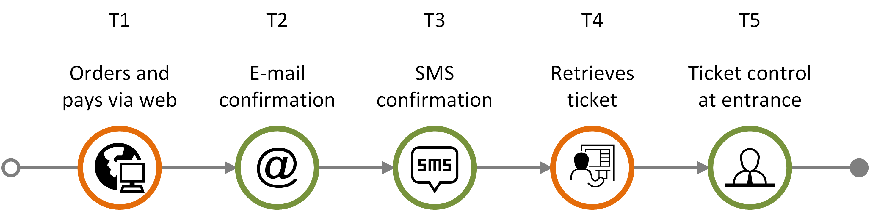
Example journey: Going to the movies
The following journey is used to illustrate different features of the customer journey diagram.
It consists of five communication points:
  The customer orders and pays for a movie ticket via online booking (T1)
  The customer receives a confirmation via e-mail (T2)
  The customer receives a confirmation via SMS (T3)
  The customer retrieves the ticket via a self-service machine at the movie theater (T4)
  The customer shows the ticket at the entrance (T5)
💡
This example journey is reused in the following slides to illustrate different features of the customer journey diagram.
Overview
Symbols
Customer journey diagram
Journey network diagram
Customer experience
Appendix

Slide 58
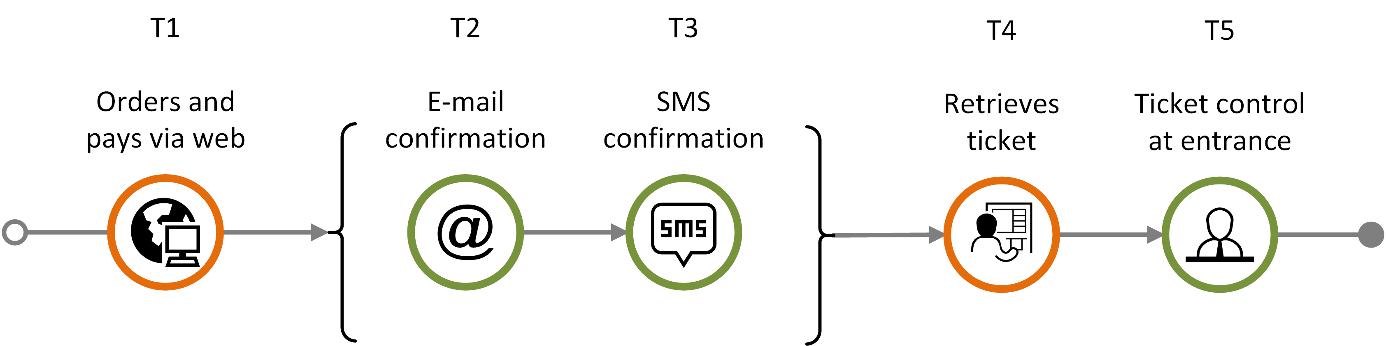
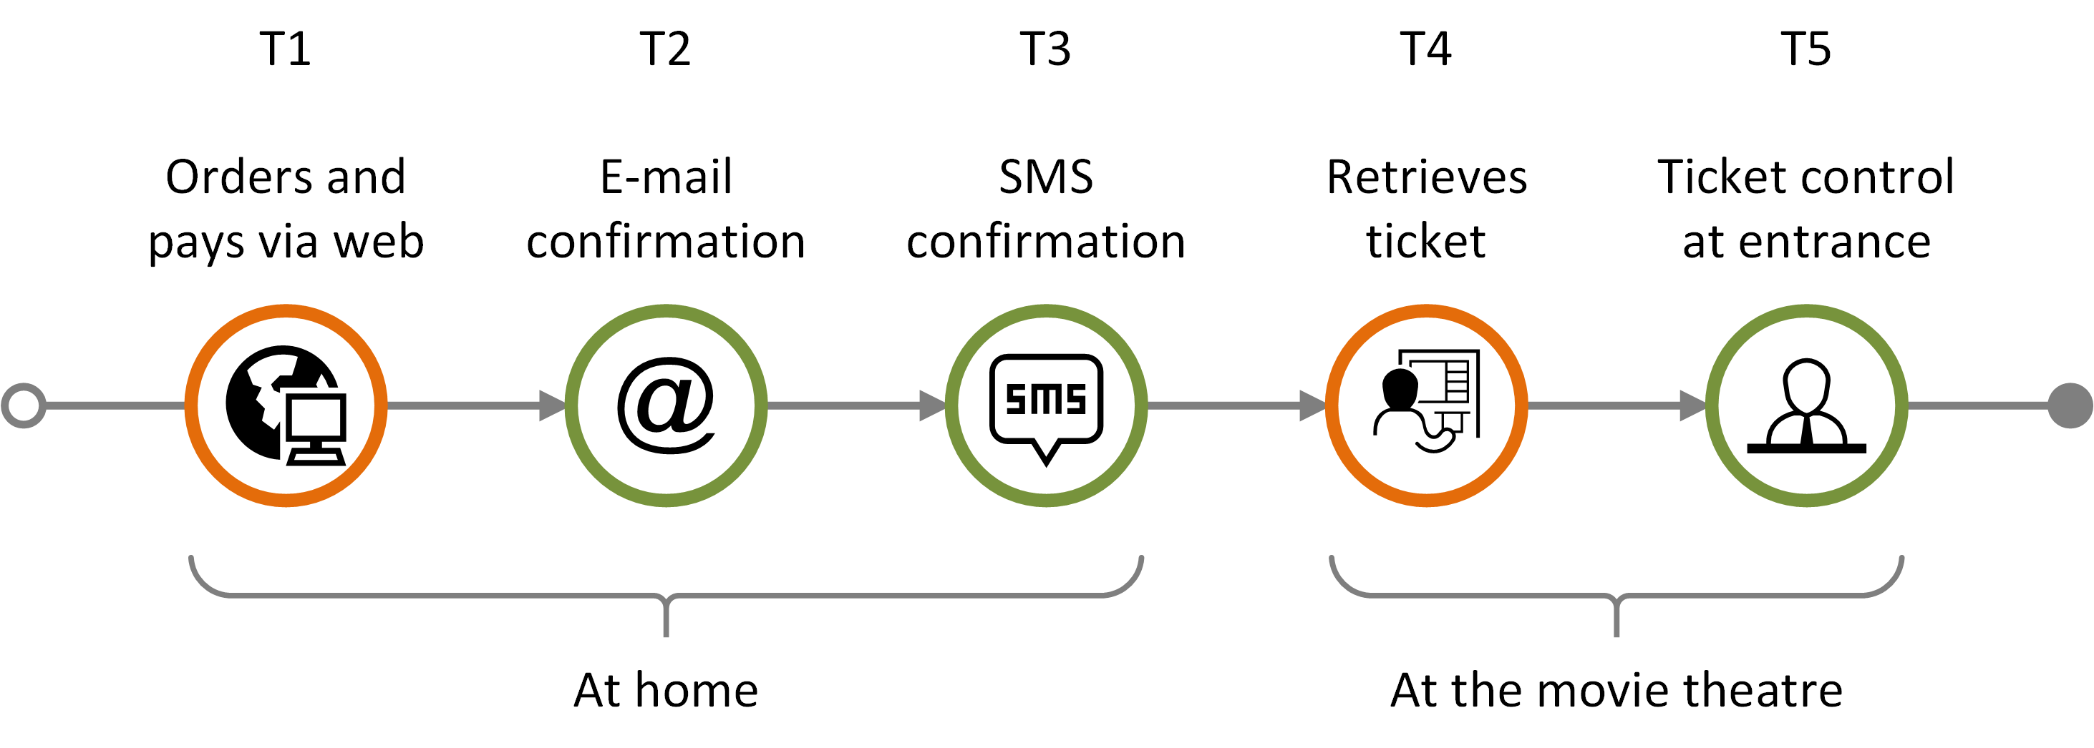
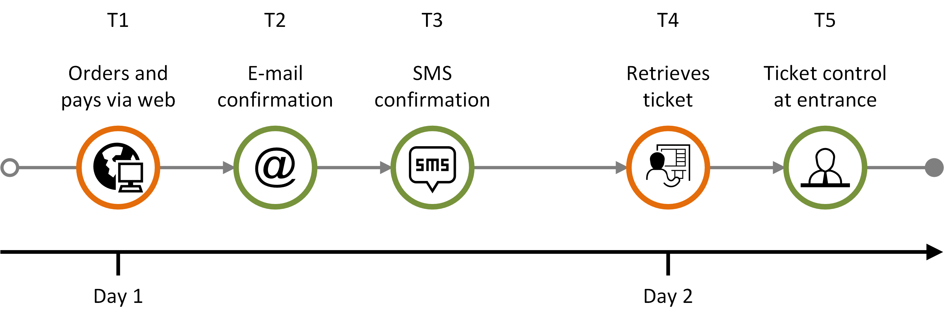
Features – plain journey diagram (1)
Planned and actual journey
Planned customer journey containing an unordered sequence (brackets)
Planned customer journey consisting of a sequence in chronological order, with journey phase
Planned customer journey consisting of a sequence in chronological order, with a timeline
Overview
Symbols
Customer journey diagram
Journey network diagram
Customer experience
Appendix

Slide 59
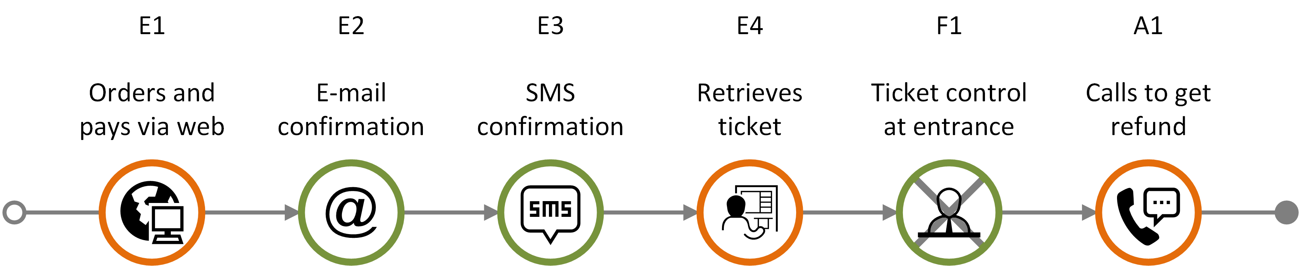
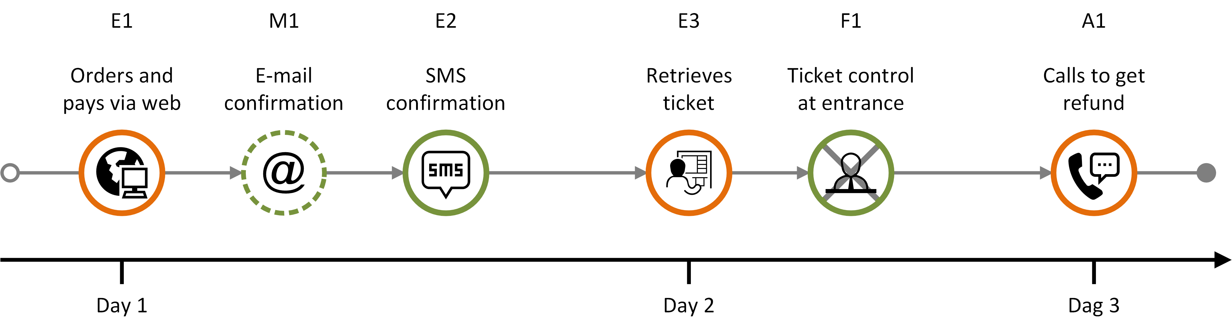
Features – plain journey diagram (2)
Actual journey
failing
communication point
ad hoc
communication point
Actual journey consisting of:
four completed expected communication points (E1-E4)
one failing communication point (F1)
one ad hoc communication point (A1)
missing communication point
failing
communication point
ad hoc communication point
Actual journey with timeline consisting of:
three completed expected communication points (E1-E3)
one missing communication point (M1)
one failing communication point (F1)
one ad hoc communication point (A1)
Overview
Symbols
Customer journey diagram
Journey network diagram
Customer experience
Appendix

Slide 60



Deviation diagram - basics
Actual journey
Expected and deviating touchpoints are shown in two different layers.
Missing communication points that are part of the planned journey appear as gray "ghost" symbols in the upper level.
E1
E2
E3
The expected elements appear above the line
When a deviation follows as a direct consequence of an ad hoc, missing, or failing element, it is displayed vertically below the touchpoint it originated from.
Otherwise, it should be positioned beside the preceding touchpoint.
M1
F1
The deviations (ad hoc, missing, and failing touchpoints) are shown below the line.
Missing and failing communication points that are part of the planned journey appear in the lower "deviations" level showing status and initiator.
A1
Overview
Symbols
Customer journey diagram
Journey network diagram
Customer experience
Appendix

Slide 61
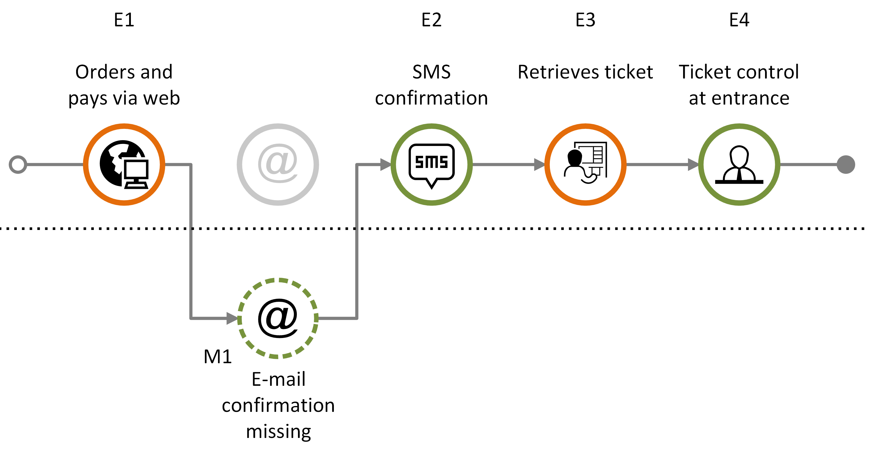
Deviation diagram: Missing touchpoint
Actual journey
Customer journey consisting of a sequence of expected communication points (E1-E4) and with one missing communication point (M1).
Overview
Symbols
Customer journey diagram
Journey network diagram
Customer experience
Appendix

Slide 62
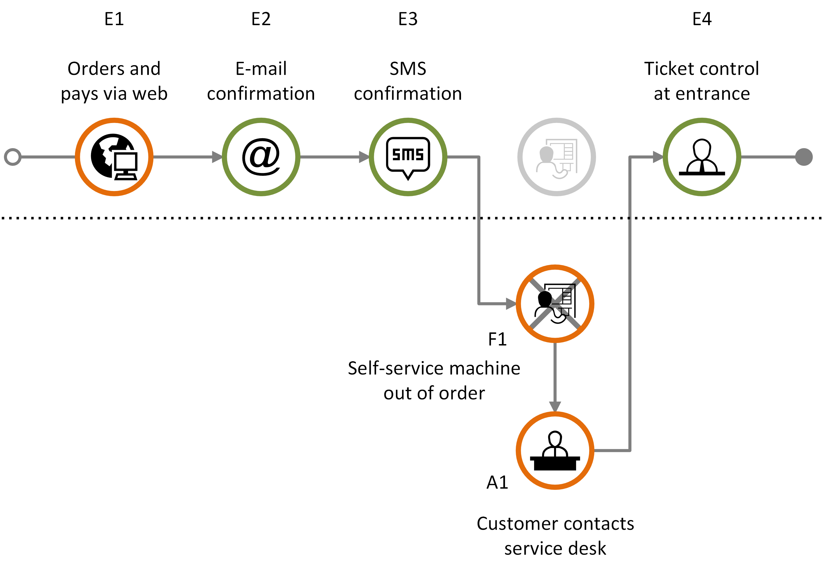
Deviation diagram: Failing touchpoint
Actual journey
Customer journey consisting of expected communication points (E1-E4), with one failing communication point (F1) that in turn generates an ad hoc communication point (A1).
Overview
Symbols
Customer journey diagram
Journey network diagram
Customer experience
Appendix

Slide 63
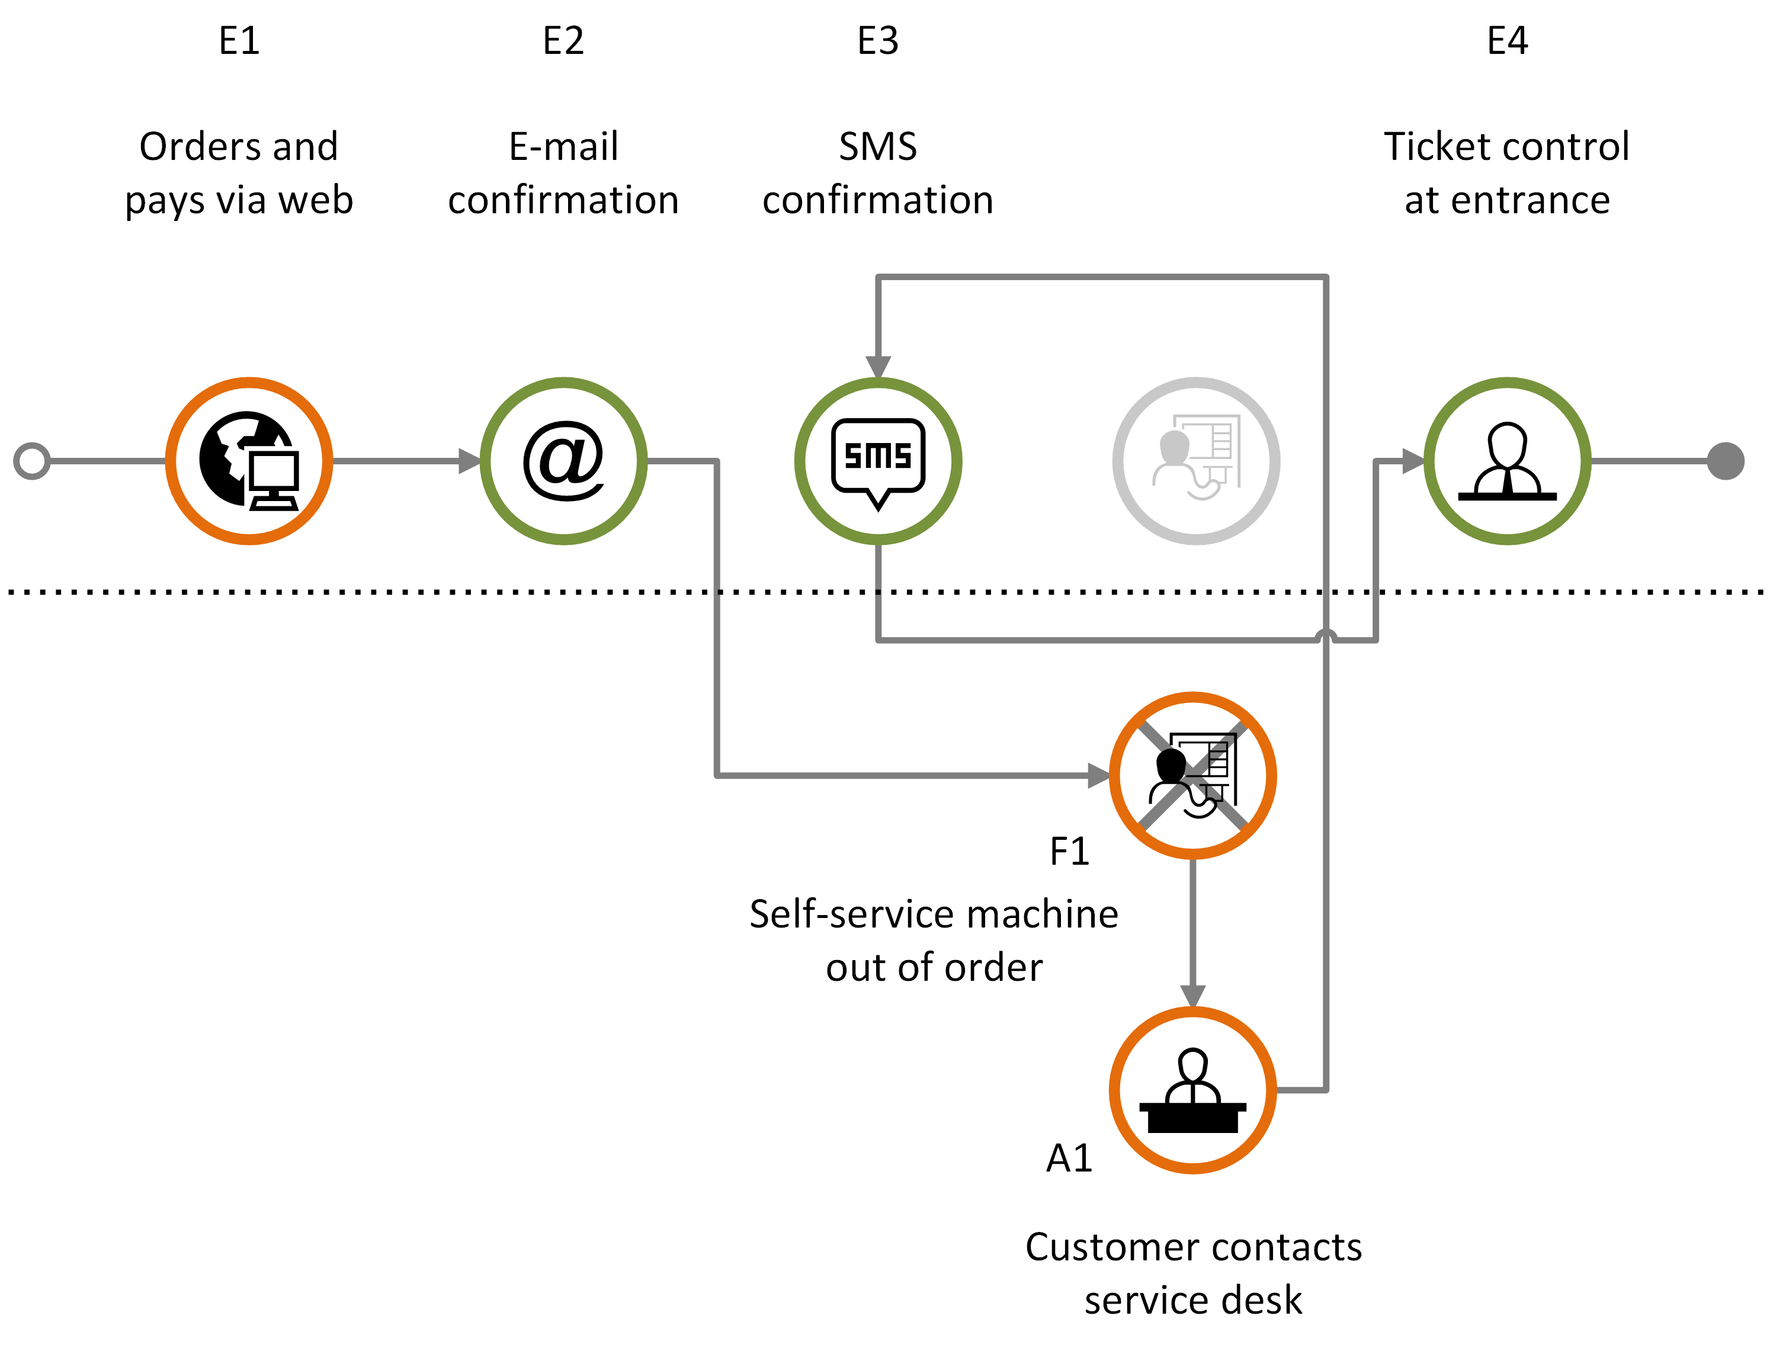
Deviation diagram: Sequence error
Actual journey
Customer journey including sequence errors and one failing element (F1) that in turn generates an ad hoc communication point (A1).
Overview
Symbols
Customer journey diagram
Journey network diagram
Customer experience
Appendix

Slide 64


Example planned journey – (1/2)
Planned journey
Planned journey of ordering electricity from a utility company.
Receives call from telemarketing and agrees to an electricity deal
Receives request for agreement confirmation and meter reading
Reads
the meter
Sends agreement confirmation and meter reading
Receives info about the agreement being processed
Customer
Calls the customer and offers an electricity deal
Sends request for agreement confirmation and meter reading
Receives agreement confirmation and meter reading
Customer info is sent to power supplier
Tele-
marketing
Receives customer info
Sends info about the agreement being processed
Power supplier
Grid company
Bank-
related
Overview
Symbols
Customer journey diagram
Journey network diagram
Customer experience
Appendix

Slide 65

Example planned journey – (2/2)
Planned journey
Planned journey of ordering electricity from a utility company.
Receives a welcome call
Receives meter reading notification
Reads
the meter
Sends
the meter reading
Receives invoice
Pays invoice
Customer
Tele-
marketing
Calls the customer for a welcome call
Receives payment
Power supplier
Sends notification for meter reading
Receives the meter reading
Sends invoice to be forwarded to customer
Grid company
Receives invoice to be forwarded to customer
Invoice ready for customer
Bank-
related
Overview
Symbols
Customer journey diagram
Journey network diagram
Customer experience
Appendix

Slide 66
Example actual journey – (1/2)
Actual journey
Missing communication point: The SMS about the agreement being processed is not received
Actual journey of ordering electricity from a utility company.
Receives a call from telemarketing and agrees to an electricity deal
Receives a request for agreement confirmation and meter reading
Reads
the meter
Sends agreement confirmation and meter reading
Receives info about the agreement being processed
Customer
Calls the customer and offers an electricity deal
Sends a request for agreement confirmation and meter reading
Receives agreement confirmation and meter reading
Customer info is sent to the power supplier
Tele-
marketing
Receives customer info
Sends info about the agreement being processed
Power supplier
Grid company
Bank-
related
Overview
Symbols
Customer journey diagram
Journey network diagram
Customer experience
Appendix

Slide 67
Example actual journey – (2/2)
Actual journey
Failing communication point: The customer fails to send the meter reading.
Actual journey of ordering electricity from a utility company.
Receives a welcome call
Receives a meter reading notification
Reads
the meter
Sends
the meter reading
Receives invoice
Pays invoice
Customer
Tele-
marketing
Calls the customer for a welcome call
Receives payment
Power supplier
Sends a notification for meter reading
Receives the meter reading
Sends invoice to be forwarded to the customer
Grid company
Receives invoice to be forwarded to the customer
Invoice ready for the customer
Bank-
related
Overview
Symbols
Customer journey diagram
Journey network diagram
Customer experience
Appendix

