Slide 1
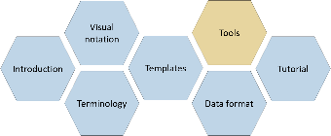

Tools
CJML – Customer Journey Modeling Language
Version 3.0 • June 2026
SINTEF Digital | Human-Computer Interaction Research Group

Slide 2
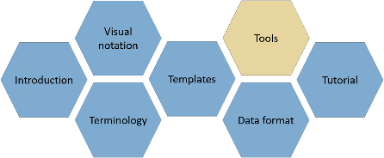

About
CJML consists of several modules, each covering a different aspect of the language. All resources are available at www.cjml.no.
Diagram types, symbol gallery, visual features, and examples
Tools for creating and working with journeys
Overview of CJML, its conceptual foundation, and a quick tour of the visual notation
Guidance on journey thinking, journey data, approaches to analysis, and use cases
Definitions, metamodel, class diagrams, and model attributes
Machine-readable model structure, XML format, and data exchange
PowerPoint templates for quick, flexible diagramming with examples
Contact us: For questions or feedback, contact us at CJML<at>sintef.no
CJML v3 was developed as part of the research project Smart Journey Mining, funded by the Research Council of Norway (grant no. 312198).
How you may use this material: © SINTEF, licensed under
CC BY-SA 4.0. You may use, share, and adapt it with attribution, with adaptations shared under the same license.

Slide 3
Content
Tools for different purposes
Tool 1: Diagram templates
Tool 2: Template for journey data
Tool 3: CJML converter
Tool 4: CJML editor

Slide 4
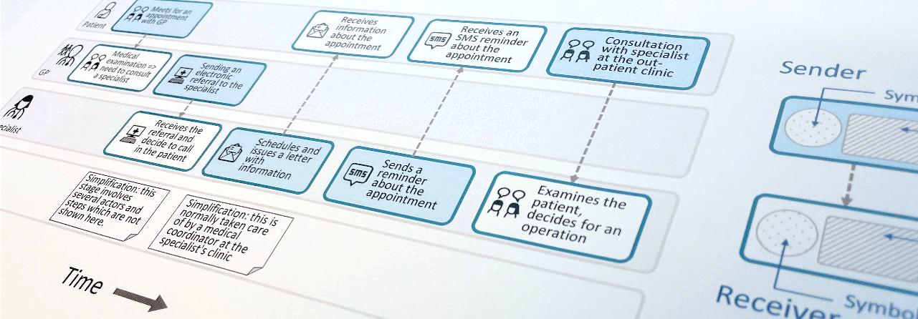
Customer Journey Modeling Language
CJML is a visual language for modeling the journey of an individual, regardless of whether the person has the role of customer, user, employee, patient, or citizen.
CJML consists of terminology, visual notation, a machine-readable data format, methods, and supporting tools.
Customer journey
User journey
Employee journey
Patient journey
Citizen journey
4

Slide 5

Tools for different purposes

Slide 6
Tools for different purposes
💡
Not sure which tool to choose? Check out the Tutorial module for guidance.
CJML currently provides four tools for working with journeys.
The tools support different ways of working with journeys.
Some tools provide full modeling freedom, while others provide more structure and validation.
The Tutorial module provides guidance on how to choose a tool depending on your starting point:
  For example, it shows how to move from a mental idea to thinking in terms of journeys.
  It discusses tools in terms of granularity, flexibility, and automation.
  It also presents different use cases for journey analysis.
The tools are research prototypes, developed as part of our research activities.
They are provided as-is for exploration and use, without a dedicated support service.
All tools and other CJML materials are available at www.cjml.no

Slide 7
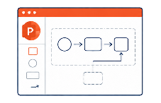
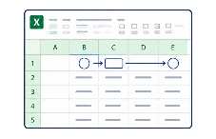
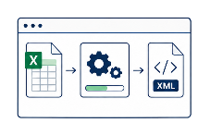
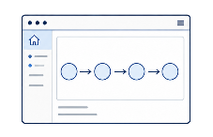
Overview of tools
Start simple. Keep full visual freedom.
Get structured. Capture journeys as data.
Make it machine-readable (xCJML).
Go fully structured.
Create, import, export.
Tool 1: Diagram templates
Tool 2: Template for journey data
Tool 3: CJML converter
Tool 4: CJML editor
Easy entry point to CJML, using PowerPoint
Ready-made templates for planned and actual journeys and both diagram types
Includes user experience, phases, and domain-specific examples from healthcare and data protection
Provides full modeling freedom, but no built-in validation
Excel template with predefined CJML fields and drop-down lists
Easy data entry, requiring minimal prior knowledge of CJML
First step towards automatic diagram generation through the Converter (Tool 3) and Editor (Tool 4)
Supports structured data entry with some built-in validation
Software that takes a journey specified in Excel as input.
Supports sorting of actors and selection of actor icons to control how they appear in the resulting model.
Supports grouping of similar actors.
Converts the journey data into a machine-readable format (xCJML), ready for use in other tools.
Web-based application for creating journey diagrams.
Supports multiple journeys and flexible input through drag-and-drop, questionnaires, or xCJML import.
Supports switching between diagram types.
Supports xCJML import/export, model validation, and export of diagrams as images.

Slide 8
Tool 1: Diagram templates
Start simple. Keep full visual freedom.

Slide 9
About diagram templates
The most accessible entry point to CJML, designed for immediate use in Microsoft PowerPoint and compatible software.
Ready-to-use templates for planned and actual journeys, supporting both diagram types:
  Customer journey diagrams.
  Journey network diagram (“swimlanes”).
The templates contain the visual elements needed to create journeys:
  Support for 2 to 5 distinct actors.
  A symbol gallery presenting all icons for CJML Core and additions.
  Touchpoints with or without associated customer experience.
  Touchpoints with or without associated comments.
Additional features, including journey phases and deviations.
Examples demonstrating the templates in different contexts, including business, health, cybersecurity, and data privacy.
Tool at a glance
🏷️ Type: PowerPoint template
🎯 Best for: Flexible and creative journey modeling with complete design freedom
⬇️ Input: Journey information
⬆️ Output: Journey diagram (.pptx)
⚙️ Requires: Microsoft PowerPoint
💡Guidance: Integrated within the templates. Elements from the CJML documentation may also be copied and adapted
📍 Where to find: All CJML tools are available at cjml.no/tools. The diagram templates are a separate module of the CJML specification, available at cjml.no/cjml

Slide 10
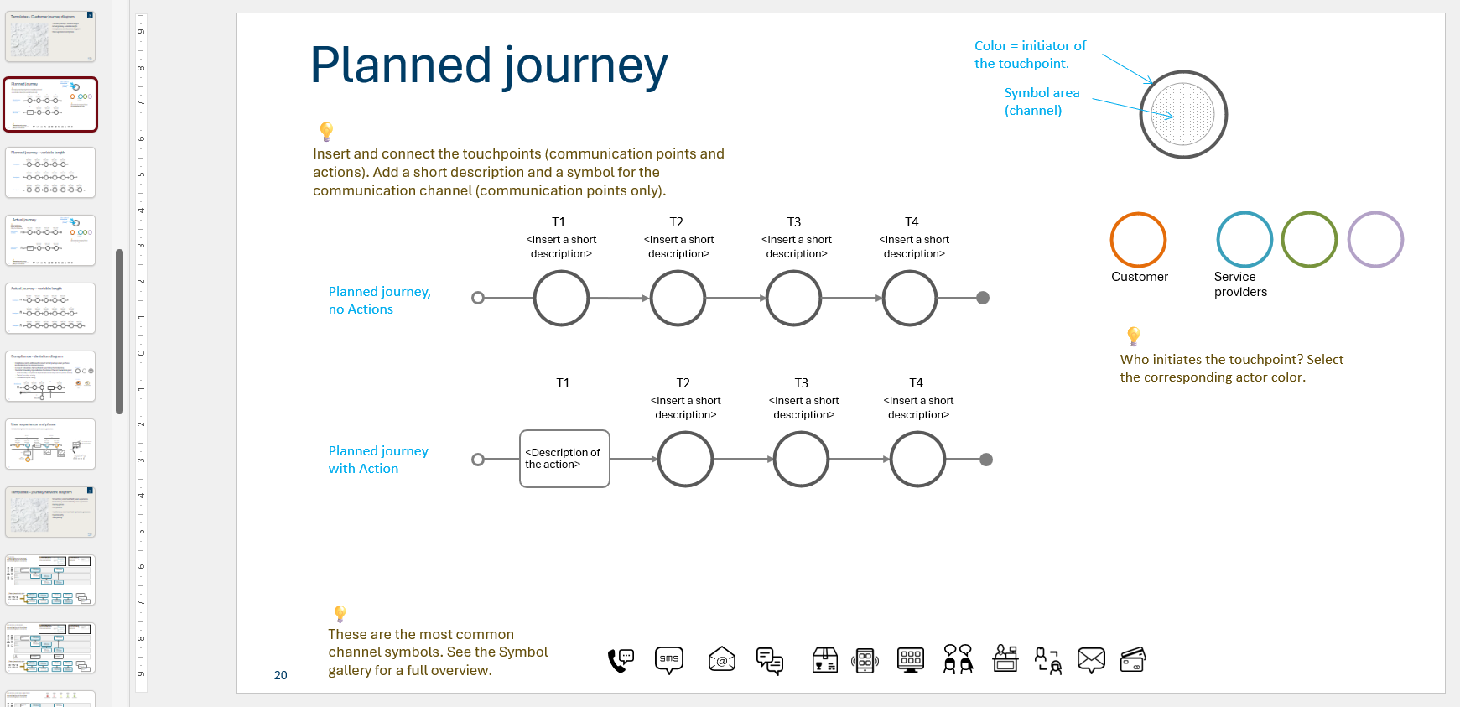
Template for customer journey diagram
Built-in guidance on how to use the templates
Ready-made elements for drag-and-drop journey modeling

Slide 11
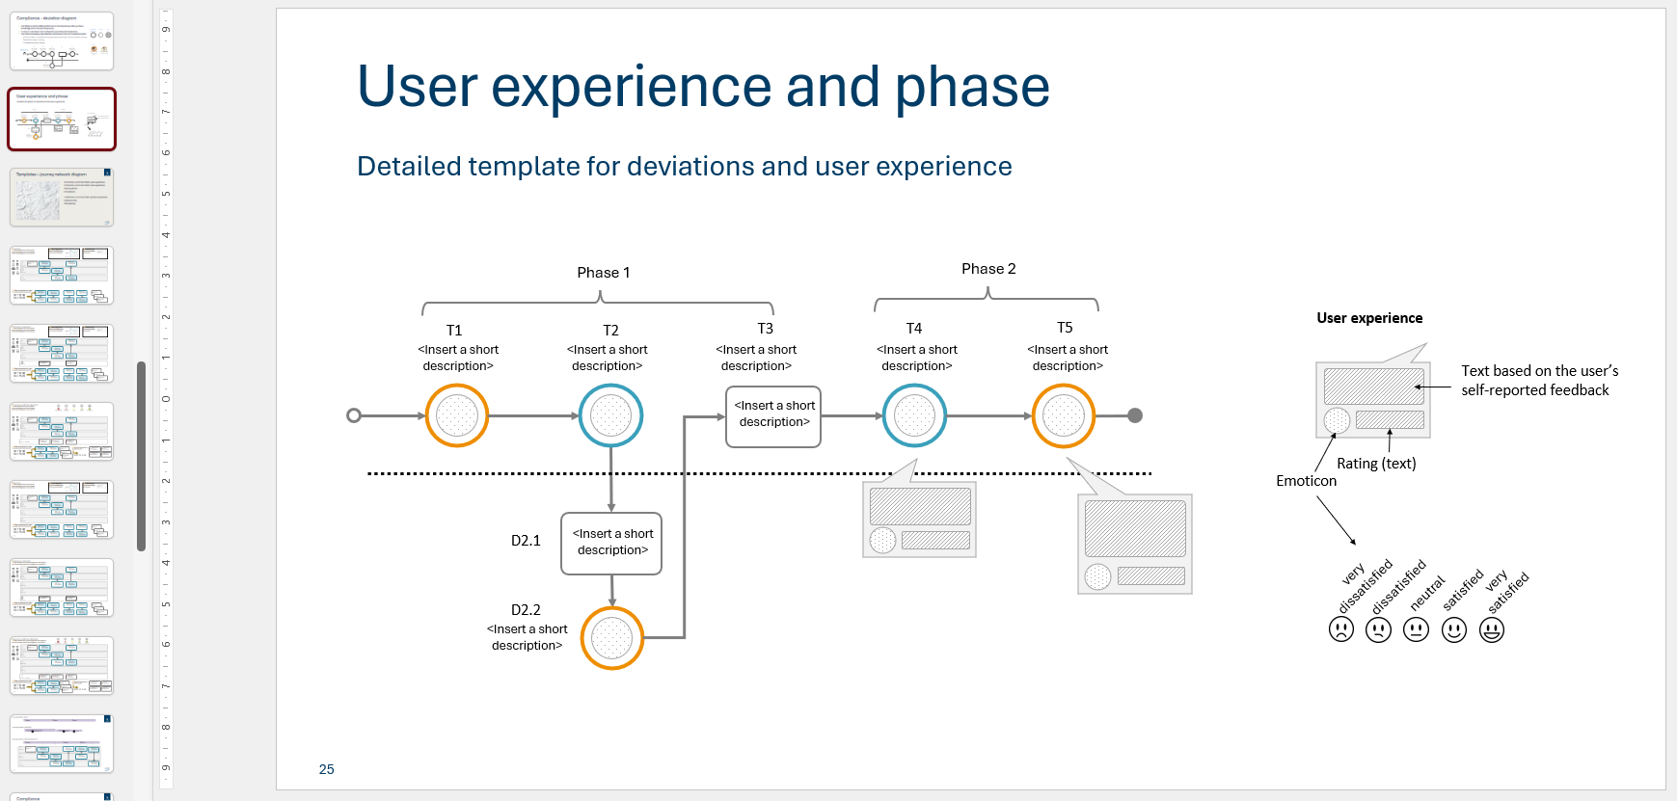
Template for deviation diagram and experience
Built-in guidance on how to use the templates
Ready-made elements for drag-and-drop journey modeling

Slide 12
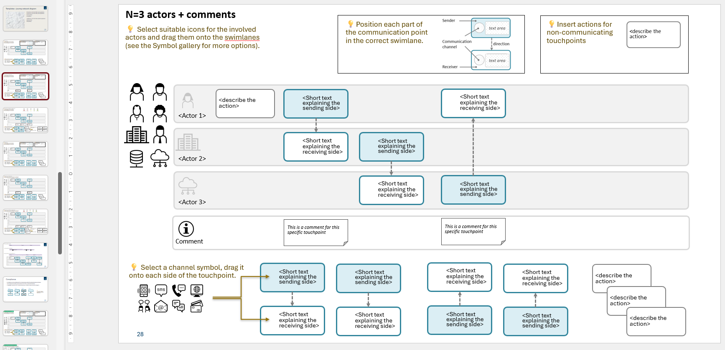
Template for swimlane diagram, three actors
Built-in guidance on how to use the templates
Ready-made elements for drag-and-drop journey modeling

Slide 13
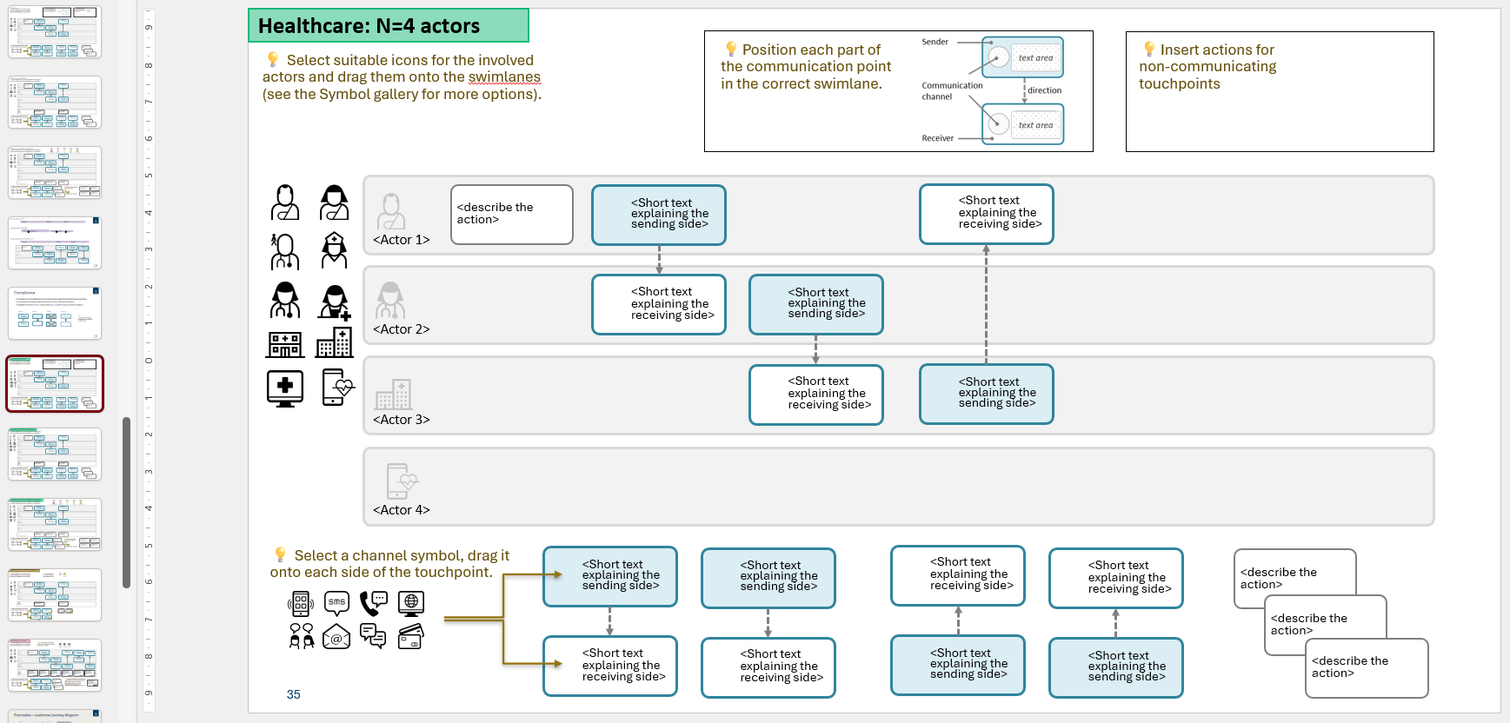
Template for healthcare journey
Built-in guidance on how to use the templates
Ready-made elements for drag-and-drop journey modeling

Slide 14
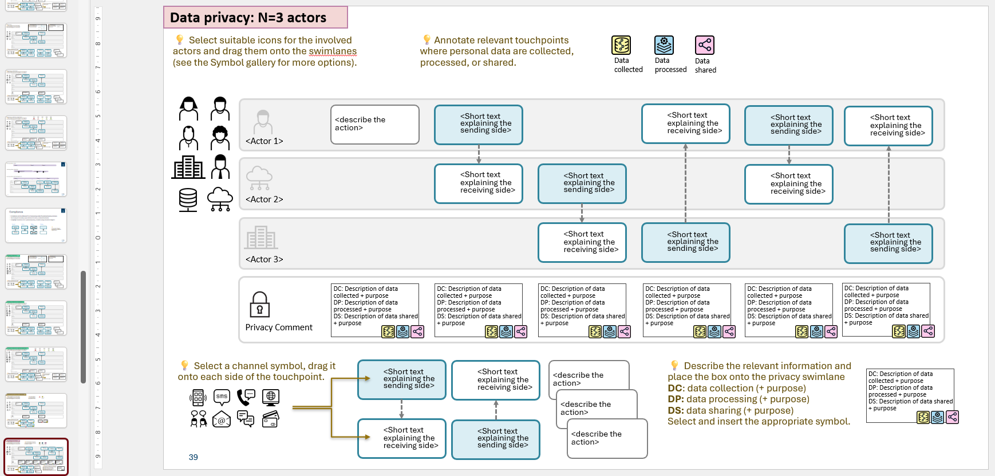
Template for data privacy journey
Built-in guidance on how to use the templates
Ready-made elements for drag-and-drop journey modeling

Slide 15
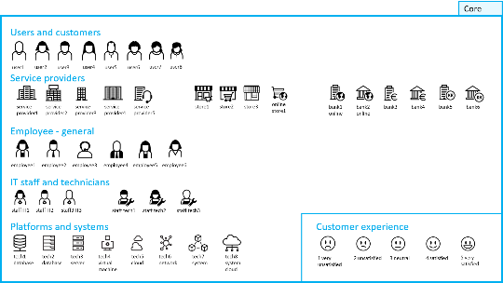
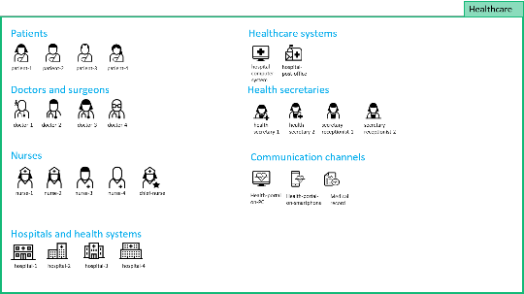
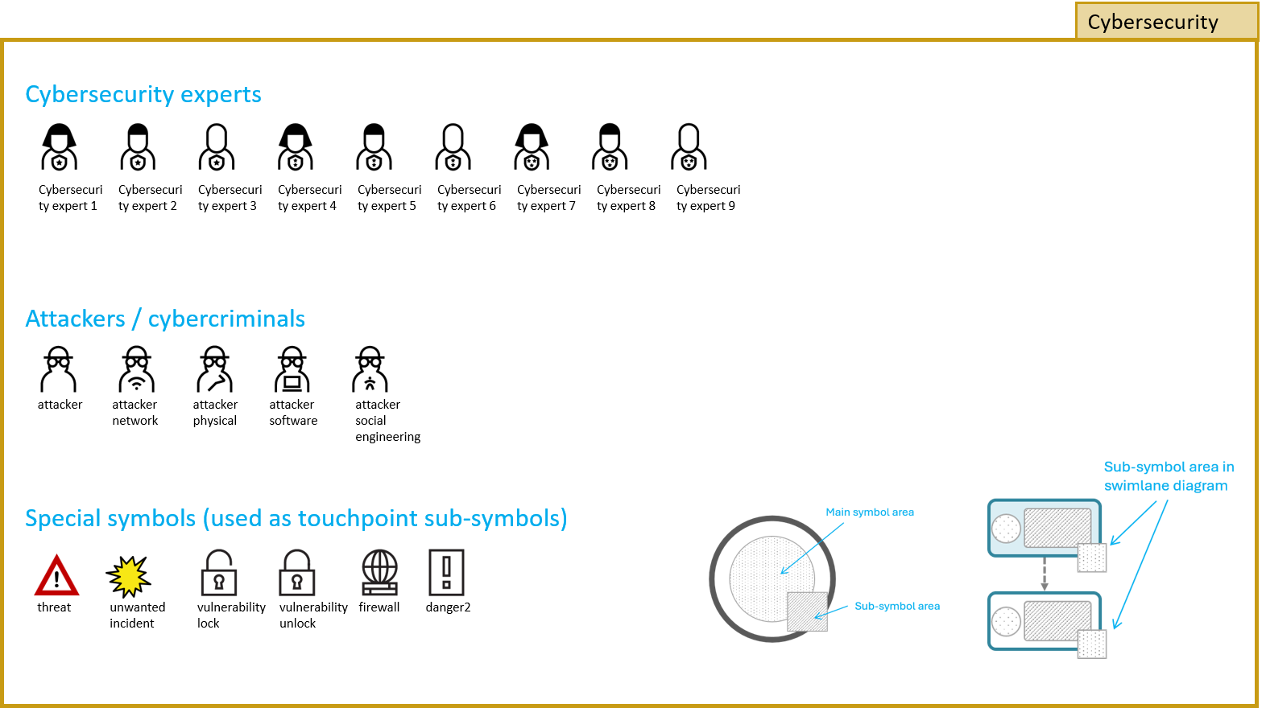
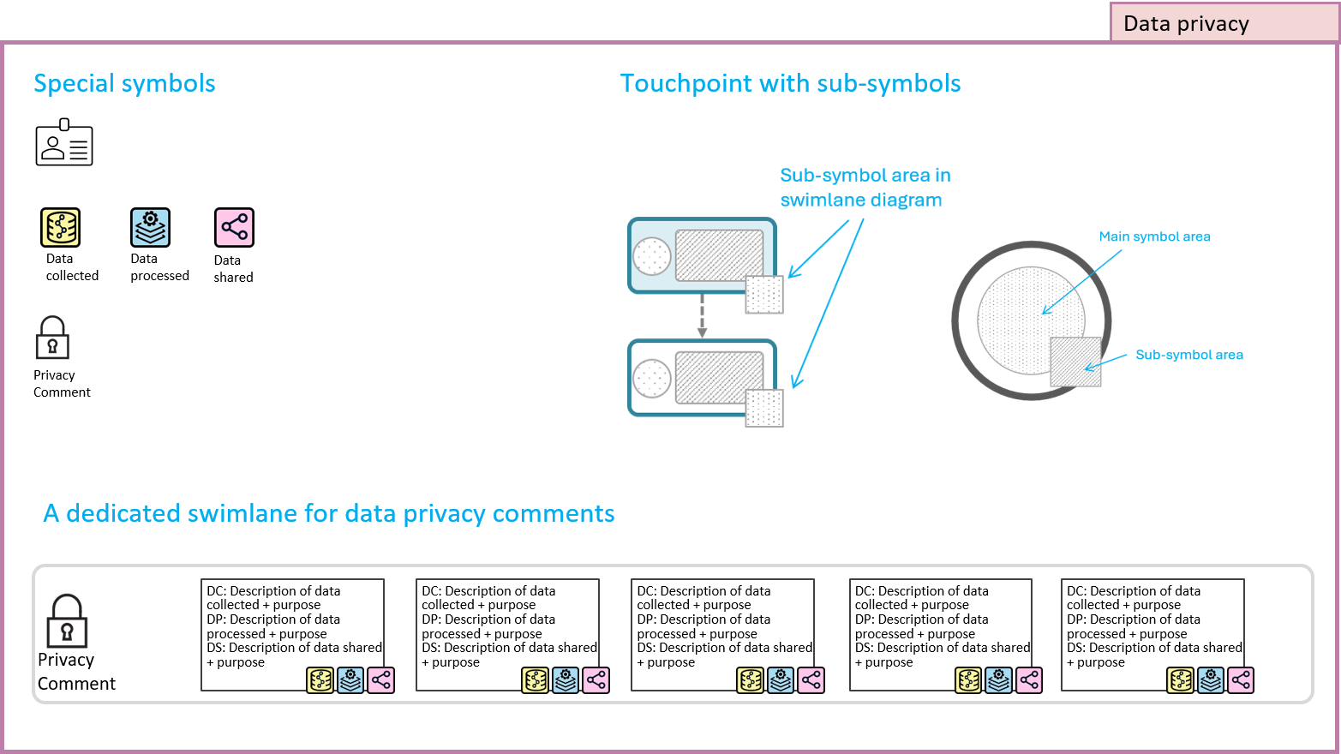
Symbol gallery

Slide 16
Tool 2: Template for journey data
Get structured.
Capture journeys as data.

Slide 17
About the data template
💡
A completed template can be converted to xCJML using the CJML Converter.
A lightweight, no-code solution for capturing customer journeys directly in Microsoft Excel.
The template requires minimal prior knowledge of CJML.
  It contains predefined fields covering all essential CJML attributes.
  It contains drop-down menus for standardized, consistent, and error-free data entry.
Journey data entered in the Excel template can be converted to machine-readable xCJML using the CJML Converter.
The resulting xCJML file can then be imported into the CJML Editor.
The next slide explains the four standard tabs, each serving a different purpose.
Tool at a glance
🏷️ Type: Excel template
🎯 Best for: Creating and organizing journey data and preparing it for conversion to xCJML.
⬇️ Input: Journey information
⬆️ Output: Structured journey data ready for xCJML conversion.
⚙️ Requires: Microsoft Excel
💡Guidance: The template includes an integrated guide and provides notes above relevant cells to indicate required fields.
📍 Where to find: All CJML tools are available at cjml.no/tools.

Slide 18
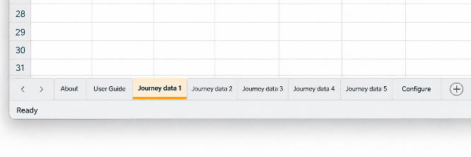
The Excel template at a glance
The template has four tabs, of which Journey data is the essential one.
  About: Provides information about the template and its version history.
  User Guide: Provides instructions for completing the template and explains the different fields.
  Journey data: The essential tab for entering journey data, including general journey information and touchpoints.
  Configure: Contains the values used in the drop-down menus.
Note that the same Excel file can contain multiple Journey data tabs for different journeys.
  The CJML Converter parses each Journey data tab separately and includes them in the same xCJML file.
💡
You can have multiple tabs with journey data in the same Excel file.

Slide 19
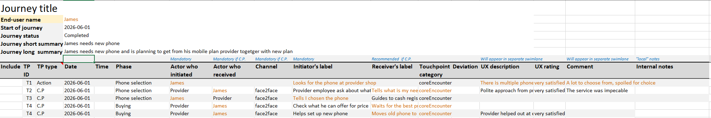
A closer look at the Journey data tab
The Journey data tab consists of two parts.
The journey header contains general information.
Touchpoint data are entered in the table below, with one touchpoint per row.
Mandatory fields are indicated by a hint above the relevant column.
Text referring to the end user is automatically highlighted.
Journey header
Touchpoint data

Slide 20
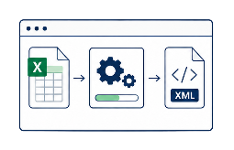
Tool 3: CJML converter
Make it machine-readable.
Turn journeys into xCJML.

Slide 21
About the CJML converter
The CJML converter is a step towards automatically generating a journey diagram from structured journey data.
It takes a completed Template for journey data (Tool 2) as input and converts it to the xCJML format.
The resulting xCJML file can be imported into the CJML Editor (Tool 4) to automatically generate a journey diagram.
In addition to generating xCJML, the converter can help with the following:
  Actor grouping
  Actor ordering
  Assigning icons
The application is currently available for Windows only.
Tool at a glance
🏷️ Type: Application (.exe)
🎯 Best for: Converting completed journey data templates to xCJML.
⬇️ Input: Excel template
⬆️ Output: xCJML (.xml)
⚙️ Requires: Microsoft Windows
💡Guidance: See the following slides.
📍 Where to find: All CJML tools are available at cjml.no/tools, which also provides a link to this tool on GitHub.

Slide 22
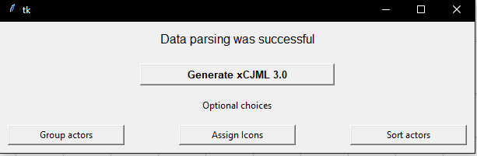
Running the application
💡
Note that the CJML Converter may take some time to respond, both when selecting the Excel file and when processing it.
When the application is opened, select the Excel file using the file browser.
If the file is valid, the data is parsed and the main menu appears.
You can go directly to Generate xCJML if no further adjustments are needed.
The menu also provides the following options:
  Group actors
  Assign icons
  Sort actors
The xCJML file is saved in the same folder as the application, with a filename based on the current date and the Excel filename.

Slide 23
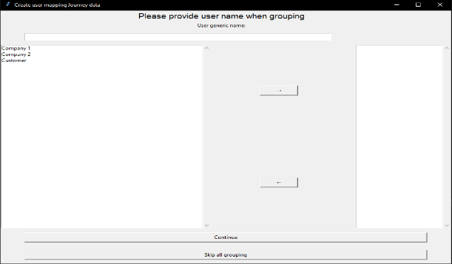
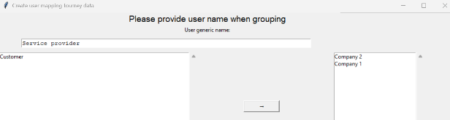
Grouping actors
The converter supports actor generalization, allowing similar actors to be grouped into common categories.
Use the Grouping window to view and merge actors into a single representation.
Touchpoints are automatically transferred to the merged actor.
The changes are automatically reflected in the xCJML file.
Example: If the customer journey includes Company 1 and Company 2, they can be grouped into a single actor: Service provider.

Slide 24
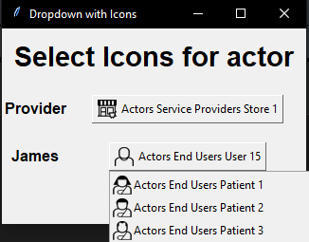
Assigning icons
Selecting Assign icons opens a window showing all actors, including grouped actors.
Select an actor to choose an icon from the drop-down list
of CJML icons.
Select Submit when the icons have been assigned.
The application then proceeds to actor sorting.

Slide 25
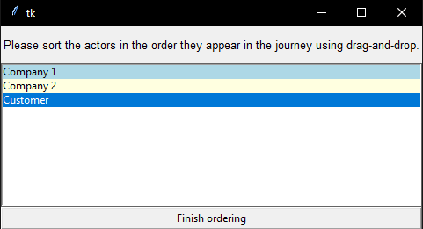
Sorting actors
Selecting Sort actors allows you to arrange the order in which the actors appear in a swimlane diagram.
Use drag and drop directly in the menu to arrange the actors in the desired order.
Clicking Finish ordering generates the xCJML file.

Slide 26
Tool 4: CJML editor
Go fully structured.
Create, import, export.

Slide 27
About the CJML editor
💡Create a diagram using the canvas or import an xCJML file to automatically generate a journey diagram.
A web application that runs in a web browser for creating and working with journey diagrams.
There are several ways to create a diagram:
  Drag and drop visual elements onto the canvas.
  Import xCJML files.
  Fill in forms.
Core functionality
  xCJML compatibility: Read and generate xCJML files for interoperability with other tools.
  Multi-journey support: Create and manage multiple journeys within a single session.
  Dynamic diagram switching: Automatically translate between the two diagram types.
  Image export: Export journey diagrams as high-quality images.
Tool at a glance
🏷️ Type: Web-based application
🎯 Best for: Creating diagrams via a graphical interface or automatically from an xCJML file.
⬇️ Input: Journey information or an xCJML file .
⬆️ Output: Diagrams (PNG) or xCJML files (.xml).
⚙️ Requires: A modern web browser.
💡 Guidance: See the following slides, or the Help button in the application.
📍 Where to find: All CJML tools are available at cjml.no/tools. The CJML Editor is available directly at https://cjml.netlify.app.

Slide 28
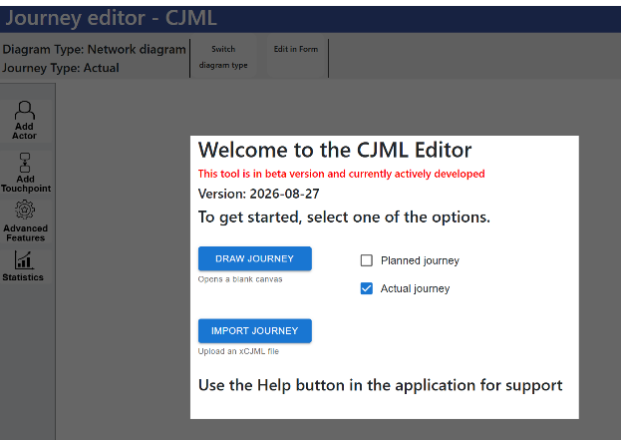
Opening the CJML Editor
Choose between two options:
  “Draw journey” opens a blank canvas for building the diagram using drag and drop from the menus.
  “Import journey” uploads an existing journey model in xCJML and automatically generates the diagram.
Once a journey has been created or imported, icons and touchpoints can be modified, and elements can be added or removed.

Slide 29
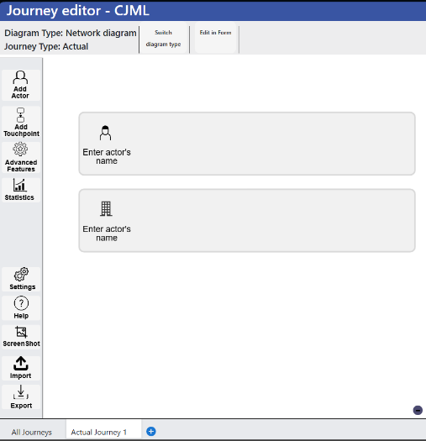
The CJML Editor workspace
Overview pane showing diagram type and journey type
Diagram switch
Editing mode switch
Overview pane – Shows the current diagram type and journey type.
Diagram switch – Switches between the network diagram and journey diagram.
Editing mode switch – Switches to form mode for journey entry.
Journey editing options – Adds actors and touchpoints, and enables experience and evaluation features.
Statistics – Shows the number of touchpoints.
Journey settings – Controls default colors, user experience, touchpoint IDs, comments, journey type, and icons.
Import and export – Imports xCJML files and exports diagrams as PNG or xCJML.
List of journeys – Adds new journeys and provides a summary view of all journeys.
Journey drawing canvas
Journey editing options
Simple statistics
Journey settings, help, import and export
List of journeys

Slide 30
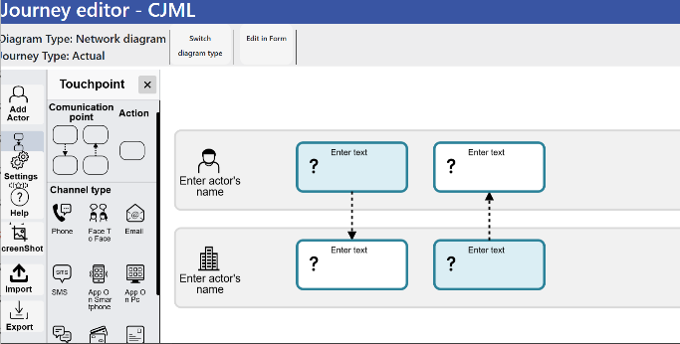
Building a diagram on the canvas
The canvas is used to build the journey diagram.
Start by adding actors. Selecting Actors opens a menu with the available options (see next slides).
Next, add touchpoints by selecting from the Touchpoint menu (see next slides).
Touchpoints can be moved freely on the canvas.
Touchpoint labels and actor names can be edited.
Selecting a touchpoint opens a menu where its properties can be edited using drop-down lists.

Slide 31
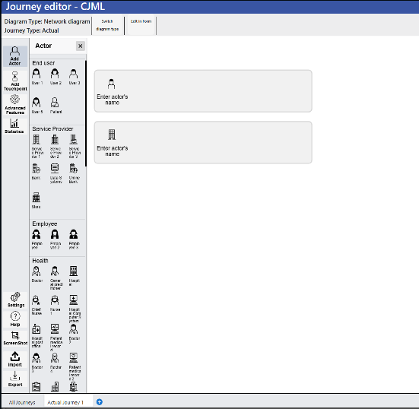
Adding actors
Selecting Add Actor opens a submenu with the available actor icons.
Select an icon to add the actor below the existing actors.
Alternatively, drag and drop an actor icon directly onto the desired position on the canvas.
The icons are grouped into four categories:
  End user
  Service provider
  Employee
  Health

Slide 32
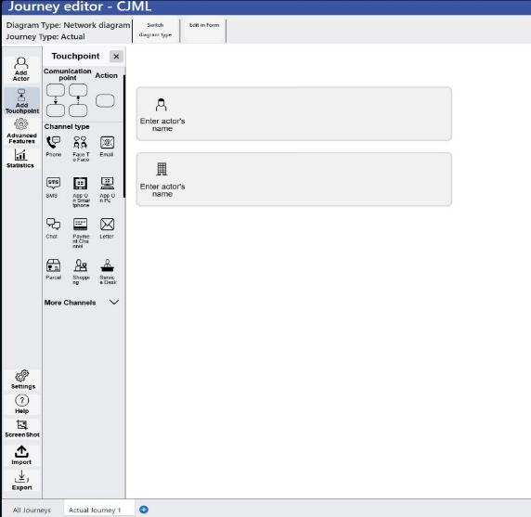
Adding touchpoints
Selecting Add Touchpoint opens a submenu with the available touchpoint icons.
The icons are grouped into Communication points, Actions, and Channels.
Selecting More Channels provides access to additional, less frequently used channel icons.

Slide 33
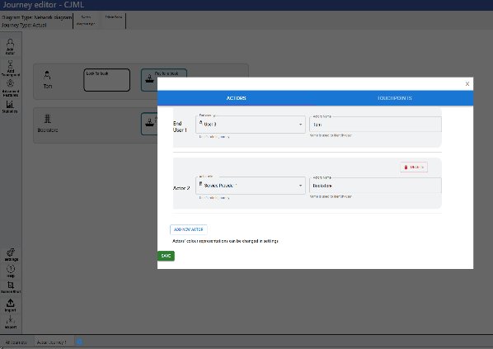
Editing in form mode
When opened, the form is populated with the current canvas data.
The form has two sections: Actors and Touchpoints.
Actors and touchpoints can be added or edited.
Names, labels, and icons can be changed.
Save applies the changes to the canvas.

Slide 34
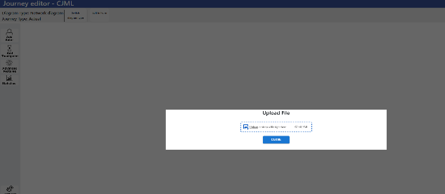
Importing an xCJML file
Selecting Import journey, either at startup or from the canvas, opens the import window.
An xCJML or XML file can be uploaded by drag and drop or by selecting the file from the upload area.
The uploaded file is parsed and validated against the xCJML format.
If valid, the journey is visualized on the canvas.

