Slide 1
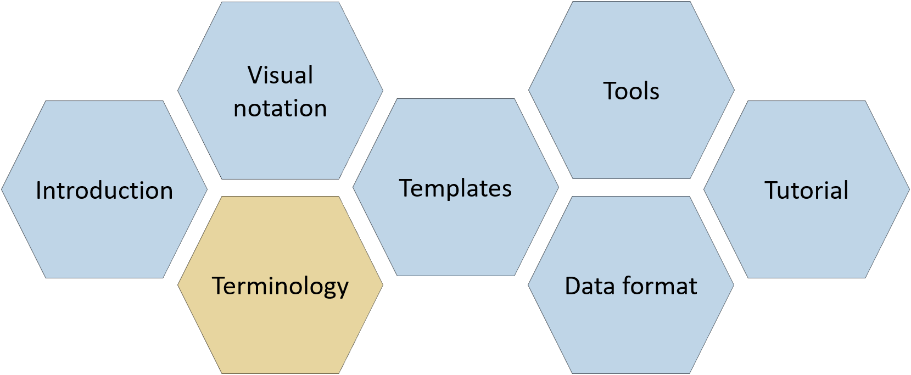
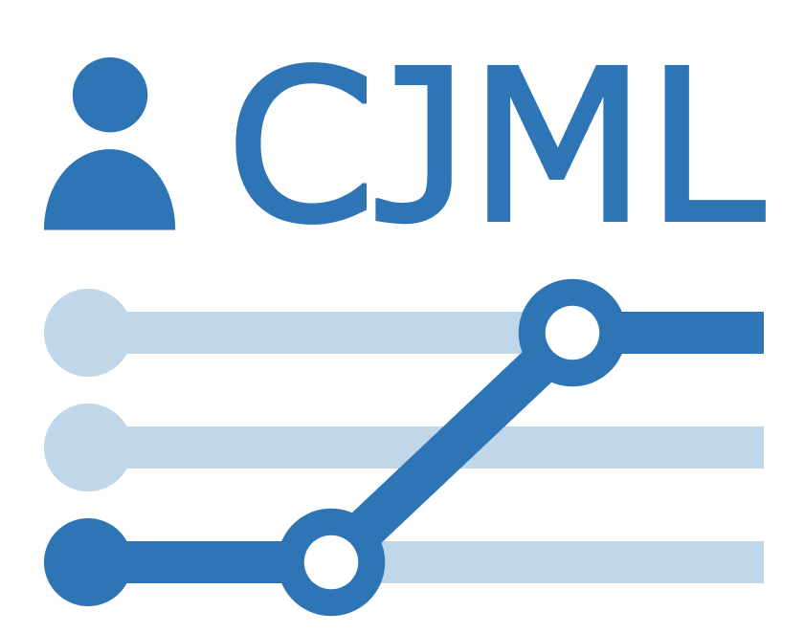
Terminology
CJML – Customer Journey Modeling Language
Version 3.0 • June 2026
SINTEF Digital | Human-Computer Interaction Research Group

Slide 2
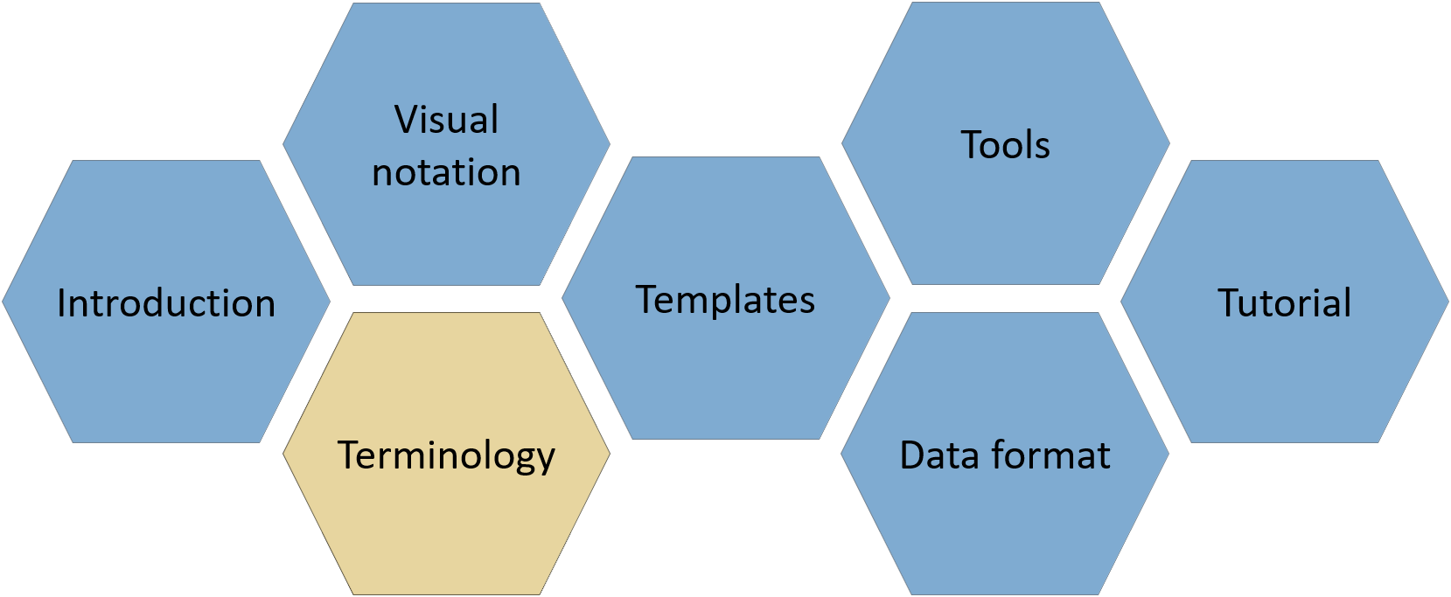

About
CJML consists of several modules, each covering a different aspect of the language. All resources are available at www.cjml.no
Diagram types, symbol gallery, visual features, and examples
Tools for creating and working with journeys
Overview of CJML, its conceptual foundation, and a quick tour of the visual notation
Guidance on journey thinking, journey data, approaches to analysis, and use cases
Definitions, metamodel, class diagrams, and model attributes
Machine-readable model structure, XML format, and data exchange
PowerPoint templates for quick, flexible diagramming with examples
Contact us: For questions or feedback, contact us at CJML<at>sintef.no
CJML v3 was developed as part of the research project Smart Journey Mining, funded by the Research Council of Norway (grant no. 312198).
How you may use this material: © SINTEF, licensed under
CC BY-SA 4.0. You may use, share, and adapt it with attribution, with adaptations shared under the same license.

Slide 3
Content
Overview
  Terminology and metamodel
  Main changes in CJML version 3
  Deprecated features
  Metamodel basics
  CJML simplified metamodel
  How to read the terminology
Terminology
  Customer journey
  Planned journey
  Actual journey
  Touchpoint
  Planned touchpoint
  Actual touchpoint
  Planned communication point
  Actual communication point
  Planned action
  Actual action
  Initiator
  Receiver
  Channel
  Message
  Back-end system
  Object
  End-user experience
  Journey phase
  Journey operator
  Concurrency
  Decision
  Actor
  Service provider
  End-user
  External
CJML complete metamodel
  Without attributes
  With attributes - validated
Appendix
  Cybersecurity syntax
  Data privacy syntax
  Future work
  References

Slide 4



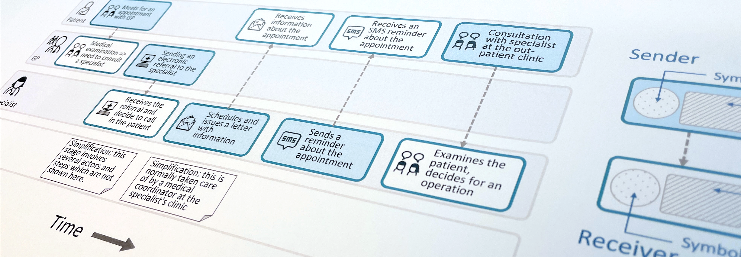
Customer Journey Modeling Language
CJML is a visual language for modeling the journey of an individual, regardless of whether the person has the role of customer, user, employee, patient, or citizen.
CJML consists of terminology, visual notation, a machine-readable data format, methods, and supporting tools.
Customer journey
User journey
Employee journey
Patient journey
Citizen journey
4

Slide 5

Overview
Terminology and metamodel
Main changes in CJML version 3
Deprecated features
Metamodel basics
CJML simplified metamodel
How to read the terminology

Slide 6
Terminology and metamodel
CJML is a conceptual modeling language for representing customer journeys.
The terminology provides a common vocabulary for describing journeys, including concepts such as touchpoints, actors, channels, and end-user experience.
The CJML metamodel specifies how these concepts are related.
The same conceptual model underlies both the visual notation and the machine-readable CJML data format.
The machine-readable format is XML-based and formally defined by an XML Schema (XSD).
CJML version 3 introduces several changes to the terminology and metamodel.
This overview presents the overall structure and the main changes from the previous version.
What is a metamodel?
A metamodel is “a model of a modeling language” (Mellor, 2004).
It specifies the building blocks, structure, relationships, and constraints of a modeling language.
What is a metamodel used for?
To define a modeling language precisely and consistently.
To make language definitions easier to understand, integrate, and manipulate (Evans et al., 2003).
To provide a foundation for model validation and machine-readable representations.

Slide 7
Main changes in CJML version 3
The changes are based on experience from applying CJML in practice.
Actors
  Actors can have multiple roles and belong to other actors, supporting hierarchies and generalization.
  The categorization of service providers has been revised and is now based on funding type or legal entity.
  Healthcare provider types have been introduced, including, for example, healthcare provider, clinical support service, digital health system, patient organization, and welfare service.
Touchpoints
  The new Touchpoint category allows touchpoints to be classified according to their function in the journey, making it easier to focus on specific aspects.
  Touchpoint categories include, for example, core encounter, supportive encounter, confirmation, status update, reminder, and payment.
Simplification
  Unused, unnecessary, or unsuitable attributes have been removed from several actor subclasses.

Slide 8
Deprecated features
Several attributes have been removed from End User:
  Preference, as it was not considered useful metadata and was not represented visually.
  Frustrations, as these are generally not known when modeling planned journeys. While potentially relevant for actual journeys, they were not supported by the visual notation.
  Preferred channels, as they were not represented visually and were not considered useful metadata.
Several attributes have been removed from Patient:
  Diagnosis, as a patient's diagnosis may change during treatment.
  Insurance name.
Several attributes have been removed from Employee:
  Company name, department, position, and years of experience.
Several attributes have been removed from Service Provider:
  Company name, department, and position. Organizational structure can instead be represented using the belongsTo relationship.

Slide 9
Metamodel basics
UML notation
Class diagram template:
multiplicity
Association
Inheritance
Aggregation
Composition
Note/Comment
Class
attribute1: Data Type attribute2: Data Type . . attributeN: Data Type
endpoint name [0..*]
Associated Class
endpoint name [0..*]
Aggregated Class
Data Types used:
Data Type | Short Description
String | Text
Integer | Whole number
Float | Number with decimal values
Boolean | True or false
Datetime | Date and time
Subclass 1
Subclass 2
comments, notes, and constraints

Slide 10
CJML simplified metamodel
Theory
Planned Communication Point
Planned Journey
plannedTouchpoints [2..*]
Planned Touchpoint
Planned Action
Customer Journey
Touchpoint
Actor
endUsers [1..*]
End User
Service Provider
actualTouchpoints [2..*]
Actual Communication Point
serviceProviders [1..*]
Actual Journey
Actual Touchpoint
Actual Action
Real-world

Slide 11
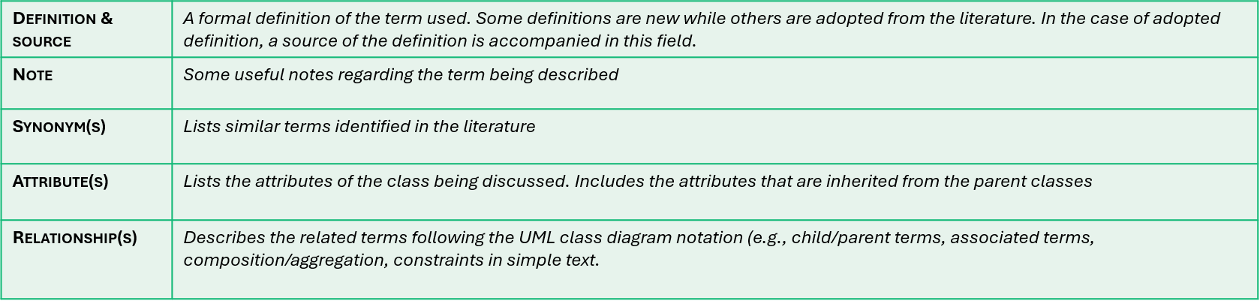
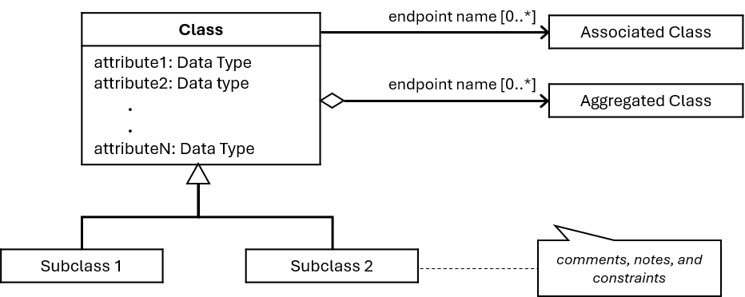
How to read the terminology
Each term is described using:
  A table that defines and provides additional information about the term.
  A relevant subset of the metamodel, represented as a UML class diagram.
The table provides the following information:
  Definition, source, notes, and synonyms from the literature.
  Attributes of the class, including attributes inherited from parent classes.
  Relationships to other terms using UML class diagram notation, such as child/parent terms, associated terms, composition/aggregation, and constraints described in simple text.

Slide 12
Terminology
Customer journey
Planned journey
Actual journey
Touchpoint
Planned touchpoint
Actual touchpoint
Planned communication point
Actual communication point
Planned action
Actual action
Initiator
Receiver
Channel
Message
Back-end system
Object
End-user experience
Journey phase
Journey operator
Concurrency
Decision
Actor
Service provider
End-user
External

Slide 13
Customer Journey
Definition & source | A sequence or constellation of touchpoints involved for a customer to achieve a specific goal or a desired outcome in the context of a service process
Note | The term is generally used to examine a service system from the customer’s perspective; "a walk in the customer’s shoes" (Holmlid & Evensson, 2008). As the journey concept has been taken up in non-commercial service contexts, practitioners and academics have expanded the role of the end-user to users, consumers, patients, and citizens.
Synonym(s) | customer path, service encounter, service process
Attribute(s) | journeyID – the system identifier of a particular journey journeyTitle – a short journey title journeyShortSummary – a short summary of what the journey is about journeyLongSummary – a long summary of what the journey is about comment - comments that can be stated for a specific journey
Relationship(s) | Involves at least one end-user, and one service provider. It can have multiple expected actors (end users and service providers) and external actors as well. It can have journey phases and journey operators if they are present. A customer journey can be either planned or actual.
End User
[1..*] endUsers
Customer Journey
journeyID: String journeyTitle: String journeyShortSummary: String journeyLongSummary: String comment: String
journeyPhases [0..*]
Journey Phase
Service Provider
[1..*] serviceProviders
journeyOperators [0..*]
Journey Operator
External
[0..*] externals
Planned Journey
Actual Journey

Slide 14
Planned Journey
Definition & source | The end-user journey as prescribed by the service provider(s) involved (deliberately or not).
Note | CJML distinguishes between the hypothetical, planned journey and the dynamic, actual journey that unfolds during the execution of a service.. Planned journeys correspond to the potential state of Shostack's model (1982)
Synonym(s) | planned customer path, customer-facing service process, planned service process, intended journey, “happy path”.
Attribute(s) | journeyID – the system identifier of a particular journey journeyTitle – a short journey title journeyShortSummary – a short summary of what the journey concerns journeyLongSummary – a long summary of what the journey is about comment - comments that can be stated for a specific journey
Relationship(s) | Contains at least 2 or more planned touchpoints
Planned Journey
journeyID: String journeyTitle: String journeyShortSummary: String journeyLongSummary: String comment: String
plannedTouchpoints [2..*]
Planned Touchpoint

Slide 15
Actual Journey
Definition & source | The real journey as experienced by an end-user
Note | Actual journeys correspond to the kinetic state of Shostack's model (1982)
Synonym(s) | Actual service encounter, actual service process, actual customer path
Attribute(s) | journeyID – the system identifier of a particular journey journeyTitle – a short journey title journeyShortSummary – a short summary of what the journey is about (OPTIONAL) journeyLongSummary – a long summary of what the journey is about (OPTIONAL) journeyStatus – current status of the journey, whether it is in-progress, completed, or aborted with respect to the planned journey contentCompliance – returns TRUE if all the actual touchpoints correspond with the planned touchpoints sequenceCompliance – returns TRUE if the sequence of actual touchpoints correspond with the sequence of the planned touchpoints timingCompliance – returns TRUE if all the start times of each actual touchpoints falls within the "allowed" times declared in the planned touchpoints comment - comments that can be stated for a specific journey
Relationship(s) | Contains (at least) 2 or more actual touchpoints, a journey-level experience, and is associated to a planned journey for its compliance
Actual Journey
journeyID: String journeyTitle: String journeyShortSummary: String journeyLongSummary: String journeyStatus: status plannedReference: String contentCompliance: Boolean sequenceCompliance: Boolean timingCompliance: Boolean comment: String
actualTouchpoints [2..*]
Planned Journey
journeyCompliance [0..1]
Actual Touchpoint
journeyExperience [0..1]
End User Experience
<<Enumeration>> status
inProgress completed aborted

Slide 16
Touchpoint
Definition & source | A step in a customer journey
Note | Touchpoints are the main components of CJML and can be seen as the “atoms” of CJML.
Synonym(s) | Contact point, episode, incident, service encounter, interaction point, moment of truth, service touchpoint, service contact
Attribute(s) | touchpointID – an alphanumeric ID specific to touchpoints; starts at T₁ to T_{n} where n is the total number of touchpoints in a single journey uncertainty – a touchpoint feature that captures uncertainty; can have multiple values of uncertainty (up to 4, the number of possible values) comment - comments that can be stated for a specific journey touchpointCategory – a classification label that defines the nature of a touchpoint (see next slide)
Relationship(s) | A Touchpoint can be associated to Objects, Systems, and may belong to a specific Journey Phase.
Touchpoint
touchpointID: String uncertainty: uncertaintyValues [0..4] comment: String touchpointCategory: classification
objects [0..*]
<<Enumeration>> classification
coreEncounter supportiveEncounter confirmation statusUpdate notification reminder Inquiry Instruction authenticationAndAuthorization payment other
belongsTo [0..1]
Object
Journey Phase
systems [0..*]
Backend System
<<Enumeration>> uncertaintyValues
uncertainOccurrence uncertainNoOfOccurrence uncertainChannel uncertainInitiator
Planned Touchpoint
Actual Touchpoint

Slide 17
Touchpoint category
Category | Hint | Definition
Core encounter | The main thing, value-creating step | The primary service interaction where value is created. Can occur repeatedly (patient journey) or as a single stage in a journey (online shopping).
Supportive encounter & handover | Supporting activity or transfer of responsibility | Action carried out as part of delivering or enabling the core service. Can also be a task or responsibility handed over from one service providing actor to another (who in turn contacts the end user).
Confirmation | Something is confirmed | Verification that an action, booking, or message has been received or accepted.
Status update | Something has changed in an ongoing process | Information about a change in state in an ongoing process. Process progression after confirmation.
Notification | Something is available (elsewhere) | A message indicating that new information is available elsewhere. Points to information without including its content.
Reminder | Don't forget | A prompt to remember something already agreed. Contains no new information.
Inquiry | A question is asked | An interaction initiated to clarify uncertainty or request information. Someone asks because they lack understanding. No new process state is asserted.
Instruction | 'You must' or 'you should' | An interaction in which one actor directs another actor to perform a specific action in order to proceed in the service or comply with requirements.
Authentication & authorization | Prove who you are | Digital or physical verification of identity or presence (e.g. BankID login, check-in).
Payment or financial interaction | You pay or are charged | Exchange of information or action related to cost, coverage, or refund.
Other | Does not fit the above | Interactions that do not match the defined categories or are difficult to classify.

Slide 18
Planned Touchpoint
Definition & source | A step in a planned journey
Note | Although the planned times are in float format in the metamodel, the default xsd:duration format is used in the XML data format
Synonym(s) | Contact point, episode, incident, service encounter, interaction point, moment of truth, service touchpoint, service contact
Attribute(s) | touchpointID – an alphanumeric ID specific to touchpoints; starts at T₁ to T_{n} where n is the total number of touchpoints in a single journey uncertainty – a feature used to represent uncertainty about the uncertainty of occurrence, channel, and initiator; can have multiple values of uncertainty (up to 4, the number of possible values) comment – comments that can be stated for a specific journey deltaTime – inter- touchpoint planned starting time (millisecond) touchpointDuration – planned duration for each planned touchpoint (millisecond) touchpointCategory – a classification label that defines the nature of a touchpoint
Relationship(s) | A Planned Touchpoint can be a Planned Action or a Planned Communication Point. A Touchpoint can be associated to Objects, Systems, and may belong to a specific Journey Phase.
<<Enumeration>> uncertaintyValues
uncertainOccurrence uncertainNoOfOccurrence uncertainChannel uncertainInitiator
Planned Touchpoint
touchpointID: String deltaTime: Float touchpointDuration: Float uncertainty: uncertaintyValues [0..4] comment: String touchpointCategory: classification
Planned Action
Planned Communication Point

Slide 19


Planned Touchpoint – example of planned times
Delta Time
inter- touchpoint start time
0
20Minutes
10Minutes
2Hours
2Days
T1
T2
T3
T4
T5
Orders a book online
Pays through debit card
Receives order confirmation
Receives delivery confirmation
Receives delivery in the mailbox
5Minutes
5Minutes
5Minutes
1Hour
5Minutes
Touchpoint Duration
Planned duration for each touchpoint

Slide 20
Actual Touchpoint
Definition & source | A step in an actual journey
Note | The separation of actual and planned touchpoint was introduced in CJML v2.0
Synonym(s) | Contact point, episode, incident, service encounter, interaction point, moment of truth, service touchpoint, service contact
Attribute(s) | touchpointID – an alphanumeric ID specific to touchpoints; starts at T₁ to T_{n} where n is the total number of touchpoints in a single journey uncertainty – a feature used to represent uncertainty about the uncertainty of occurrence, channel, and initiator; can have multiple values of uncertainty (up to 4, the number of possible values) comment – comments that can be stated for a specific journey timeStarted – a timestamp value that indicates the time the touchpoint has started timeCompleted – a timestamp value that indicates the time the touchpoint has completed compliance – checks whether a real-world touchpoint follows the planned touchpoint, is missing, or is failing. An ad hoc touchpoint is an unintended touchpoint that is not present in a planned journey
Relationship(s) | An Actual Touchpoint can be an Actual Action or an Actual communication Point and may contain an End User Experience. A Touchpoint can be associated to Objects, Systems, and may belong to a specific Journey Phase.
Actual Touchpoint
touchpointID: String timeStarted: Datetime timeCompleted: Datetime compliance: complianceValues uncertainty: uncertaintyValues [0..4] comment: String touchpointCategory: classification
<<Enumeration>> complianceValues
planned missing failing adhoc
<<Enumeration>> uncertaintyValues
uncertainOccurrence uncertainNoOfOccurrence uncertainChannel uncertainInitiator
touchpointExperience [0..1]
End User Experience
Actual Action
Actual Communication Point

Slide 21
Planned Communication Point
Definition & source | A planned communication or interaction between two actors
Note | The difference between action and communication points is the presence of a communication medium and message for the communication point. Though the planned times are in float format in the metamodel, the default xsd:duration format is used in the XML data format.
Synonym(s) | Contact point, episode, incident, service encounter, interaction point, moment of truth, service touchpoint, service contact
Attribute(s) | touchpointID – an alphanumeric ID specific to touchpoints; starts at T₁ to T_{n} where n is the total number of touchpoints in a single journey uncertainty – a feature used to represent uncertainty about the uncertainty of occurrence, channel, and initiator; can have multiple values of uncertainty (up to 4, the number of possible values) comment – comments that can be stated for a specific journey deltaTime – inter- touchpoint planned starting time (default: milliseconds - flexible) touchpointDuration – planned duration for each planned touchpoint (default: milliseconds - flexible) touchpointCategory – a classification label that defines the nature of a touchpoint
Relationship(s) | A Planned Communication Point is composed of exactly one Initiator, one Receiver, one Channel, and may have a Message. A Touchpoint can be associated to Objects, Systems, and may belong to a specific Journey Phase.
<<Enumeration>> uncertaintyValues
uncertainOccurrence uncertainNoOfOccurrence uncertainChannel uncertainInitiator
<<Enumeration>> classification
coreEncounter supportiveEncounter confirmation statusUpdate notification reminder Inquiry Instruction authenticationAndAuthorization payment other
Planned Communication Point
touchpointID: String deltaTime: Float touchpointDuration: Float comment: String touchpointCategory: classification
initiator [1..1]
Initiator
receiver [1..1]
Receiver
channel [1..1]
Channel
message [1..1]
Message

Slide 22
Actual Communication Point (1/2)
Definition & source | An instance of communication or interaction between two actors
Note | The differences between action and communication points is the presence of a communication medium for the communication point. The difference between actual and planned communication points are their times and compliance. When asynchronous channels are used, timeStarted and timeCompleted are used. In case of using asynchronous channels, timeOriginated, timeAvailable, and timeConsumed are used.
Synonym(s) | Contact point, episode, incident, service encounter, interaction point, moment of truth, service touchpoint, service contact
Attribute(s) | touchpointID – an alphanumeric ID specific to touchpoints; starts at T₁ to T_{n} where n is the total number of touchpoints in a single journey uncertainty – a feature used to represent uncertainty about the uncertainty of occurrence, channel, and initiator; can have multiple values of uncertainty (up to 4, the number of possible values) comment – comments that can be stated for a specific journey timeStarted – a timestamp value that indicates the time the touchpoint has started (for synchronous channels e.g., telephone) timeCompleted – a timestamp value that indicates the time the touchpoint has completed (for synchronous channels e.g., telephone) compliance – checks whether a real-world touchpoint follows the planned touchpoint, is missing, or is failing. An ad hoc touchpoint is an unintended touchpoint that is not present in a planned journey timeOriginated – a timestamp value that indicates the time when an asynchronous communication has been started by the initiator (e.g., email sent) timeAvailable – a timestamp value that indicates the time when an asynchronous communication became available to the receiver (e.g., email received) timeConsumed – a timestamp value that indicates the time when an asynchronous communication has been consumed by the receiver (e.g., email read) touchpointCategory – a classification label that defines the nature of a touchpoint
Relationship(s) | A Planned Communication Point is composed of exactly one Initiator, one Receiver, one Channel, and may have a Message. A Touchpoint can be associated to Objects, Systems, and may belong to a specific Journey Phase.
See next slide for class diagram

Slide 23
Actual Communication Point (2/2)
Actual Communication Point
touchpointID: String timeStarted: Datetime timeCompleted: Datetime timeOriginated: Datetime timeAvailable: Datetime timeConsumed: Datetime compliance: complianceValues uncertainty: uncertaintyValues [0..4] comment: String
initiator [1..1]
Initiator
<<Enumeration>> uncertaintyValues
uncertainOccurrence uncertainNoOfOccurrence uncertainChannel uncertainInitiator
<<Enumeration>> complianceValues
planned missing failing adhoc
<<Enumeration>> classification
coreEncounter supportiveEncounter confirmation statusUpdate notification reminder Inquiry Instruction authenticationAndAuthorization payment other
receiver [1..1]
Receiver
channel [1..1]
Channel
message [0..1]
Message

Slide 24
Planned Action
Definition & source | A planned activity conducted by an actor as part of a customer journey (that does not contain communication).
Note | An action do not involve direct communication, in contrast to a communication point. Example to distinguish communication points and actions: Action: signing a contract with a pen and scanning the contract Communication point: sending the contract through e-mail Though the planned times are in float format in the metamodel, the default xsd:duration format is used in the XML data format.
Synonym(s) | Event, process step, activity
Attribute(s) | touchpointID – an alphanumeric ID specific to touchpoints; starts at T₁ to T_{n} where n is the total number of touchpoints in a single journey uncertainty – a feature used to represent uncertainty about the uncertainty of occurrence, channel, and initiator; can have multiple values of uncertainty (up to 4, the number of possible values) comment – comments that can be stated for a specific journey deltaTime – inter- touchpoint planned starting time (millisecond) touchpointDuration – planned duration for each planned touchpoint (millisecond)
Relationship(s) | An action is only composed of an Initiator. A Touchpoint can be associated to Objects, Systems, and may belong to a specific Journey Phase.
<<Enumeration>> uncertaintyValues
uncertainOccurrence uncertainNoOfOccurrence uncertainChannel uncertainInitiator
Planned Action
touchpointID: String deltaStartTime: Float touchpointDuration: Float uncertainty: uncertaintyValues comment: String touchpointCategory: classification
initiator [1..1]
Initiator

Slide 25
Actual Action (1/2)
Definition & source | An activity conducted by the customer or the service provider as part of a customer journey (that does not contain communication).
Note | An action does not involve direct communication, in contrast to a communication point. Example to distinguish communication points and actions: Action: signing a contract with a pen and scanning the contract Communication point: sending the contract through e-mail
Synonym(s) | Event, process step, activity
Attribute(s) | touchpointID – an alphanumeric ID specific to touchpoints; starts at T₁ to T_{n} where n is the total number of touchpoints in a single journey uncertainty – a feature used to represent uncertainty about the uncertainty of occurrence, channel, and initiator; can have multiple values of uncertainty (up to 4, the number of possible values) comment – comments that can be stated for a specific journey timeStarted – a timestamp value that indicates the time the touchpoint has started timeCompleted – a timestamp value that indicates the time the touchpoint has completed compliance – checks whether a real-world touchpoint follows the planned touchpoint, is missing, or is failing. An ad hoc touchpoint is an unintended touchpoint that is not present in a planned journey
Relationship(s) | An action is only composed of an Initiator. A Touchpoint can be associated to Objects, Systems, and may belong to a specific Journey Phase.
See next slide for class diagram

Slide 26
Actual Action (2/2)
Actual Action
touchpointID: String timeStarted: Datetime timeCompleted: Datetime compliance: complianceValues uncertainty: uncertaintyValues [0..4] comment: String touchpointCategory: classification
<<Enumeration>> uncertaintyValues
uncertainOccurrence uncertainNoOfOccurrence uncertainChannel uncertainInitiator
initiator [1..1]
Initiator

Slide 27
Initiator
Definition & source | Any person or entity that initiates an action or communication point and is involved in the service delivery or service consumption
Note | Both types of touchpoints has an initiator. In the case of an actions, there is only an initiator (no receiver)
Synonym(s) | Sender
Attribute(s) | InitiatorLabel – a short description of the event describing the initiator's point of view (e.g., if Bob is the Initiator of the call, the description would be "Bob calls Alice")
Relationship(s) | An Initiator refers to an Actor involved in a journey
Initiator
initiatorLabel: String
refersTo [1..1]
Actor

Slide 28
Receiver
Definition & source | Any person or entity that receives a communication and is involved in the service delivery or service consumption
Note | Receiver exist only the communication point and the receiver of the communication initiated by the initiator
Synonym(s)
Attribute(s) | ReceiverLabel – a short description of the event describing the receiver's point of view (e.g., if Bob is the Initiator of the call, the description would be "Alice received a call from Bob")
Relationship(s) | A Receiver refers to an Actor involved in a journey
Receiver
receiverLabel: String
refersTo [1..1]
Actor

Slide 29
Channel
Definition & source | A service provider's means of communicating or interacting with its customers (Osterwalder, 2004)
Note | The list of predefined channels corresponds to symbols in the CJML visual notation
Synonym(s) | Distribution channel, customer channel, service interface
Attribute(s) | channelName — the medium of communication used by communication points comType — the mode of communication; it can be "unicast" where there is only one receiver, "broadcast" where everybody can be a receiver, or "multicast" where there is only a specific group of receivers isSynchronous — A Boolean format that is true if the channel is used synchronously (e.g., telephone)
Relationship(s)
Channel
channelName: channels comType: comTypes isSynchronous: Boolean
<<Enumeration>> comTypes
unicast multicast broadcast
<<Enumeration>> channels
telephone sms email socialMediaMessage messageService chat faceToFace internetViaPC internetViaSmartPhone internetViaTablet appOnPC appOnSmartPhone appOnTablet internet selfServiceMachine letter ……
<<Enumeration>> channels (cont'n)
……. (continuation) packageDelivery faxMessage shopCounter serviceDesk paymentChannel unknownChannel
29

Slide 30
Message
Definition & source | The accompanying information or message relayed in a communication or interaction
Note
Synonym(s)
Attribute(s) | messageContent — the message content of the communication (e.g., the content of the email or the text message of the SMS) keyMessageContent — the shortened essential content of the communication given by the data provider (usually the CJML user) derivedMessageContent — when the KeyMessageContent is not present, it can be estimated or derived from the raw data
Relationship(s)
Message
messageContent: String keyMessageContent: String derivedMessageContent: String

Slide 31
Backend System
Definition & source | The backend system that processes the touchpoint or parts of it.
Note | Several systems can be associated with a touchpoint. For instance, a different system might have been the source of information for delivering a letter with a SIM card until it reaches the customer's mailbox while the main provider's system might be the source for the actual consumption: Delivery system = involves both the timeOriginated and timeAvailable fields Telecom system = involves the timeConsumed when the customer opened/activated the SIM card
Synonym(s) | IT system
Attribute(s) | systemID – the system identifier of a particular backend system systemName – the name of the backend system/software systemDescription – a short description of the backend system
Relationship(s) | Every Touchpoint can be associated with one or more Backend Systems
systems [0..*]
Backend System
systemID: String systemName: String systemDescription: String
Touchpoint

Slide 32
Object
Definition & source | A physical or virtual item that is made available to the customer as part of a journey.
Note | An object belongs to a service actor in relation to the journey. Examples include a receipt or an attachment to an email.
Synonym(s) | item
Attribute(s) | objectID – the system identifier of a particular object objectName – the object's name objectDescription – the object's short description isVirtual – if true, the object is a virtual object and not a physical object
Relationship(s) | Every Touchpoint can be associated with one or more Objects
Object
objectID: String objectName: String objectDescription: String isVirtual: Boolean
objects [0..*]
Touchpoint

Slide 33
End User Experience
Definition & source | End-user’s perceptions and responses that result from the use and/or anticipated use of a system, product, or service (ISO 2019, Law et al., 2009).
Note | End-user experience is associated with actual journeys only and is based on a user’s self-reported input.
Synonym(s) | User experience, customer experience, human experience, service experience.
Attribute(s) | experienceDescription – a textual description of an end-user‘s experience experienceRating – a numeric description of an end user experience, larger = better experience. Currently, CJML uses the following scale: 1 = very dissatisfied, 2 = dissatisfied, 3 = neutral, 4 = satisfied, 5 = very satisfied.
Relationship(s) | The end-user experience should be addressed for each touchpoint. A journey-level experience encompasses the experience for the whole journey.
Actual Journey
journeyExperience [0..1]
EndUserExperience
experienceDescription: String experienceRating: Integer
experienceRating in [1,5]
larger == better experience
Actual Touchpoint
touchpointExperience [0..1]

Slide 34
Journey Phase
Definition & source | Every journey can be divided into multiple phases. The journey phases can be based on touchpoints that occur in groups, at a certain place, or in a certain channel
Note | It is not required to have journey phases, and each touchpoint does not have to that each touchpoint must belong to a journey phase
Synonym(s) | Stages
Attribute(s) | phaseName: the name of a specific phase phaseDescription: a short description/summary of a specific phase phaseID: a system identifier for a specific phase
Relationship(s) | A customer journey may contain multiple journey phases and declares these phases at the journey-level. A touchpoint may then belong to a certain phase that has been declared
journeyPhases [0..*]
Journey Phase
phaseID: String phaseName: String phaseDescription: String
Customer Journey
belongsTo [0..1]
Touchpoint

Slide 35
Journey Operator
Definition & source | Logical operators used to split paths (choose one among several paths) or parallelize activities (performing activities simultaneously)
Note | Since the logical operators are applied in the journey concept, they also need to have the "forward-in-time" logic. This means that there is a clear visual notation when a logical operator starts to split/parallelize and when paths should be merged at the end.
Synonym(s) | Logical operator, logic gate, gateway in BPMN
Attribute(s) | operatorID – the system identifier of a particular operator operatorName – the name of a particular operator operatorDescription – a short description of the operator's function
Relationship(s) | A customer journey may contain multiple journey operators. A journey operator may belong to a declared phase. The journey operator can be a Concurrency or Decision.
journeyPhases [0..*]
Journey Operator
operatorID: String
belongsTo [0..1]
Customer Journey
Journey Phase
Concurrency
Decision

Slide 36
Concurrency
Definition & source | Touchpoints that happen in parallel (activities that occur simultaneously) may be described through Concurrency
Note | The UML fork/join notation is adopted for concurrency; the visual notation is described in the Visual Notation module
Synonym(s) | AND gate, AND operator, parallel
Attribute(s) | operatorID – the system identifier of a particular operator concurrencyPaths – number of parallel paths
Relationship(s)
Concurrency
operatorID: String concurrencyPaths: Integer

Slide 37
Decision
Definition & source | Decisions refer to points in time where a journey branches into several possible paths. They are used when there are two or more path alternatives.
Note | Decisions are only used exclusively by the planned journey groups and can't be used by planned journeys. A decision can be in control of the customer or can also be the service provider(s)' choice.
Synonym(s) | Exclusive OR gate, XOR gate, XOR operator
Attribute(s) | operatorID – the system identifier of a particular operator decisionPaths – number of decision paths to choose condition – a short description of the condition
Relationship(s) | The decision maker can be any actor, such as an end-user or a service provider
Decision
operatorID: String decisionPaths: Integer condition: String
decisionMaker [0..1]
Actor

Slide 38
Actor
Definition & source | Any person or entity involved in the service delivery or service consumption
Note | As a minimum, there should be one end-user and one service provider. There may also be more than one end-user and more than one service provider involved. Each actor is represented by a symbol in the visual notation.
Synonym(s) | Stakeholder, participant
Attribute(s) | actorID – the system identifier of a particular actor actorName – the (anonymized) name of the actor, as needed in the text description in the visual notation actorDescription – a short description of the actor isVirtual – if true, the actor is a virtual actor and not a human actor
Relationship(s) | An Actor may be a Service Provider, an End User, or an External Actor that is not directly involved in a journey
Actor
actorID: String actorName: String isVirtual: Boolean actorDescription: String
Service Provider
End User
External

Slide 39
Service Provider
Definition & source | An organization, individual, or other entity (virtual or physical) that delivers or contributes to the delivery of a service to end users. Inspired by theWikipedia definition: https://en.wikipedia.org/wiki/Service_provider
Note | A service provider may operate independently or as part of a service delivery network (Tax, 2013).
Synonym(s) | Service supplier, service owner
Attribute(s) | actorID – the system identifier of a particular actor actorName – the (anonymized) name of the actor, as needed in the text description in the visual notation actorDescription – a short description of the actor isVirtual – if true, the actor is a virtual actor and not a human actor providerName – Name of the service providing entity providerType – the type of service provider; it depends on the provider's funding type or legal entity type belongsTo – list of actors that belong to this actor, used to capture hierarchy
Relationship(s) | The service provider can be defined in a domain-specific manner - particularly in healthcare- to accurately capture the precise type of healthcare provider.
belongsTo [0..n]
belongsTo [0..n]
Service Provider
actorID: String actorName: String actorDescription: String isVirtual: Boolean providerName: String providerType: providerTypes
<<Enumeration>> providerTypes
HealthcareServiceProvider PublicServiceProvider CommercialServiceProvider PrivateServiceProvider NonProfitServiceProvider VoluntaryServiceProvider CommunityServiceProvider OtherServiceProvide
roles [0..n]
Role
roleName: String roleDescription: String
Health Care Service Provider

Slide 40
Health Care Service Provider
Definition & source | An organization, individual, or other entity (virtual or physical) that delivers or contributes to the delivery of healthcare or welfare services to patients or other service recipients
Note | A service provider may operate independently or as part of a service delivery network (Tax, 2013).
Synonym(s)
Attribute(s) | actorID – the system identifier of a particular actor actorName – the (anonymized) name of the actor, as needed in the text description in the visual notation actorDescription – a short description of the actor isVirtual – if true, the actor is a virtual actor and not a human actor providerName – Name of the service providing entity providerType – the type of service provider; it depends on the provider's funding type or legal entity type belongsTo – list of actors that belong to this actor, used to capture hierarchy HealthCareServiceProviderType - the type of health care service provider
Relationship(s)
<<Enumeration>> HealthCareServiceProviderType
Healthcare provider Clinical support service Patient’s personal network Digital health system Digital system – general Patient organization and auxiliary service Employer Welfare service and social care Health authority Health registry and quality system Other
Health Care Service Provider
actorID: String actorName: String actorDescription: String isVirtual: Boolean providerName: String providerType: providerTypes HealthCareServiceProviderType: HealthCareServiceProviderType

Slide 41
Healthcare service provider type
Actor category | Hint | Definition
Patient’s personal network | People close to the patient | The private sphere of the patient, such as family members, friends, or informal caregivers.
Healthcare provider | Delivers care | Entities delivering medical treatment and care, e.g. hospitals, general practitioners, and physiotherapists.
Clinical support service | Supports clinical care | Services that support healthcare providers, such as laboratory testing, diagnostic imaging, or pathology.
Digital health system | Health-specific digital tools | Digital tools designed to support patients and healthcare providers, e.g. patient portals and clinical systems.
Digital system – general | Generic digital infrastructure | Platforms serving the general population for public services or utilities, e.g. digital postboxes and payment solutions.
Patient organization and auxiliary service | Advice and practical support | Organizations and services offering advocacy, guidance, or practical support, e.g. patient organizations or transport services.
Employer | Workplace | The patient’s employer or workplace, relevant for sick leave, accommodations, or return to work.
Welfare service and social care | Social and welfare support | Public or private services supporting social, financial, or daily living needs, e.g. sick leave benefits or home care.
Health authority | Governs healthcare | Entities responsible for regulation, planning, and governance of healthcare at national or municipal levels.
Health registry and quality system | Collects health data | National or regional systems collecting and analyzing health-related data to support quality improvement and oversight.
Other | Anything else | Any additional actor intersecting the patient journey that does not fit the above categories.

Slide 42
End User
Definition & source | The person, group of persons, or organization receiving the outcome of a service. This definition is adopted from Edvardsson and Olsson (1996).
Note | CJML extends the traditional concept of a customer journey to the more general concept of an end-user journey.
Synonym(s) | The terms most commonly used in the literature are customer, user, patient, and consumer.
Attribute(s) | See Actor for the description of actorID, actorName, isVirtual, and actorDescription isMain – indicates whether this is the main end user; useful when there are several end users
Relationship(s) | An end user may be a customer, user, employee, patient, or citizen
End User
actorID: String actorName: String isVirtual: Boolean actorDescription: String isMain: Boolean
Customer
User
Employee
Patient
Citizen

Slide 43
External
Definition & source | Actors that are not directly involved in the service interaction but may influence the customer journey
Note | External actors may influence the customer's journey, although they are not responsible for any part of the service delivery.
Synonym(s)
Attribute(s) | actorID – the system identifier of a particular actor actorName – the name of the actor, as needed in the text description in the visual notation actorDescription – a short description of the actor isVirtual – if true, the actor is a virtual actor and not a human actor
Relationship(s)
External
actorID: String actorName: String actorDescription: String isVirtual: Boolean

Slide 44
Complete metamodel
Without attributes
With attributes - validated

Slide 45
CJML complete metamodel – without attributes
Customer Journey
journeyOperators [0..*]
Journey Phase
belongsTo [0..1]
Journey Operator
journeyPhases [0..*]
belongsTo [0..1]
endUsers [1..*]
End User
Concurrency
Decision
serviceProviders [1..*]
Service Provider
Planned Journey
Object
Backend System
Actual Journey
externals [0..*]
objects [0..*]
systems [0..*]
journeyExperience [0..1]
External
Touchpoint
End User Experience
touchpointExperience [0..1]
plannedTouchpoints [2..*]
actualTouchpoints [2..*]
Planned Touchpoint
Actual Touchpoint
Actor
refersTo [1..1]
refersTo [1..1]
Customer
User
Planned Action
Planned Communication Point
Actual Communication Point
Actual Action
message [0..1]
endUserExperienceRating in [1,5]
Employee
message [0..1]
Message
receiver [1..1]
receiver [1..1]
Patient
Receiver
Citizen
channel [1..1]
Channel
channel [1..1]
initiator [1..1]
Initiator
initiator [1..1]
initiator [1..1]
initiator [1..1]
45

Slide 46
CJML complete metamodel – validated using EMF eCore
46

Slide 47
Appendix
Cybersecurity syntax
Data privacy syntax
Future work
References

Slide 48


Cybersecurity syntax
💡
More information is provided in the CJML Visual Notation and CJML Templates modules.
Human behavior and errors are an important source of cybersecurity risk.
CJML can be extended with cybersecurity-specific concepts and notation to represent security risks.
CJML diagrams may illustrate threat scenarios, unwanted behavior, and best practices to reduce cyber risks.
A new parameter, RiskElement, represents various levels of risks:
  Threat: riskThreat
  Unwanted Incident: riskUnwantedIncident
Definitions
The definitions are from the CORAS* language for risk modelling.
Threat: a potential cause of an unwanted incident.
Unwanted incidence: An unwanted incident is an event that harms or reduces the value of an asset.
Asset: Something with an assigned value that requires protection.
Actual Touchpoint
touchpointID: String timeStarted: Datetime timeCompleted: Datetime .... riskElement: riskType
threat
unwanted incident
<<Enumeration>> riskType
riskThreat riskUnwantedIncident
*) Lund, M. S., Solhaug, B., & Stølen, K. (2011). Model-driven risk analysis: The CORAS approach. Springer.
Actual Action
Actual Communication Point

Slide 49




Data privacy syntax
💡
This is work in progress. More information is provided in the CJML Visual Notation and CJML Templates modules.
Privacy policies are known to be long and complex, making it hard for users to understand how their personal data are handled.
CJML can be extended with data privacy-specific concepts to describe how personal data are handled at individual communication points.
Additional fields specify the nature and type of personal data captured at each communication point.
New privacy parameters:
  PrivacyShared:privacyTypes[]
  PrivacyComment: string
Data privacy is addressed at a global level for the journey as a whole and locally for individual touchpoints.
Global elements describe what personal data are collected across the journey and provide an overall view of the data.
Local elements at each touchpoint includes:
🎯 Purpose
Data collected
Data processed
Data shared
Actual Touchpoint
touchpointID: String timeStarted: Datetime timeCompleted: Datetime … PrivacyShared: privacyTypes[] PrivacyComment: string
<<Enumeration>> privacyTypes
DataCollected DataProcessed DataShared
Privacy Comment
Actual Action
Actual Communication Point

Slide 50
Future work
Extending actor information
  Explore the use of additional attributes for actors, particularly end users.
  Consider existing standards and user-profile models as a basis for such extensions.
The connection between touchpoints and back-end data
  Further investigate how touchpoints can be linked to the underlying back-end systems and event data.
  Develop methods for handling this complex and non-trivial mapping.

Slide 51
References
Edvardsson, B., and J. Olsson (1996). Key concepts for new service development. Service Industries Journal 16(2), 140-164.
Holmlid, S. and Evenson, S. (2008). Bringing Service Design to Service Sciences, Management and Engineering. In Service Science, Management and Engineering Education for the 21st Century: Springer, 341-5.
ISO (2019): Ergonomics of Human-system Interaction: Part 210: Human-centred Design for Interactive Systems. International Organization for Standardization, Switzerland (2019)
Koivisto, M. (2009). Frameworks for structuring services and customer experiences. In S. Miettinen & M. Koivisto (Eds.), Designing Services with Innovative Methods (pp. 136-149). Helsinki: University of Art and Design, Helsinki.
Law, E. et al. (2009). Understanding, scoping and defining user experience: a survey approach. Proceedings of 27th SIGCHI conference on Human factors in computing systems (pp. 719-728).
Mellor, S.J. (2004). MDA distilled: principles of model-driven architecture. Addison-Wesley Professional.
Osterwalder, A. (2004). The business model ontology: A proposition in a design science approach. PhD thesis. University of Lausanne, Ecole des Hautes Etudes Commerciales, Switzerland.
Shostack, G. L. (1982). How to design a service. European Journal of Marketing, 16(1), 49-63.
Stickdorn, M., and J. Schneider (2011). This is service design thinking. Amsterdam, BIS Publishers.
Tax, S. S., McCutcheon, D., & Wilkinson, I. F. (2013). The service delivery network (SDN) a customer-centric perspective of the customer journey. Journal of service research, 16(4), 454-470.

